Slide 1

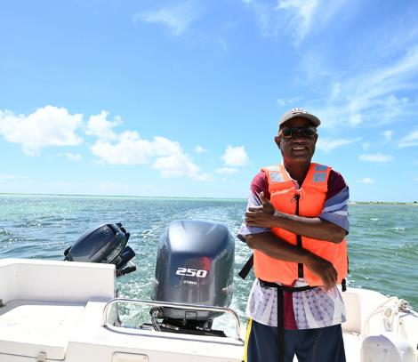


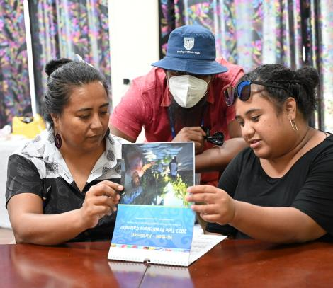

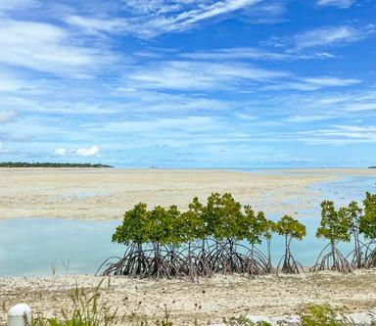
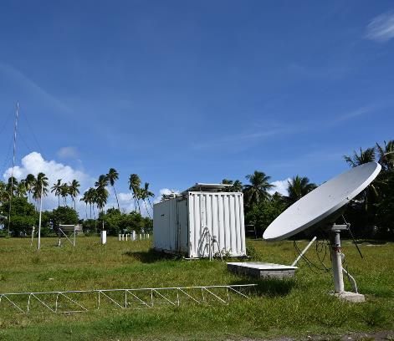
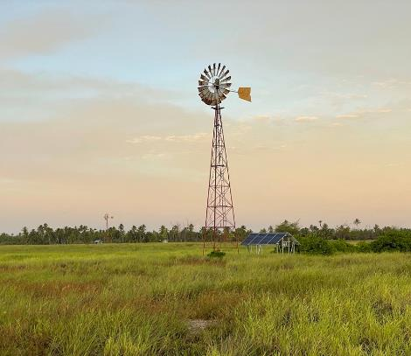




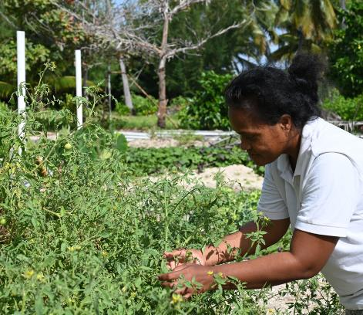
PACIFIC ISLANDS
CLIMATE OUTLOOK
FORUM - 13
23 - 27 OCTOBER, 2023
NADI, FIJI

Slide 2
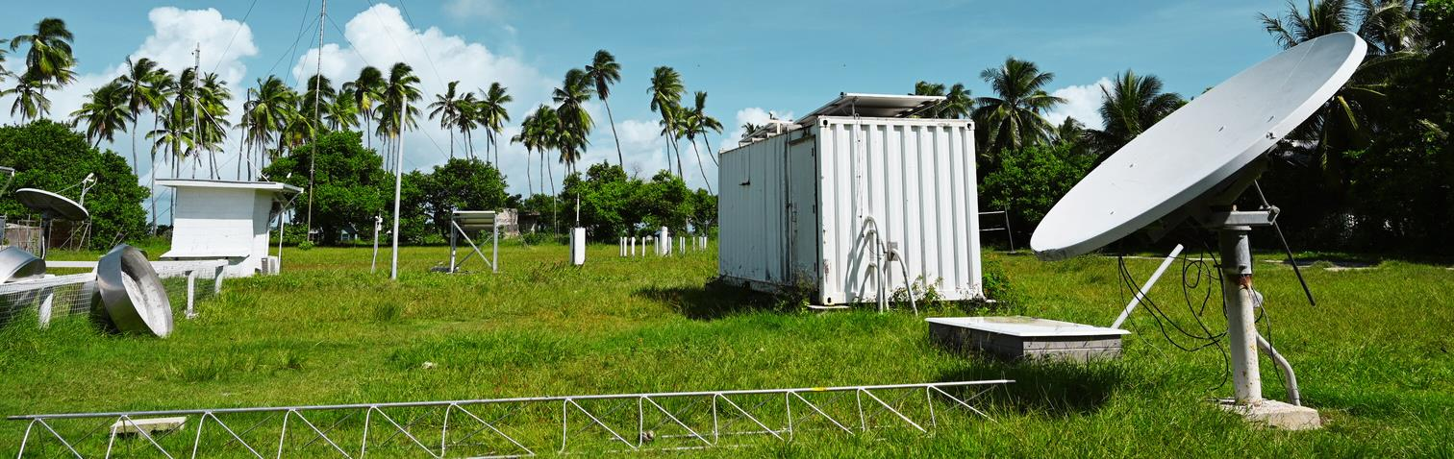
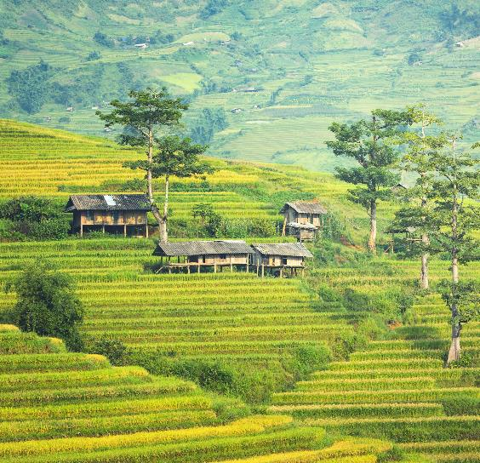










Climate change impacts on the Agriculture and Forestry Sectors
An overview and opportunities for collaboration
Gibson Susumu - Programme Leader, Sustainable Agriculture
Dr Stephanie Ramona O’ Conner, Research for Development Adviser

Slide 3
Presentation outline
Background of the Pacific Community.
Overview of the Land Resources Division.
Challenges in the agriculture and forestry sectors.
Impacts of climate change on the agriculture and forestry sectors – a case study.
Opportunities for collaboration.
Summary

Slide 4
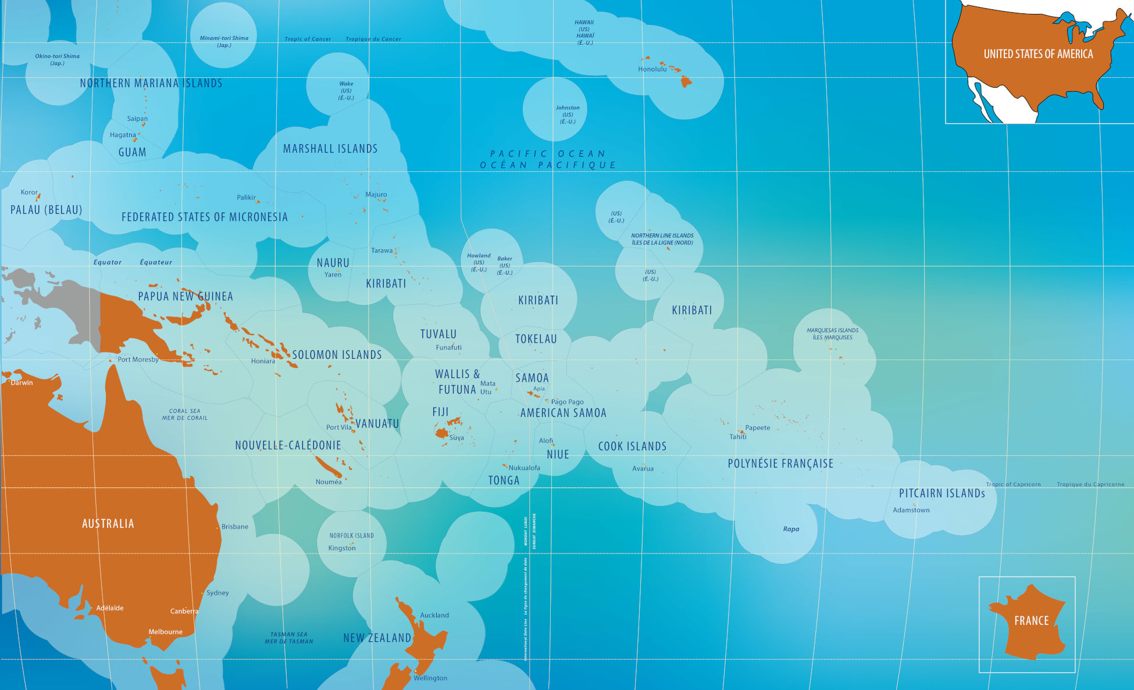






















Background of the Pacific Community
Serving our Blue Pacific Region
Notes:
Founded in Australia in 1947 – Canberra agreement (Aus, FR, Neth, UK, NZ, US)
SPC membership spans the Blue Pacific continent, 22 PICTs and 5 metropolitan members
Initial focus was on stability, evolved into all socio-economic sectors
Principal scientific and technical organisation in the Pacific region with capabilities in over 27 sectors

Slide 5
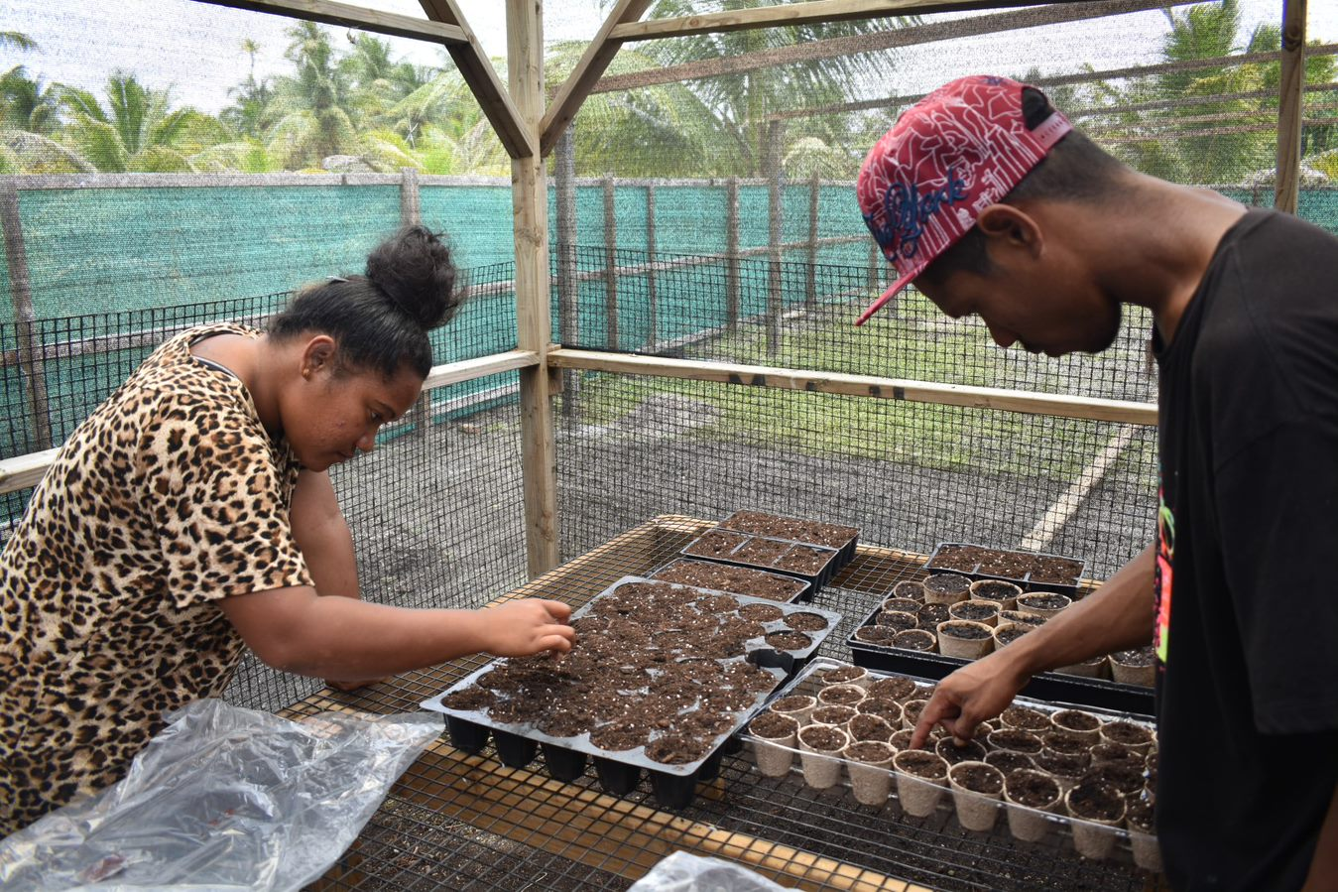
Regional Centres of Excellence
Background of the Pacific Community
SPC is custodian of centres delivering regional public goods
Centre for Pacific Crops and Trees (CePaCT).
Pacific Community Centre for Ocean Science (PCCOS).
Pacific Centre for Renewable Energy and Energy Efficiency (PCREE).
Maritime Technology Cooperation Centre.
Nationally Determined Contribution (NDC) Hub.
Pacific Data Hub.
Digital Earth Pacific.
Plant Health Laboratory.
Notes:
The Pacific Community hosts several regional centres focussed on oceans, data/knowledge, genetic resources and energy. These centres provide support to Pacific Island countries and territories towards progressing their respective priorities and commitments for achieving sustainable development goals.

Slide 6
Overview of the Land Resources Division
Resilient Communities
Food and
Nutritional Security
French Overseas Terr
Fiji Hub – Narere
Melanesia Hub
Micronesia Hub
Pillar 1
Pillar 2
Pillar 3
Pillar 4
Pacific Seeds for Life
Genetic Resources
Conservation of GR
Development of GR including resilient and nutritious varieties
Promotion and utilization of diverse resilient and nutritional crop varieties
Sustainable Forests & Landscapes
Forests and Trees
Participatory and community-based land use plans
Agroforestry systems
DRR, adaptation and mitigation strategies
Sustainable Agriculture
Sustainable crop production systems (Soil, Water, Seeds, agronomy)
Pests and diseases management
Animal Health and Production
Extension systems
Markets for Livelihood
Biosecurity
Value chains analyses for specific commodities or market niches
Capacity building on post-harvest handling, small scale processing and marketing
Market access pathways
Healthy Ecosystems for Resilient Communities
Excellence in Atoll Agriculture
Food Systems for Health and Nutrition
Sanitation / Phyto-Sanitation standards and Biosecurity
Finance and Administration; Information, Communication and Knowledge Management; Research for Development, Planning Monitoring, Evaluation & Learning;
Notes:
Pillar 1: conservation, propagation, genetic diversity, developing and evaluating climate smart varieties),
Pillar 2: sustainable forests and landscapes (reforestation, soil profiling, mapping, crop suitability, climate change adaptation & mitigation, land use policy etc),
Pillar 3: sustainable agriculture (crop production, plant health, soil health, livestock husbandry etc)
Pillar 4: markets for livelihoods (biosecurity, high value crops production and transformation etc)
Integrated programmes to support effective and efficient approach in responding to members needs

Slide 7
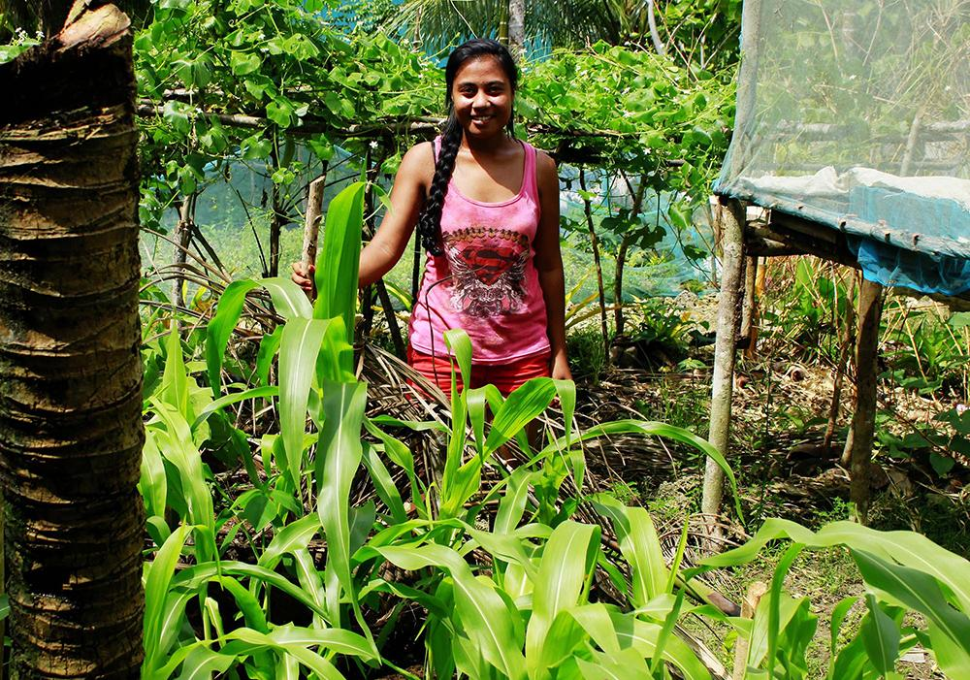
SPC Flagships
Background of the Pacific Community
Climate Change Flagship
Food Systems Flagship
Ocean Flagship
Gender Equality Flagship
Notes:
The Pacific Community also has their flagship programmes which focus on Climate Change, Food Systems, Oceans and Gender Equality.
Food Systems Flagship focuses on addressing key areas with our food insecurities in the Pacific through work related in the area of
Science for nutritious and resilient food production
Healthy and equitable food environments
Critical public goods for Pacific Food Systems
Innovation in coastal and atoll food systems
Future food capacities
Harnessing digital technologies

Slide 8
Challenges in the agriculture and forestry sectors
Declining food production per capita
High dependency on imported food items
Reduced number of farmers
Increasing NCD rates
Increasing population growth
Limited land area
Loss of forest cover
Soil health
Increased incidence of pests and diseases
Land degradation
Climate Change
Food and nutrition insecurity
Notes:
There are many factors contributing to the continued food and nutrition insecurities experienced by our communities. This is not a comprehensive list but it outlines some of the challenges that continue to persist and challenge our efforts to support our member countries and communities in their efforts to ensure food and nutrition security.
Limited arable lands leading to vulnerability of farmlands to extreme weather events such as landslides----flooding, etc
Forests remain an important sector not only to maintain ecosystems services but as well as livelihoods and food and nutrition security of communities
Soil health is vital for climate carbon sequestration and plant health. Studies have shown significant downward spiral of soil health across the region
Surveillance in at least 5 countries have shown significant recurrence of pests and disease problems in the region
Declining food production per capita due to aging of farmers and outward migration
High dependency of imports, studies by SPC has shown from 35% to 92% of HHs diets are imported. Most alarming is that these are rural HHs. Urban HHs would range from 80 to 100% in some PICTs
NCDs due to reliance eon poor nutritious foods
Increasing population with average agriculture annual growth rate declined since 1990;
Land degradation due to a combinations of these challenges
All these challenges are contributing to the increased vulnerability of the agriculture and forestry sectors

Slide 9
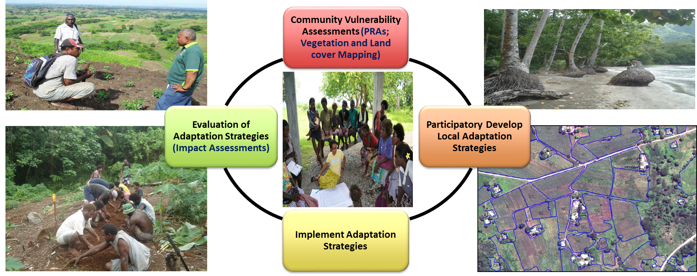
Impacts of climate change on our people – A case study
Notes:
With the range of challenges confronting the Ag and Forestry sectors, LRD has developed a comprehensive approach to working with communities to better understand the impacts of climate change so that better support can be provided to build their resilience.
Our approach to building community resilience involves the following
SPC has developed a comprehensive community based participatory vulnerability and food security assessment to determine factors contributing to the vulnerabilities so adaptation responses can be devised around
From the vulnerability assessment, SPC then works with governments and communities to develop adaptation strategies for communities
Implementation is jointly with government, partners and communities
Evaluation of interventions to support scale up and out of lessons

Slide 10
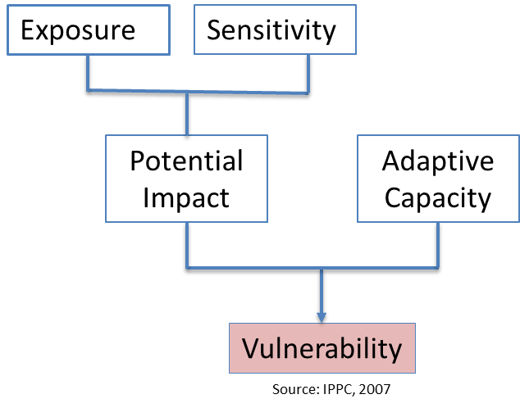
Determinants of Vulnerability
Building resilience starts with reducing vulnerabilities
Vulnerability is a function of character, magnitude and rate of climate variation to which a system is exposed, its sensitivity, and its adaptive capacity (IPCC, 2007).
Exposure is the nature and degree to which a system is exposed to significant climatic variations. Climate variation includes average climate change and extreme climate variability (IPCC, 2007).
Sensitivity is the degree to which climate-related factors affect a system, either adversely or beneficially (IPCC, 2007).
Adaptive capacity is defined as the ability of a system (the community) to adjust to climate change (including climate variability and extremes), to mitigate potential damages, to take advantage of opportunities, or to cope with the consequences (IPCC, 2007).
Notes:
The community vulnerability assessment aims at establishing understanding the factors contributing to the vulnerability of communities and their farming systems in a holistic approach. To determine vulnerabilities, the IPPC (2007) defines Vulnerability as …..
To determine vulnerabilities, we assess the exposure of communities to CC and extreme calamities, their impacts (sensitivities) and the communities adaptive capacity

Slide 11
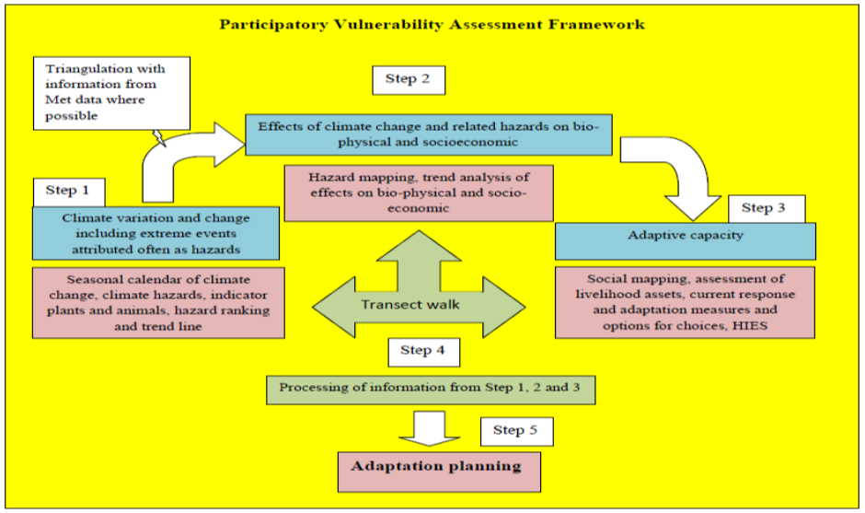
SPC Vulnerability Assessment Framework
Using each of the PRA tools, E, S and A were assessed at LOW (1), MEDIUM (2), HIGH (3) and VERY HIGH (4) scales through assessment of their elements based on community perceptions.
Community perceptions were recorded and collated to determine the E Index, S Index and A Index
V = E X S/A
Elements of E, S, & A
Exposure (local climate change and variability) | Sensitivity (effects of changes at local level) | Adaptive Capacity (livelihood assets)
Temperature Precipitation Plants/Animal behaviour (Proxy) Hazards | Agriculture and Food Security Forest and biodiversity Settlement and Infrastructure Water and energy Human Health | Human resources Natural assets Social assets Financial assets Physical assets
Notes:
CBVA assesses community vulnerability and its variables based on the community perception and evidences. The Variables (E, S and A) of Vulnerability and the Vulnerability (V) are categorised at 4 levels based on community perception and the numerical values are used in the equation.
- Low or 1
- Medium or 2
- High or 3 and
Very High or 4
Why PRA? - tools empower the communities to study and analyse their circumstances, identify the problems, and prepare, implement and monitor the plans.
Triangulation is based on CSIRO data as access to Met data at the regional level is a challenge

Slide 12
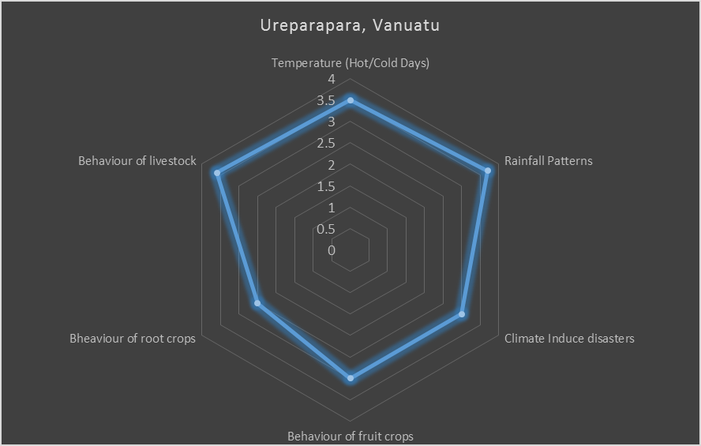
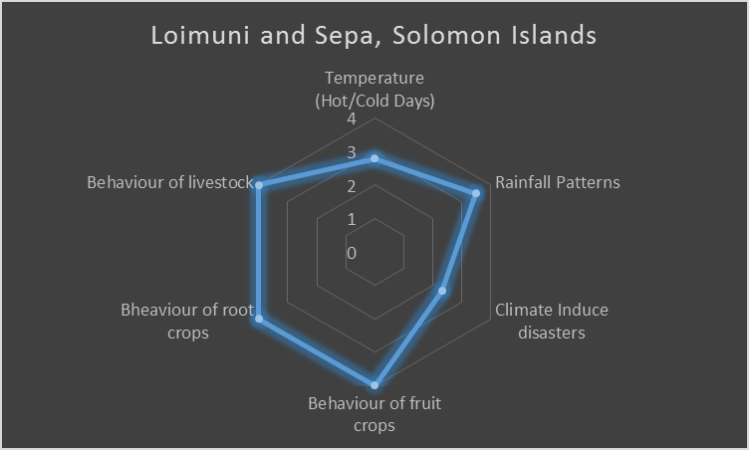
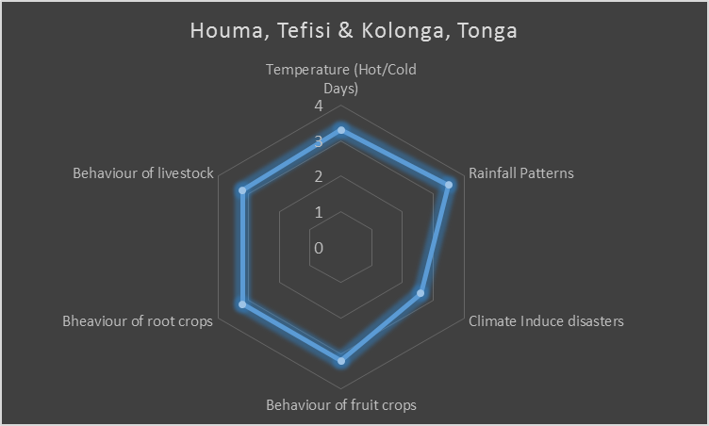
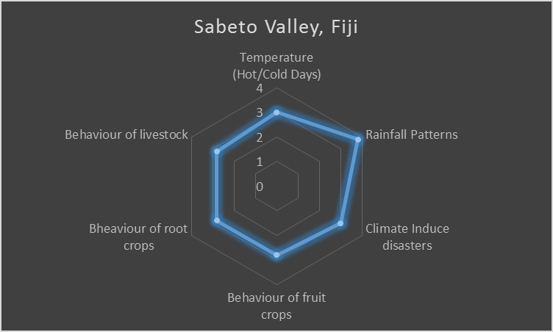
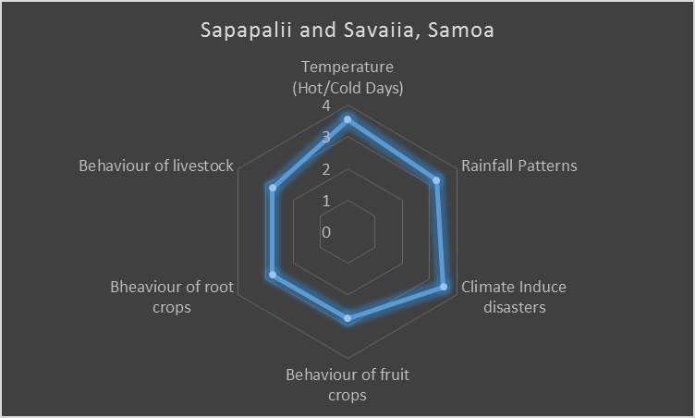
Community exposure to climate change impacts
1 – Low
2 – Medium
3 – High
4 – Very High

Slide 13
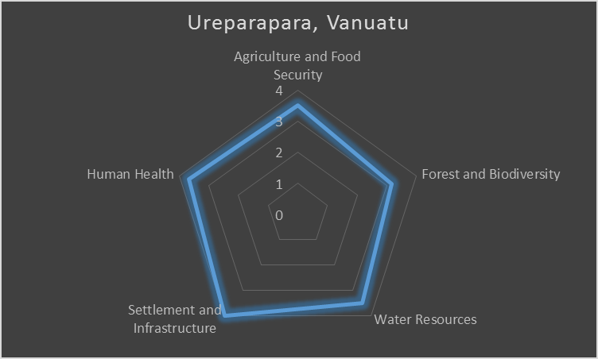
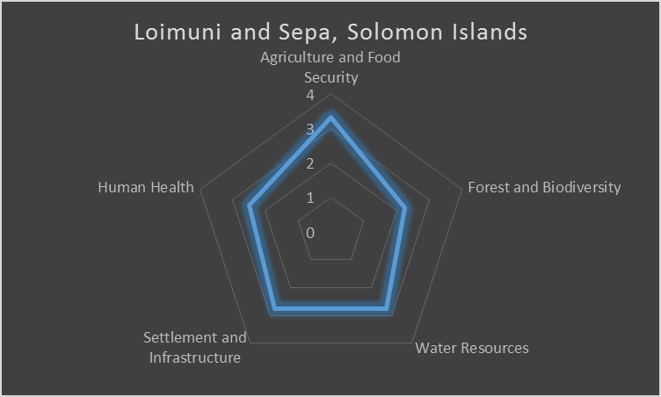
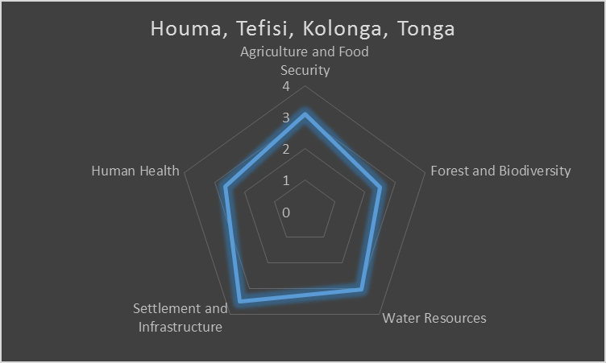
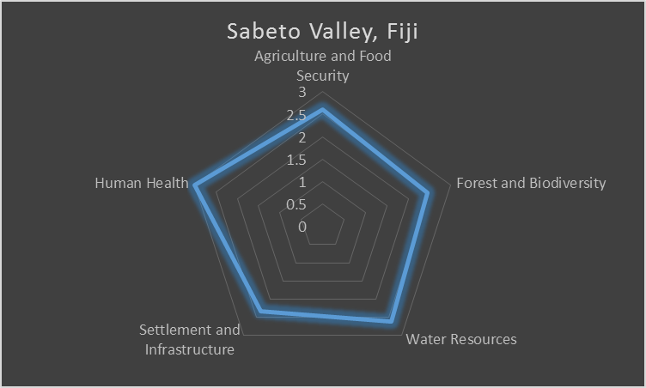
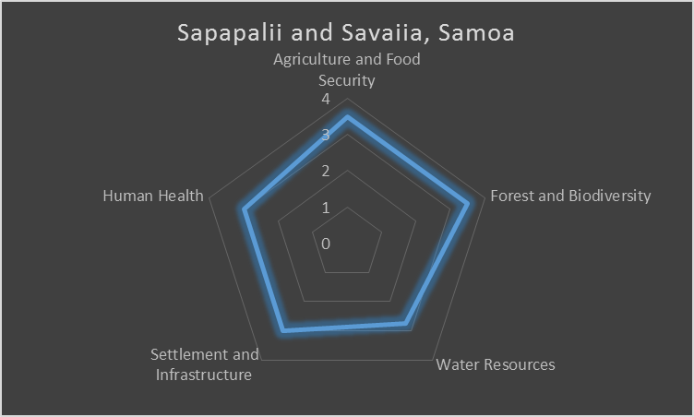
Community sensitivity to climate change impacts
1 – Low
2 – Medium
3 – High
4 – Very High

Slide 14
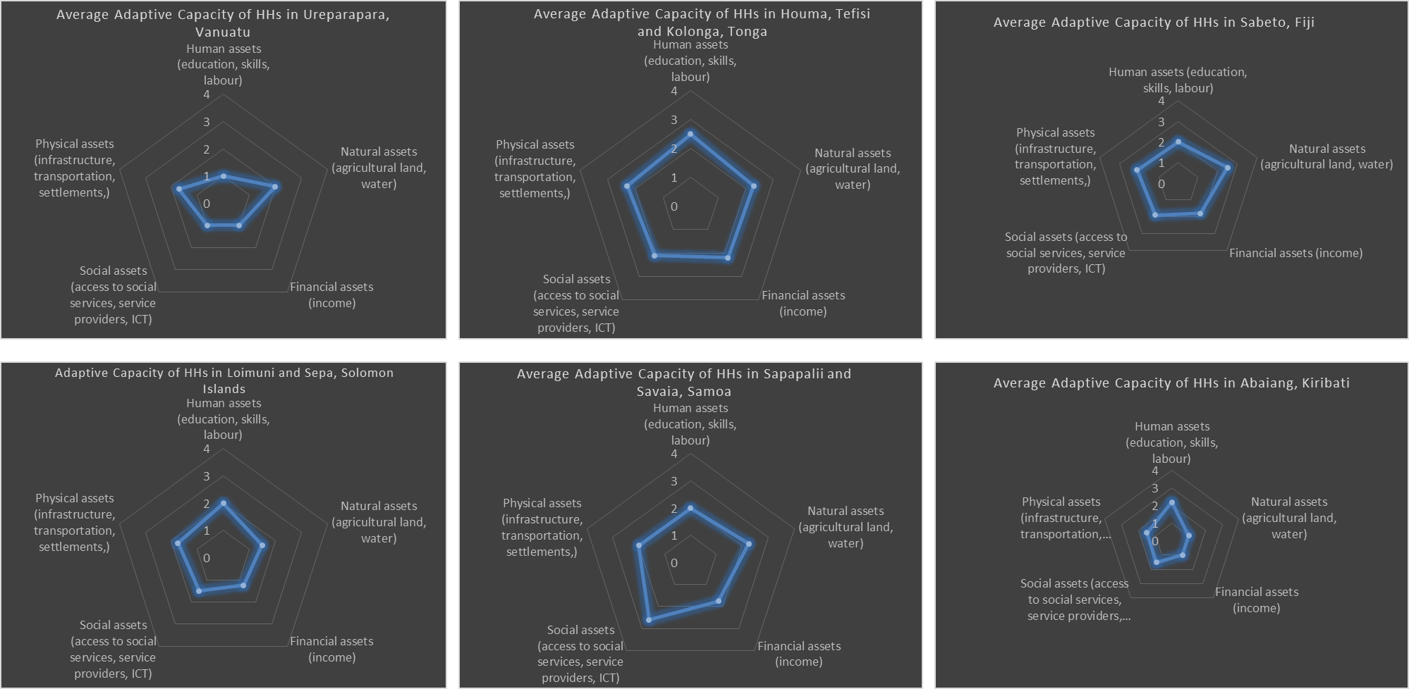
Communities Adaptive Capacity

Slide 15
Establishing indicators with communities
Variables/Hazards | Indicators based on discussions with communities | Correlation with scientific studies (references)
Temperature | Number of hot days has increased. Number of cold days has decreased. | Extreme hot days to increase
Rainfall | Rainfall season has shifted (longer) and increasingly unpredictable. | Seasonal rainfall to increase
Climate induced disasters | Occurrence of landslides has increased. Occurrence of flooding has increased. Occurrence of drought. Cyclone and tsunami intensity has increased. Sea level rise and saltwater inundation (atoll and coastal communities). | Tropical cyclone frequency unchanged, intensity increased Mean Sea level to increase Surface and sea surface temperature to increase Ocean acidification to increase
Livestock Behaviour (Pigs and Chicken) | Reduced performance and productivity. Livestock diseases. | Production and productivity
Behaviour of fruit crops | Mango season ceased past 10 years and shifted. The productivity of banana has declined due to pests and diseases. Breadfruit season shifted and extended or all year round. | Climatic factors – soil health issues; P&D regime, production declines.
Behaviour of root crops | Yam season is shorter with reduced tuber size and disease problems. Cassava productivity declined. Productivity of sweet potato reduced due to pest and disease. Widespread of Taro Leaf Blight has affected taro production. Soil Health issues affecting production and productivity in all countries. | Climatic factors – soil health issues; P&D regime, production declines.
Notes:
Original: The documented causes of the high exposures shown in the previous slide shown in the second column as indicators of high exposure of communities for each the variables measured (column 1). These assessments correlates with IPPC reports with respect to temperature, rainfall although different findings on climate induced hazards (4rth row) – increasing frequency and intensity of climate induced disasters
Based on discussions with the communities some of the indicators identified for the variables (rainfall patterns, high rainfall, natural disasters, livestock, root crop and fruit crop production and productivity), we would like to bring your attention to the highlighted variables of fruit and root crop production and productivity otherwise referred to as behaviour. According to the communities, their view is that climate change exposure has had impacts on:
Fruiting season of crops such as mangos and breadfruit.
There has also been an impact to the seasonal production of root crops such as yam.
Certain pests and diseases were impacted such as an increase in pest and diseases of bananas and sweet potato.
Taro Leaf Blight in the Solomon Islands has also increased in the selected areas.
A decline in productivity of cassava which are due to soil health issues.
Overall their area soil health issues affecting production and productivity in general in the countries.
Specifically for livestock, we see the reduced performance and productivity as well as an increase in livestock diseases.
There is scientific evidence to support the views of the communities regarding the seasonal changes, decline in soil health and also an increase in pests and diseases which is impacting both production and productivity.
Support was provided to these communities through tailored interventions to support the communities in addressing these concerns. However, we know that climate continues to impact the lives of our communities and there needs to be more effective mechanisms in place to support decision making.

Slide 16
Climate induced Pest and Disease Incidences
Year | Climatic factors | Effects | Diseases | Impacts | Country | Cost
1992 | Cyclone Val | Disruption to the ecological balance | Taro cluster caterpillar or armyworm (Spodoptera litura) | Taro | Samoa | ??
1993 | high humidity | Taro caterpillar also contributed to the disease proliferation | Taro leaf blight (TLB) Pytophthora colocasiae | Taro | Samoa | USD 22 million (95%)
2000 + | Flood, landslides, and prolonged inundation | Facilitate the spread of the disease | Leptospirosis, Bovine Brucellosis and Tuberculosis | Cattle, Pigs and human health | Fiji | ??
2005 | El Nino | Increased heat and humid conditions | Little Fire Ant | General vegetation, livestock and human | Vanuatu | ??
2009 - 2010 | El nino 2009 – 2010 | Increased heat, humidity | Asian subterranean termite and Little fire ant outbreak | sugarcane, rice, cassava, yam, maize and coconuts | Fiji | US$ 1 million in 2010
2015 | El Nino | Increase heat and humidity | Pacific fruit fly and Yellow Crazy Ant | Fruits and general vegetation | Tuvalu | ??

Slide 17
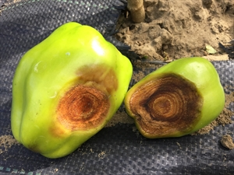
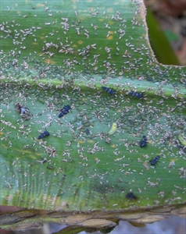
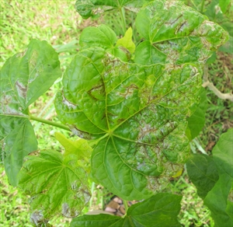
Pest diagnosis data from FJ, SI, WS & TO
Anthracnose
Aphids
Leaf miner

Slide 18
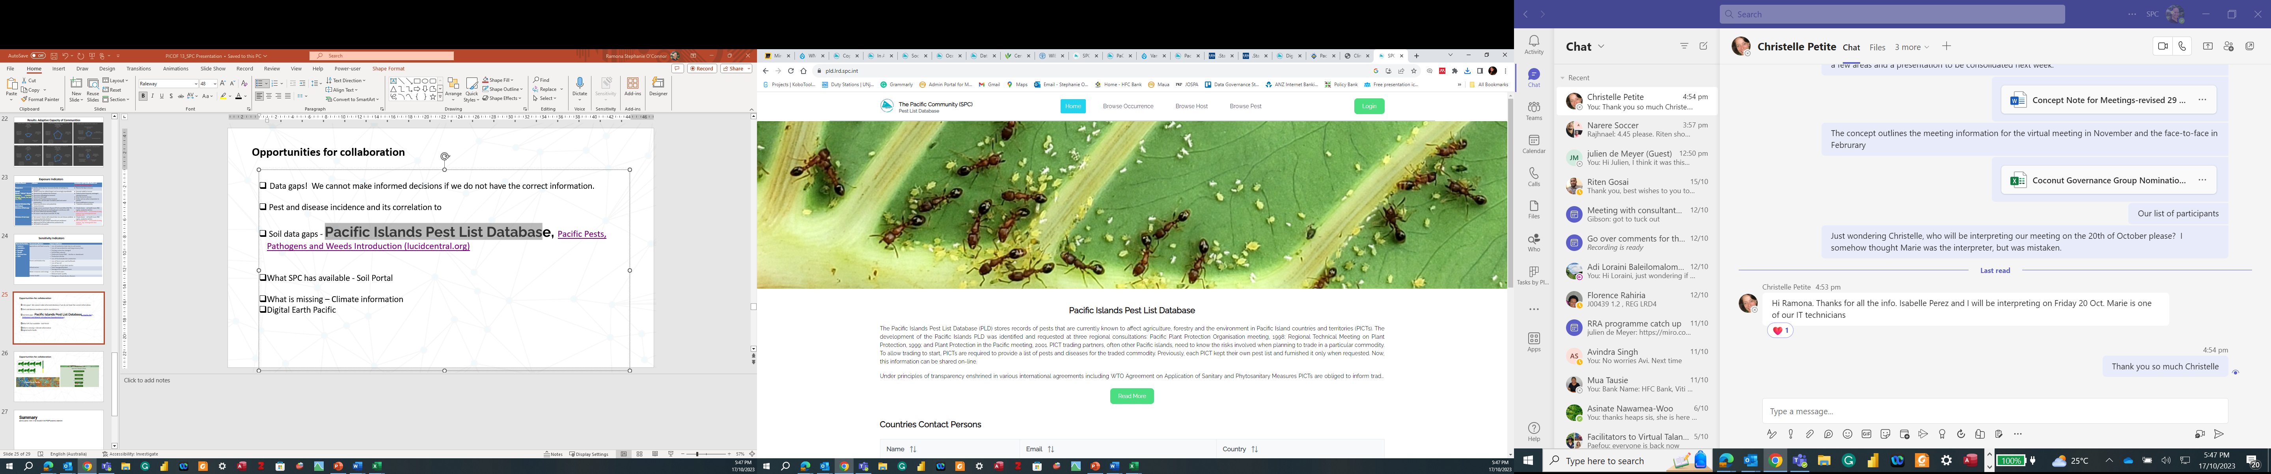
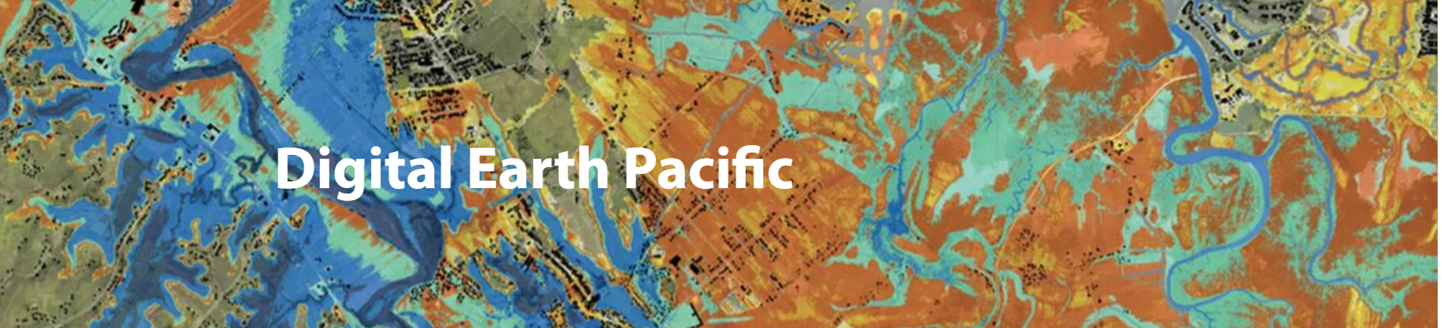
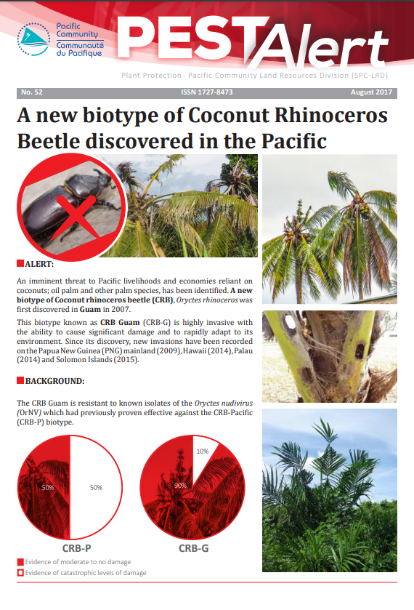
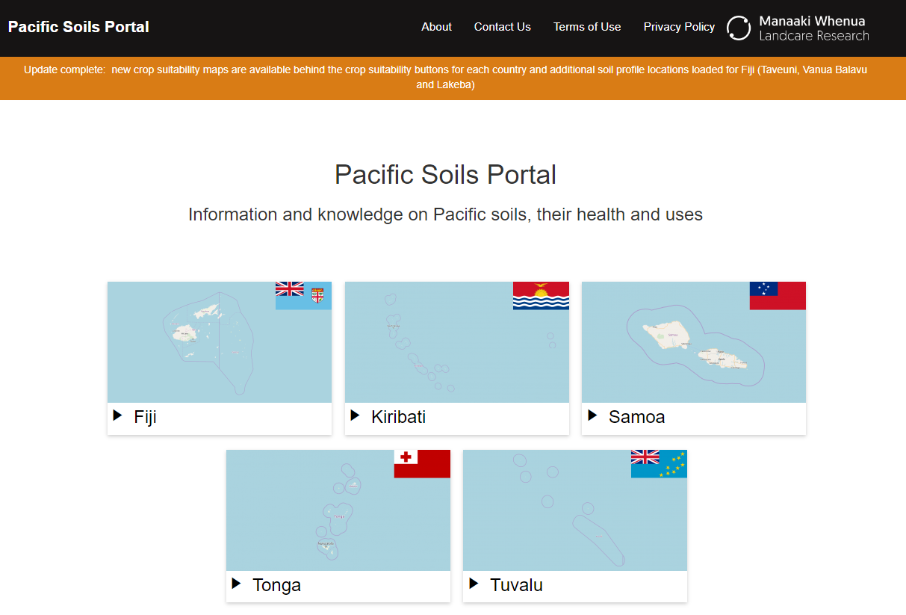
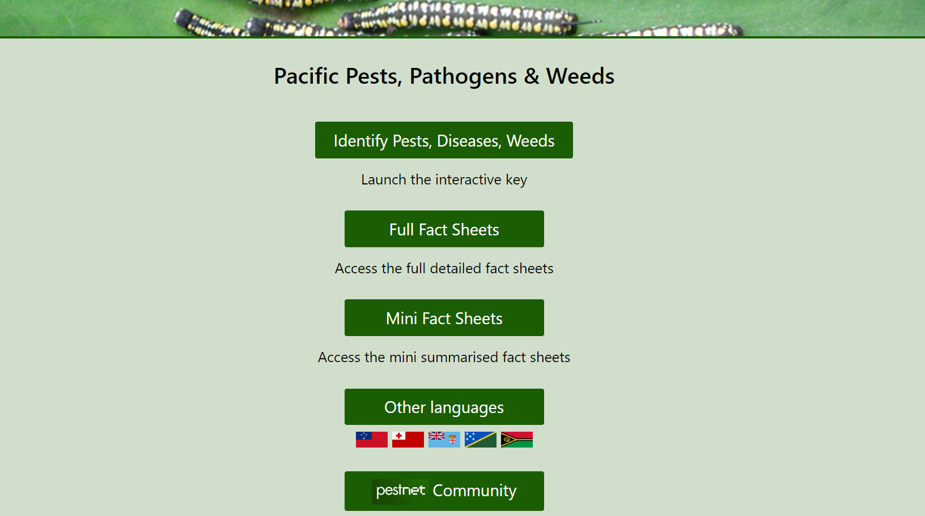
Tools available at SPC
Notes:
The Pacific Community has over the years worked with relevant partners to start consolidating information on pests and diseases, and soil information from countries to try and bring this information into a place where it can be of some use to our member countries and for those carrying out research.
We have our Pacific Pest, Pathogens and Weeds database, our Pacific Island Pest List Database, our Soil Portal and recently, the Digital Earth Pacific is a project that supports the development of an operational earth observation system that takes decades of freely available data and brings it together in a sensible way within the Pacific context.

Slide 19
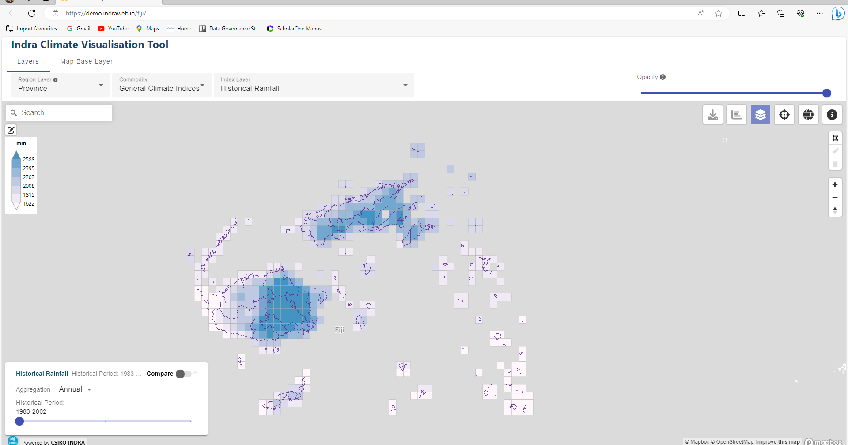
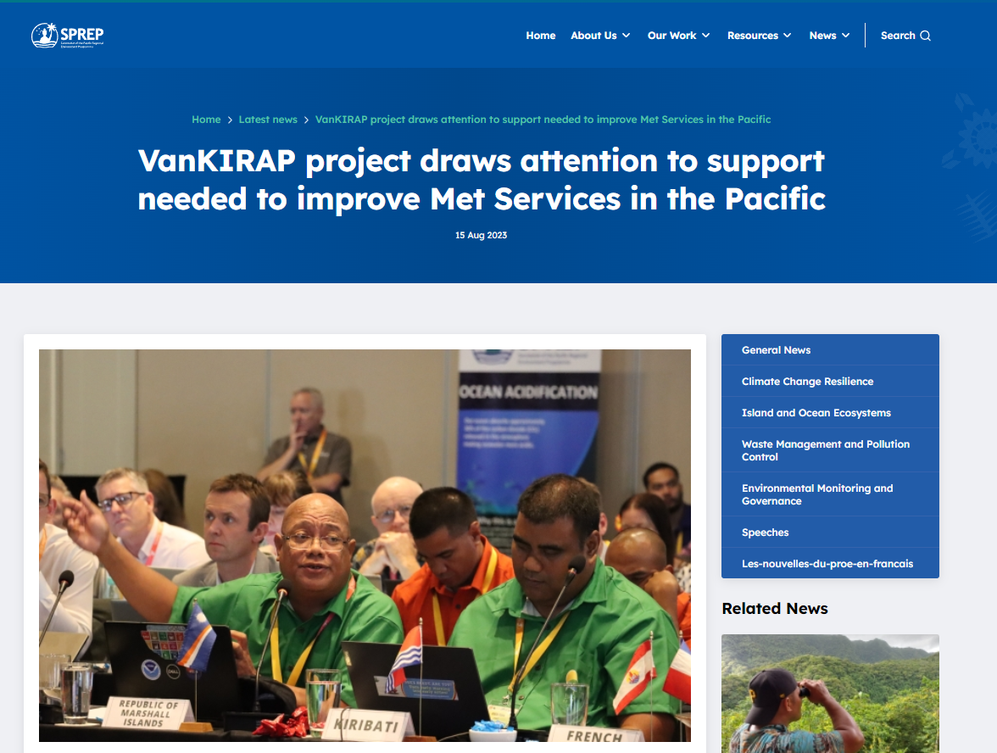
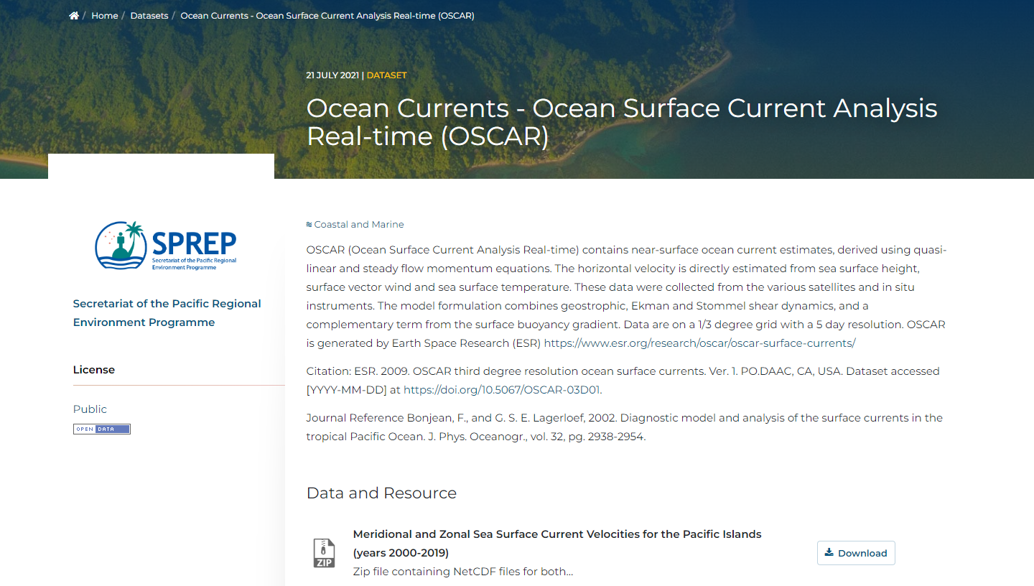
Tools available (that we are aware of)
Source: The Bureau Meteorology
Source: SPREP
Source: SPREP

Slide 20
Opportunities for collaboration
Accessing microclimate information in localities is critical to support adaptation options.
Participatory adaptation strategies empowers communities to understand of climate and weather information to inform decisions on farming practices
Governments need data to support in making informed decisions for the correct interventions.
Collaboration through combination of climate data and agriculture production data can better support decision making e.g.
  Correlation of climate information to soil health and pest and disease infestation.
  Forecasting of climate impacts to soil health and pest and disease infestation.

Slide 21
Summary
Food and nutrition security concerns continue to persist.
Require effective partnerships at all levels.
Fragmented climate information/dashboards.
Need collaborative efforts to streamline data and information.
Improve communication channels to support dissemination of climate data and information.
Notes:
Food and nutrition security is an ongoing concern in the region
Require effective partnerships at all levels
Fragmented climate information/dashboards
Need collaborative efforts to streamline data and information
Improve communication channels to support dissemination of climate data and information

Slide 22




Contact
gibsons@spc.int
Programme Leader, Sustainable Agriculture
https://lrd.spc.int/
stephanieo@spc.int
Research for Development Adviser

Slide 23






Thank
You
Notes:
Do not delete logos/images

