Slide 1

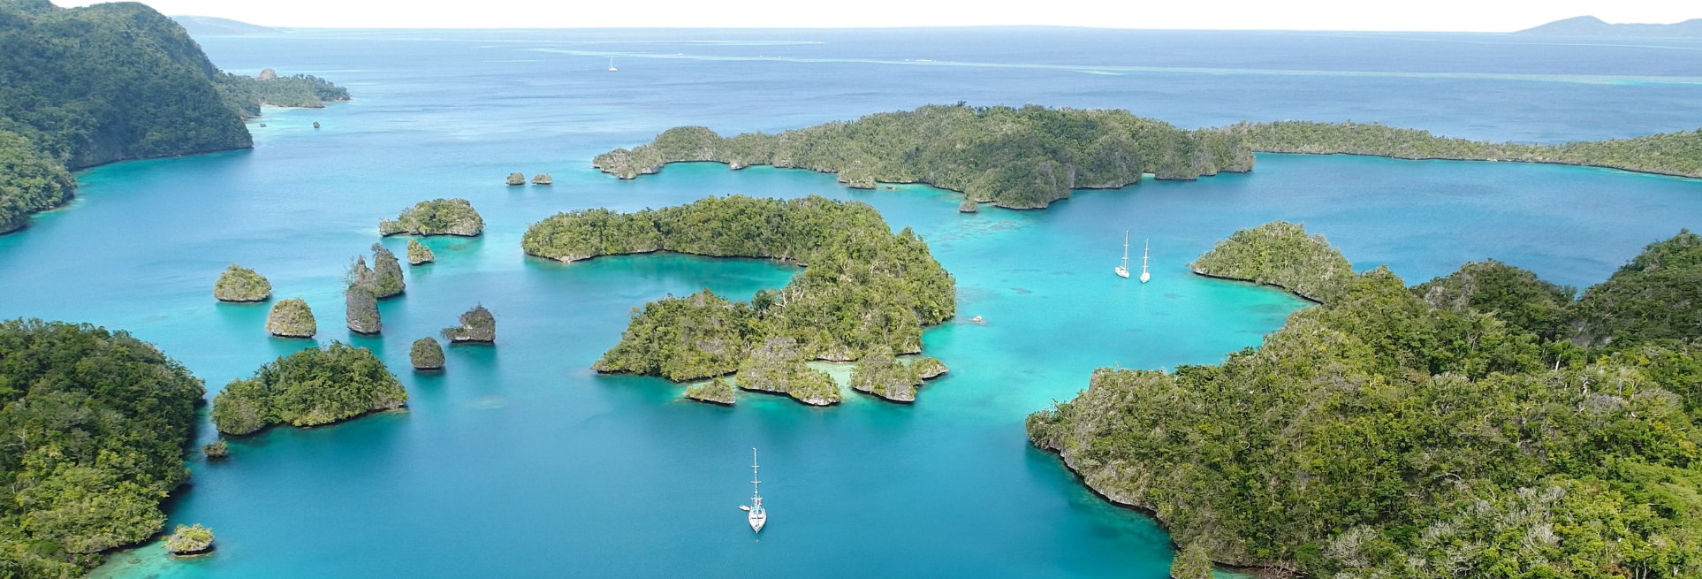









th
18 session of the
pacific islands climate outlook Forum
PICOF -18
23 - 24 April, 2026 | Nadi, Fiji

Slide 2
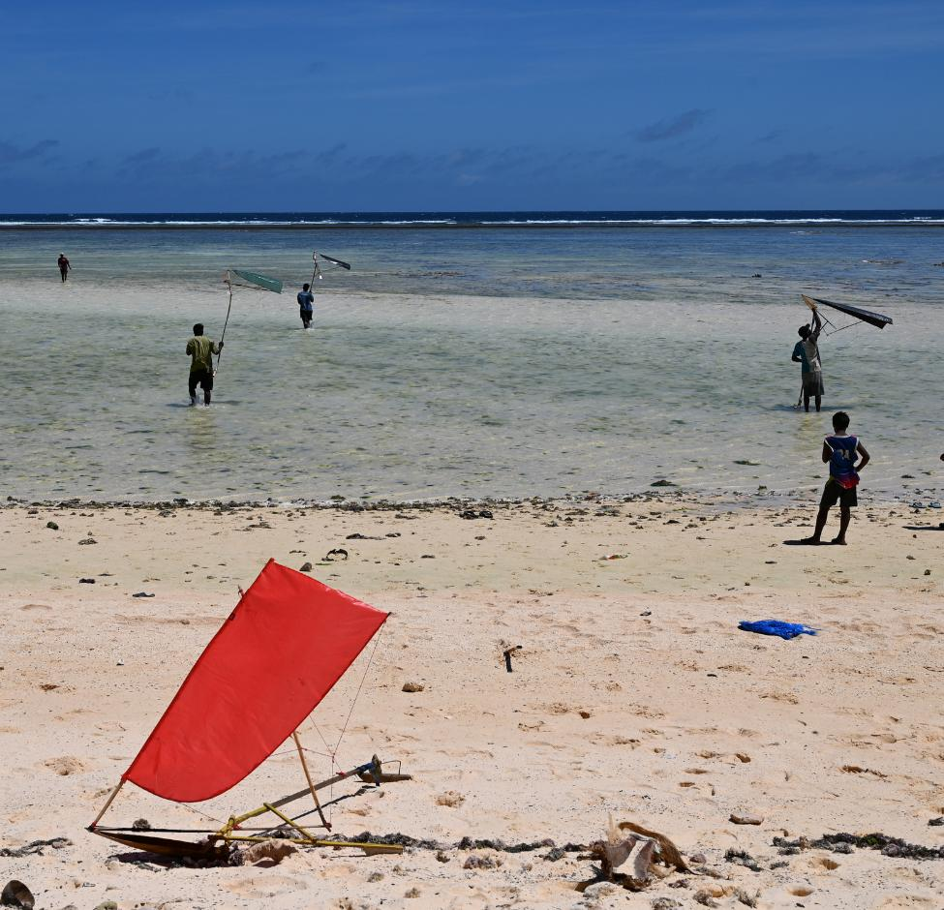
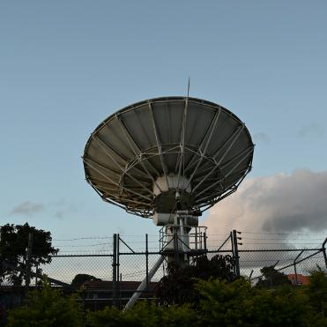

PICOF Objectives
Simon McGree
PICS Panel Chair/RCC-N Management Committee Chair

Slide 3

Pacific Islands Climate Outlook Forum-18
WMO associated RCOF delivered via the Pacific RCC-Network
Aimed at producing objective, user-relevant climate outlooks in order to members reduce climate-related risks and support sustainable development for in climate-sensitive sectors of critical socioeconomic significance
NMHSs are the primary participants of PICOF but the focus remains delivering climate information to climate-sensitive sectors and the community

Slide 4
PICOF-18 objectives
Review the climate of November 2025 to April 2026 including performance of climate, ocean and tropical cyclone outlooks
Present climate, ocean and tropical cyclone outlooks and confidence in these outlooks for May to October 2026
Present and discuss long-term trends and projections for selected climate and ocean variables. On this occasion focus on surface and subsurface ocean temperature, coral bleaching and marine heat waves

Slide 5
PICOF-18 outcomes
Improved understanding of climate and ocean monitoring and prediction specifically for the target monitoring and prediction periods
Enhanced understanding of outlook confidence/skill for the period in question
A regional PICOF statement containing climate, ocean and tropical cyclone outlooks for May to October 2027 which you can use as guide to develop your national statements
A PICOF-18 report
Content for regional partner and NMHSs climate and ocean bulletins as well as media and social media releases

Slide 6
What's different this time?
Longer sessions with more time for questions and discussion. PICOF now 1.5 days (trial)
A new session under Locking Back. Attribution of impacts (trial)
Group work identifying potential impacts in the Looking Forward session (trial)
Session on prompting the Pacific RCC-Network website

Slide 7
Thank You
simon.mcgree@bom.gov.au

