Slide 1

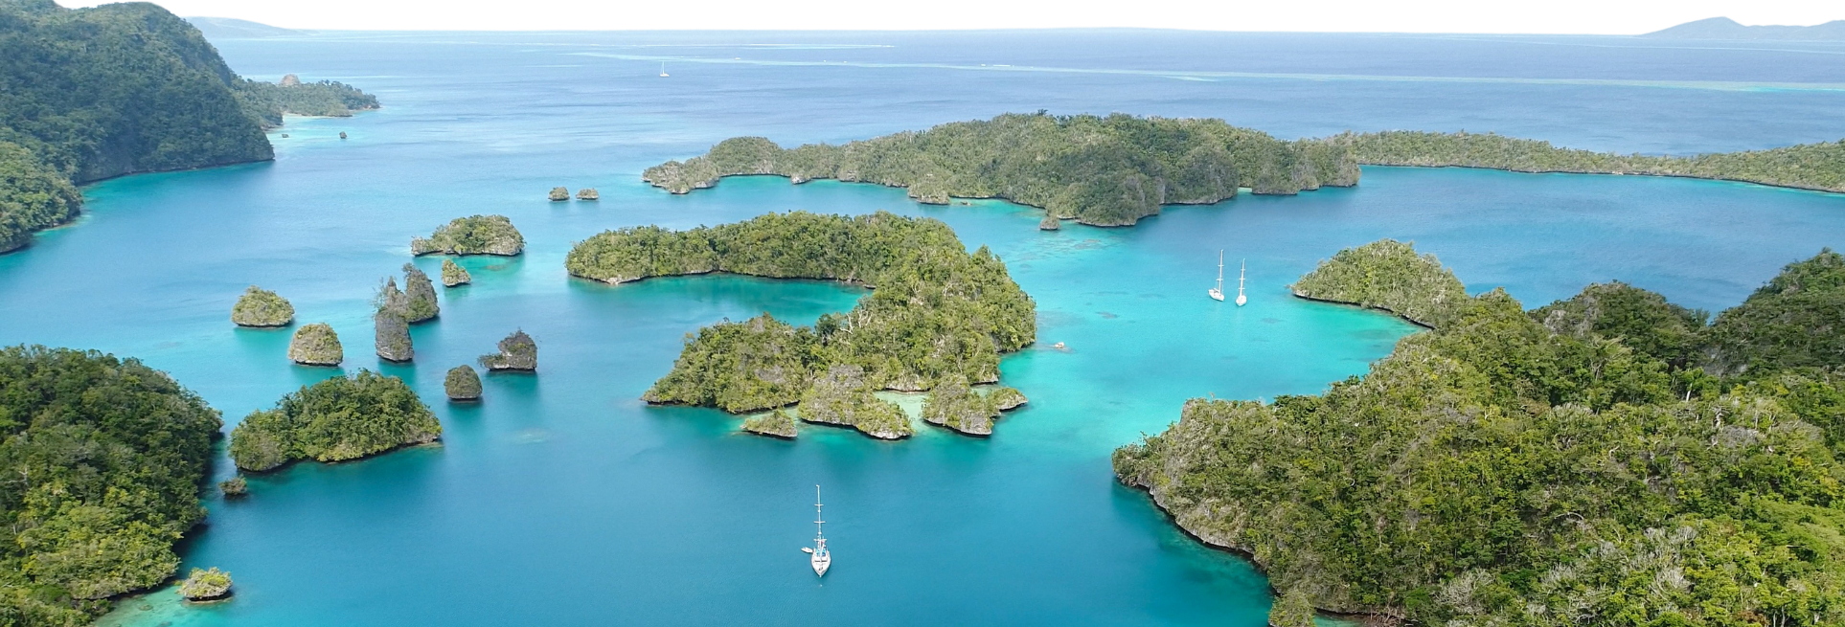









th
18 session of the
pacific islands climate outlook Forum
PICOF -18
23 - 24 April, 2026 | Nadi, Fiji

Slide 2
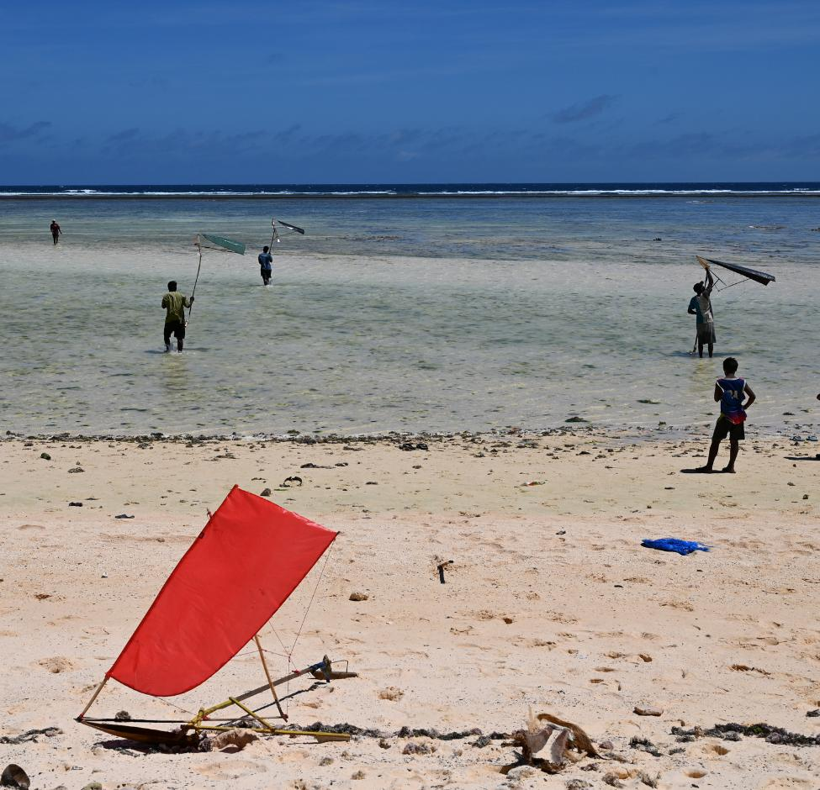
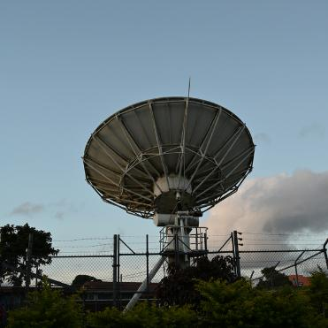

Session 3ii. Ocean
Daeun Jeong
Researcher, APEC Climate Center

Slide 3
Table of Contents
01
Sea Surface Temperature
WMO LC for Seasonal Prediction MME
APCC
BOM
03
Marine Heat Wave
BOM
02
Sea Surface Height (Sea Level)
BOM
UH
04
Coral Bleaching
Ocean Portal
NOAA
05
Fisheries Convergence Zone
Ocean Portal

Slide 4
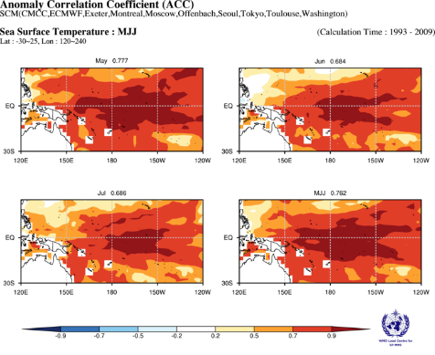
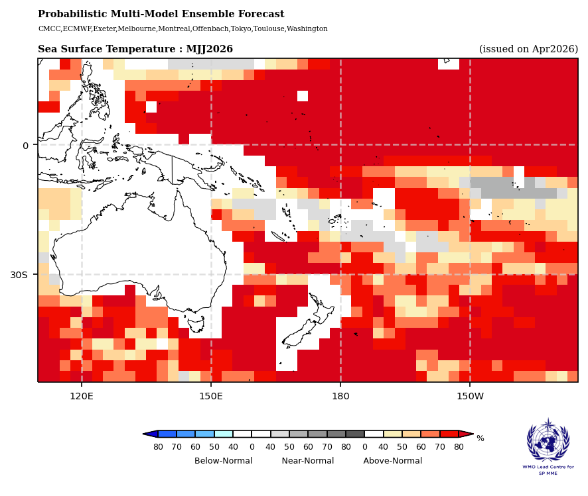
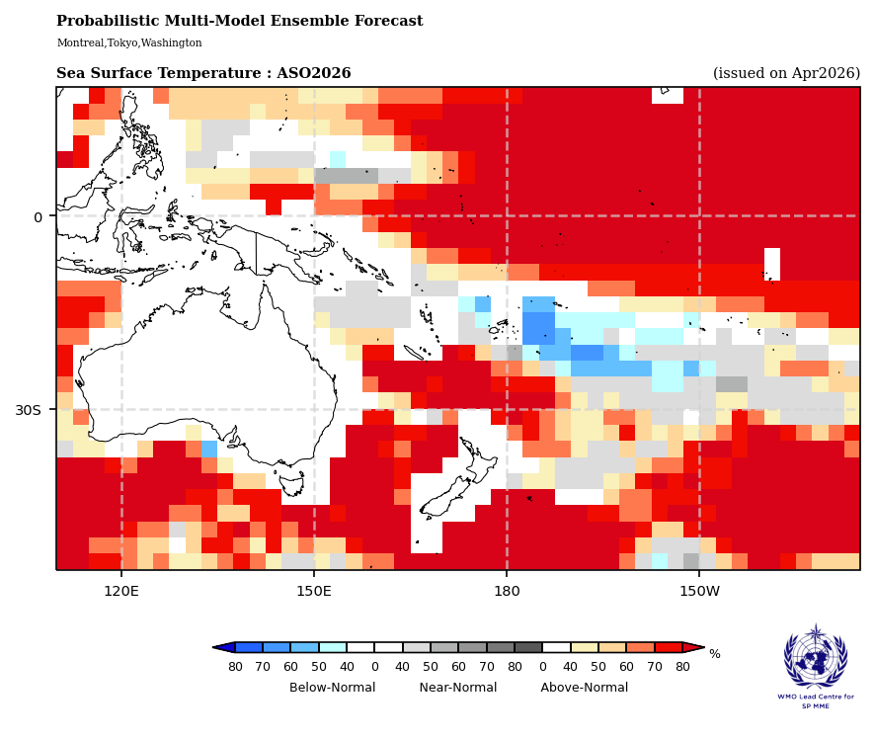
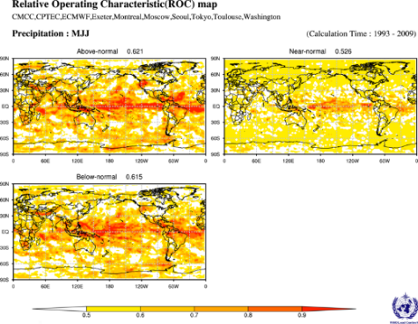
1. Sea Surface Temperature – WMO LC for Seasonal Prediction MME
Mostly above-normal SSTs across the equatorial Pacific, with possible slight cooling for western parts of Polynesia by ASO 2026
Moderate–high skill (ACC ~0.7, ROC ~0.8), supporting confidence in warm signals across the equatorial Pacific
Seasonal Probabilistic MME Prediction of SST
Source: www.wmolc.org

Slide 5
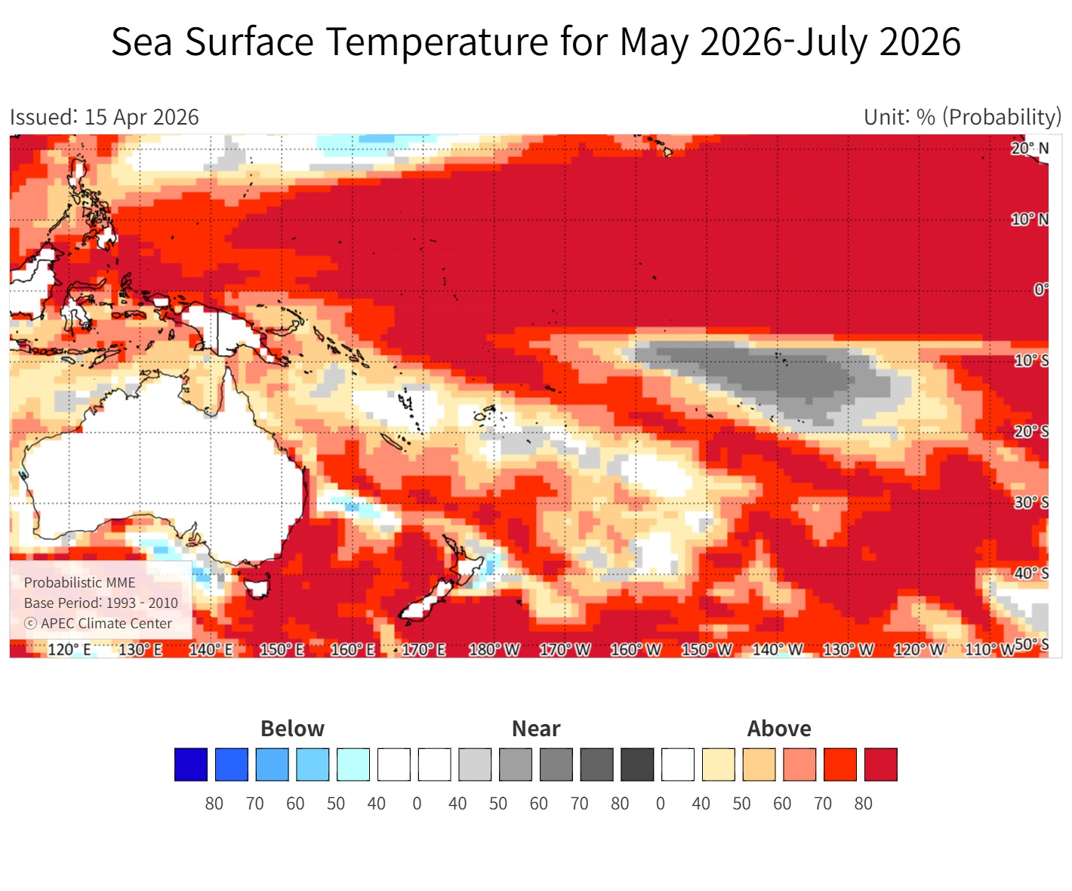
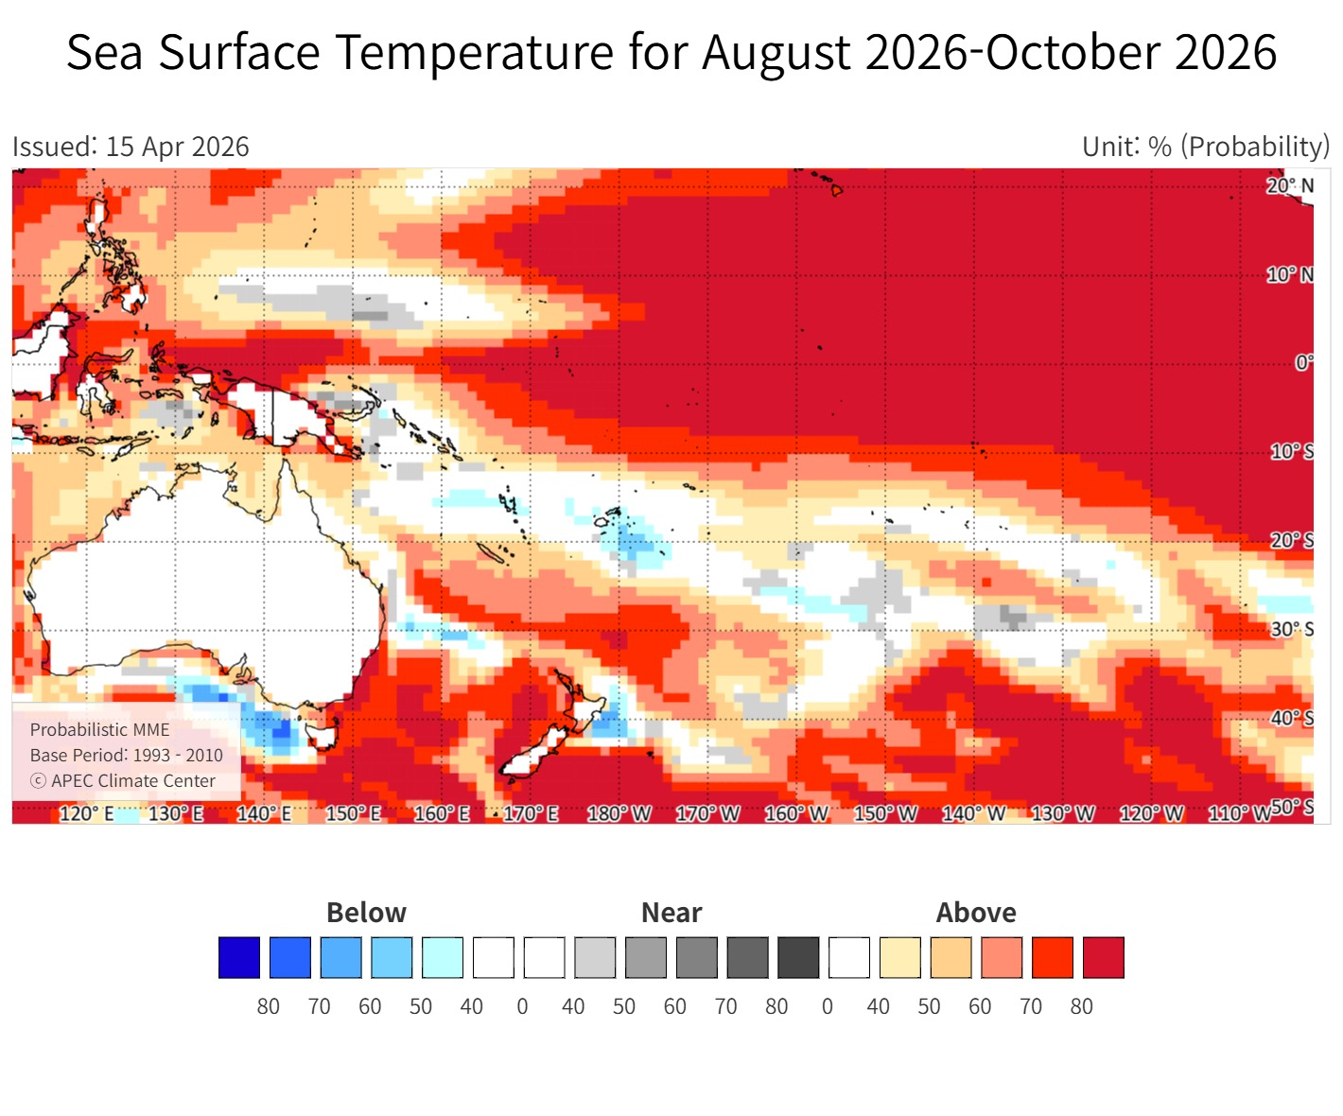
1. Sea Surface Temperature – APEC Climate Center
Seasonal Probabilistic MME Prediction of SST
Source: www.apcc21.org

Slide 6
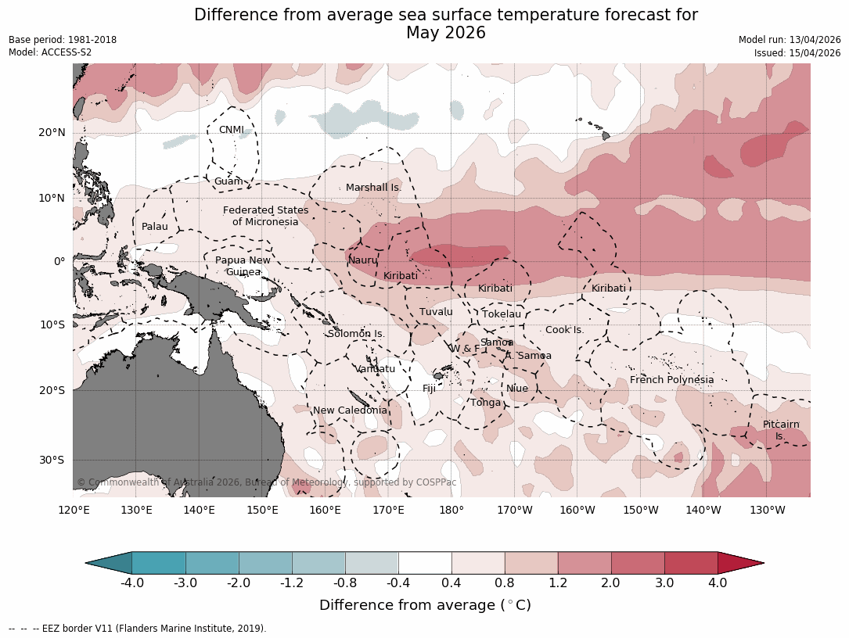
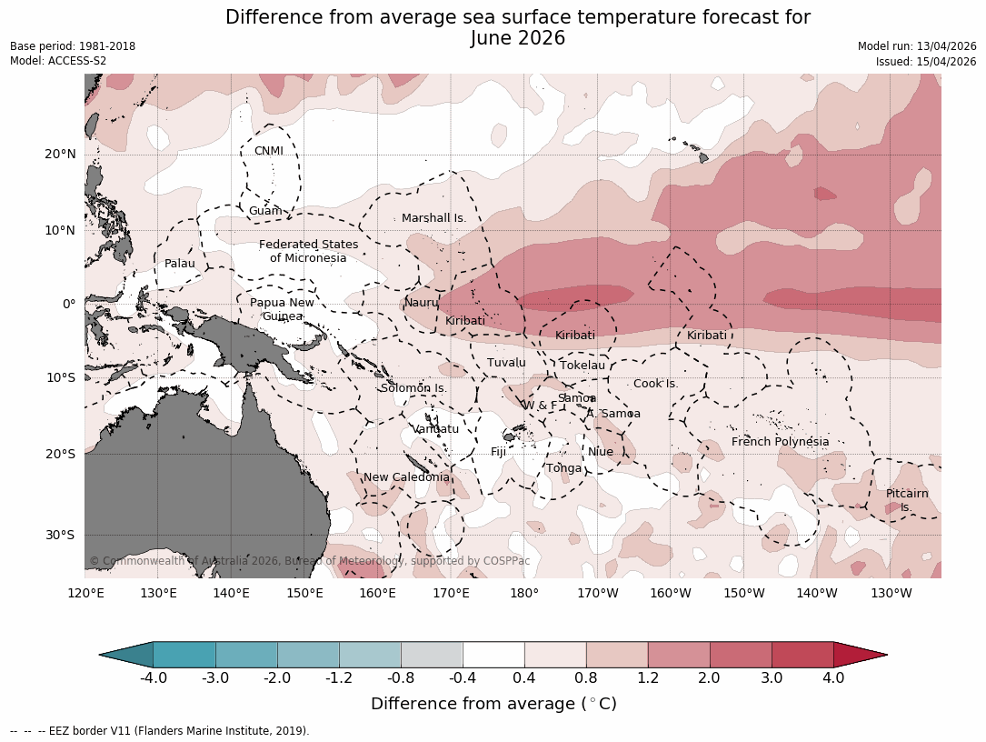
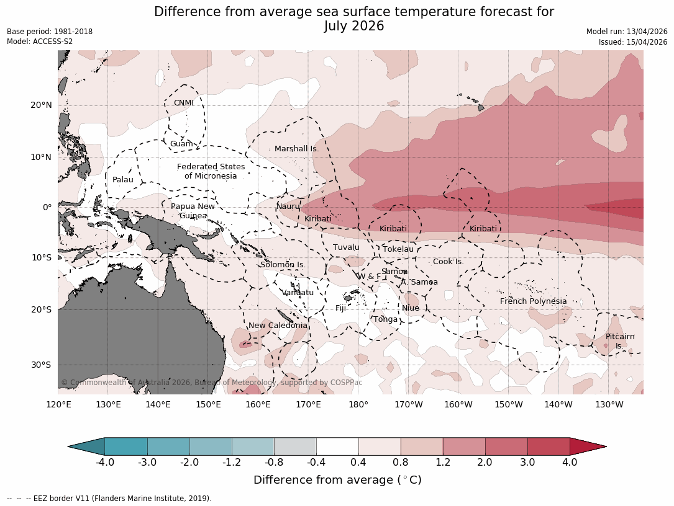
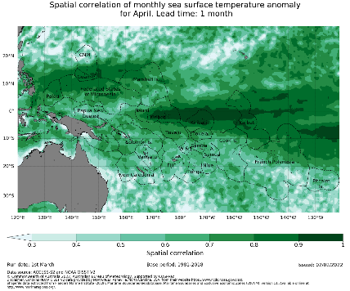
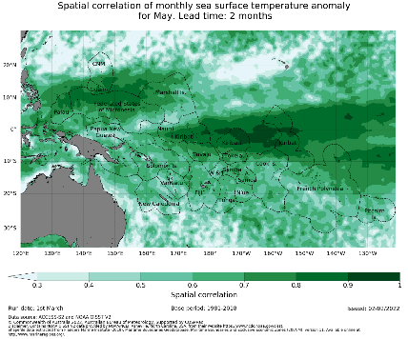
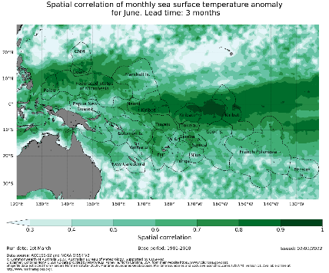
1. Sea Surface Temperature – BOM
Forecast
Above-average SST for the equatorial Pacific for MJJ 2026
Verification
High model skill across the region (correlation 0.8–0.9)
Anomaly prediction of SST
Source: https://access-s.clide.cloud/

Slide 7
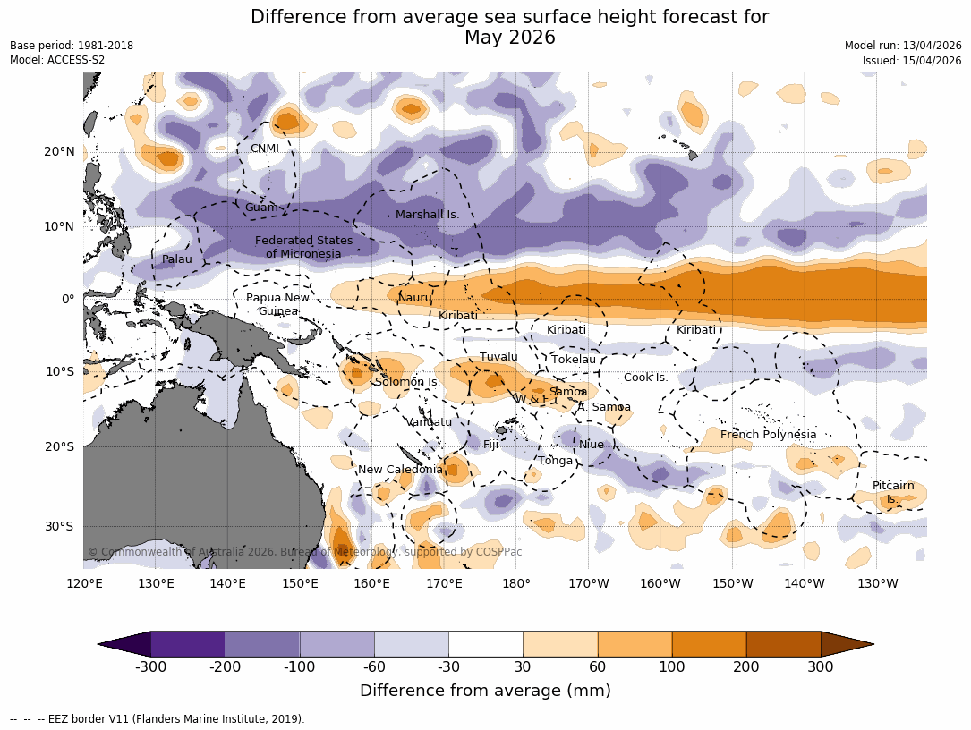
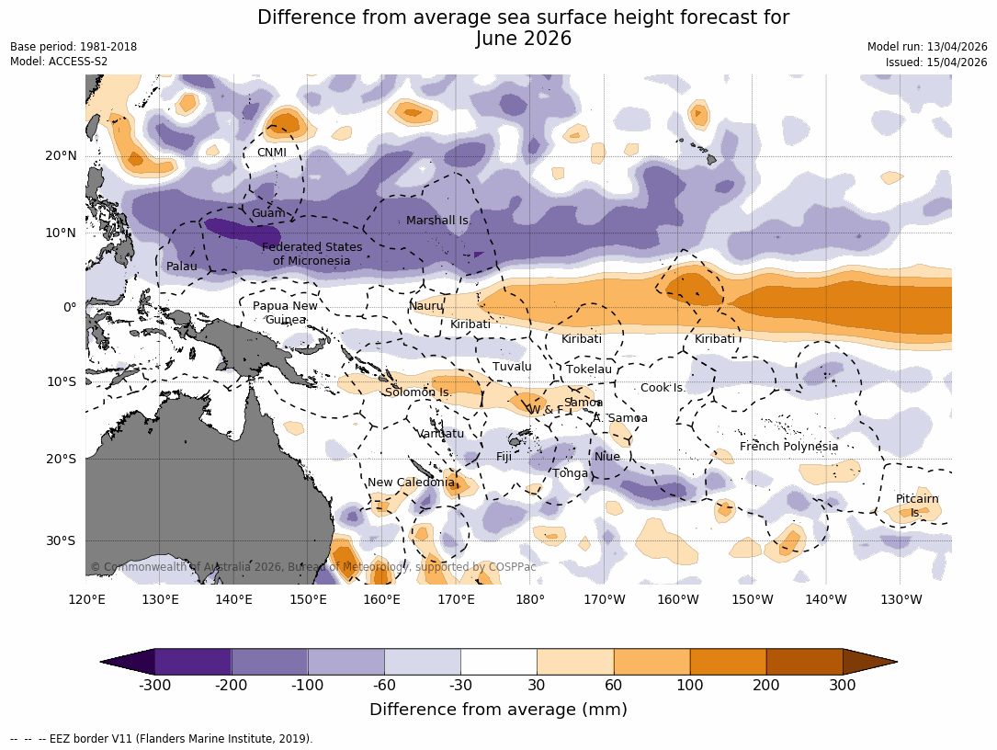
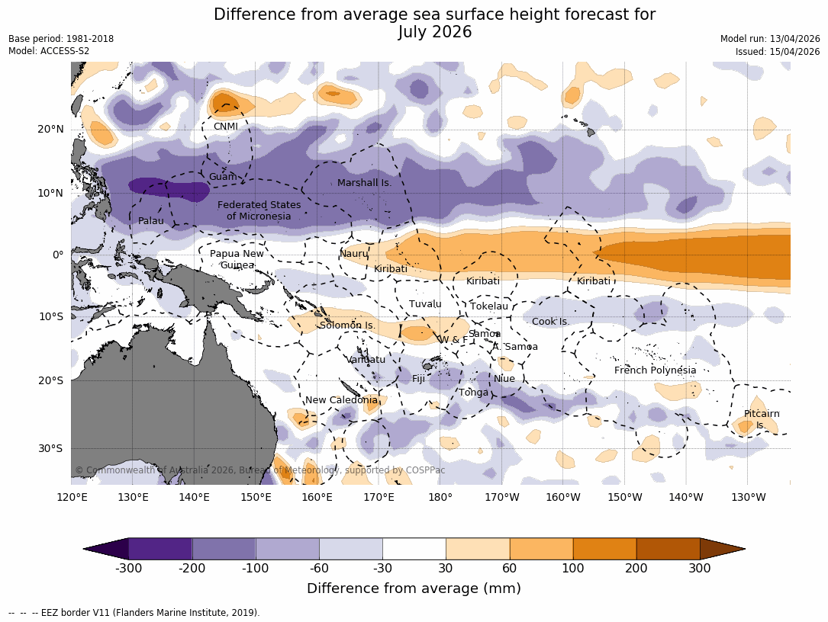
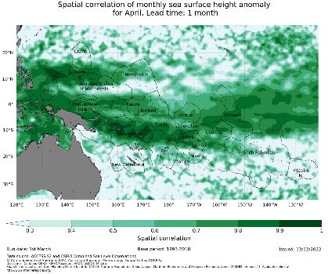
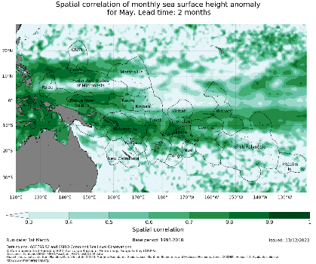
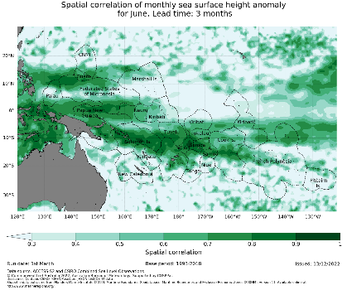
2. Sea Surface Height – BOM
Forecast
Above-average for Nauru to Kiribati; below-average heights for Micronesia and some region of southwest Pacific
Persistent contrast pattern through the season
Verification
High model skill across Micronesia and the off-equatorial Pacific region
Anomaly prediction of SSH
Source: https://access-s.clide.cloud/

Slide 8
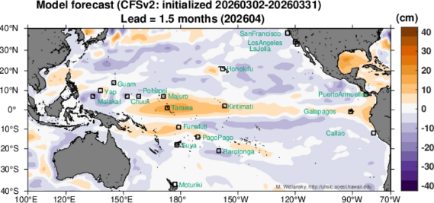
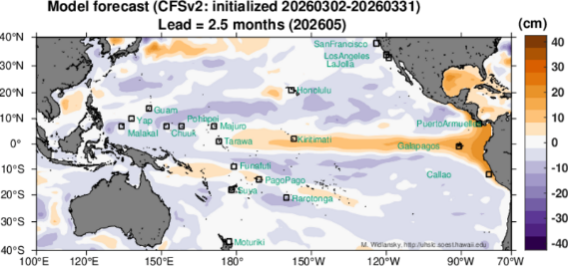
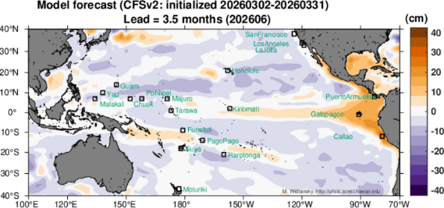
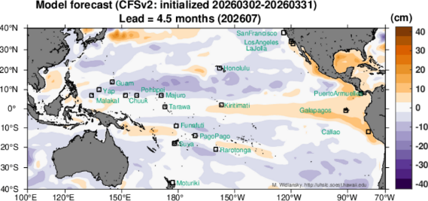
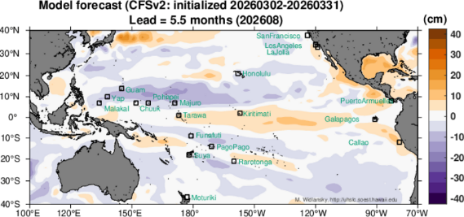
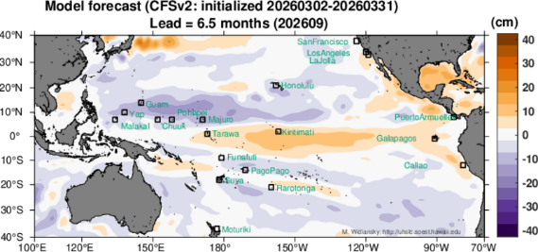
2. Sea Surface Height – UH
Equatorial Highs: Persistent above-average sea levels across the equatorial Pacific, specifically impacting Kiribati (Kiritimati) through September 2026
Off-equatorial Lows: Conversely, below-average sea levels are forecasted for Micronesia (Guam, FSM)
Anomaly prediction of SSH
Source: https://uhslc.soest.hawaii.edu/products/slforecasts/

Slide 9
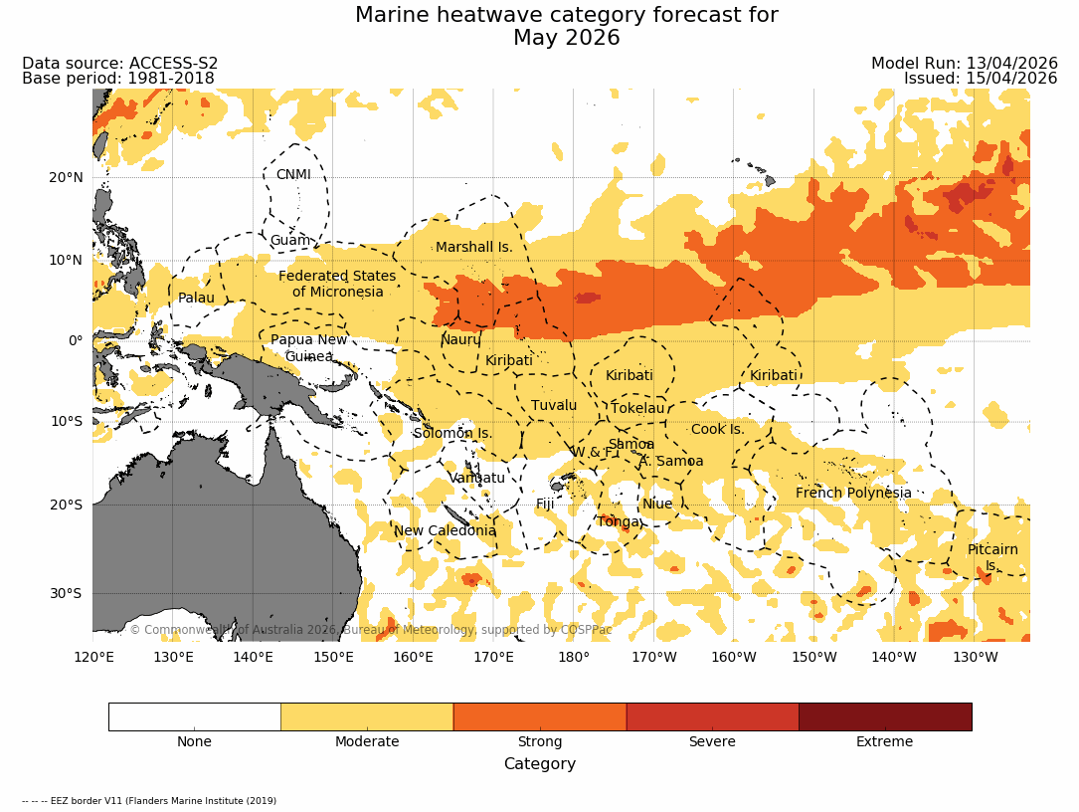
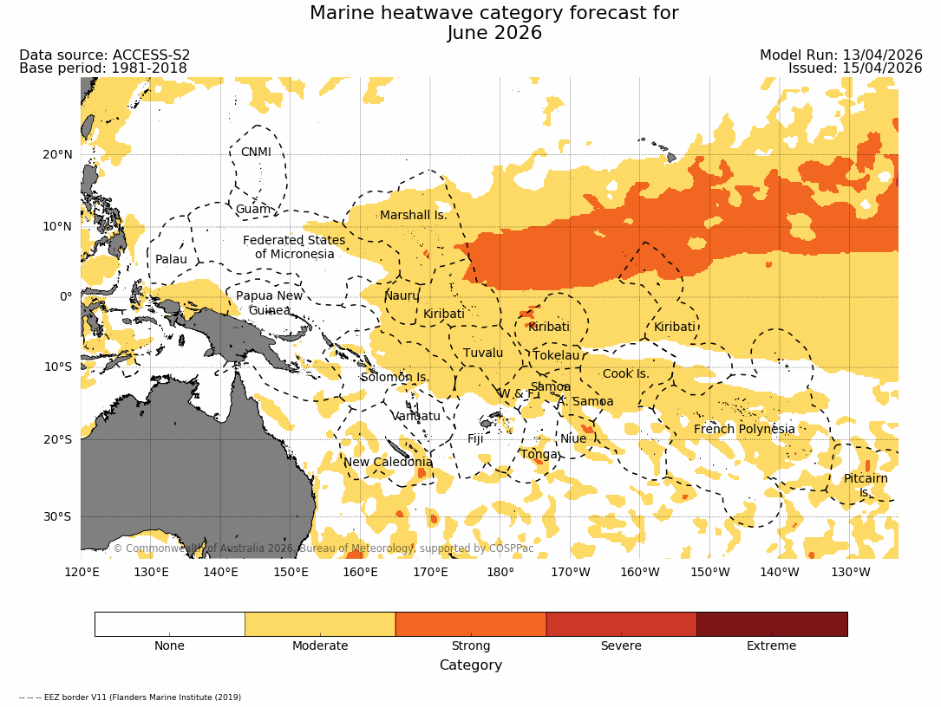
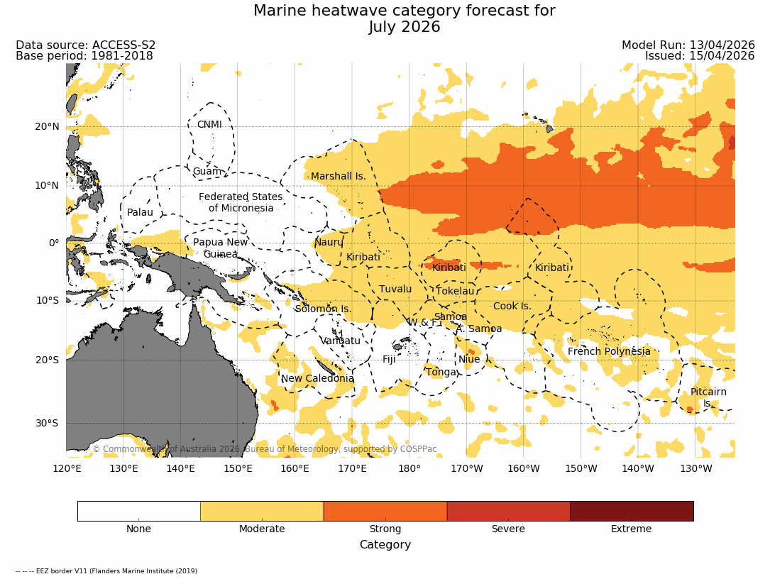
3. Marine Heatwave – BOM
May 2026: Widespread moderate MHW conditions across much of the Pacific Islands, with strong MHW north of the equator
June 2026: Intensification and eastward expansion of MHWs, extending into the central Pacific
July 2026: Persistent MHWs, remaining strong across the central equatorial Pacific and Polynesia, indicating prolonged ocean heat stress.
MHW heatwave category forecast
Source: https://access-s.clide.cloud/

Slide 10
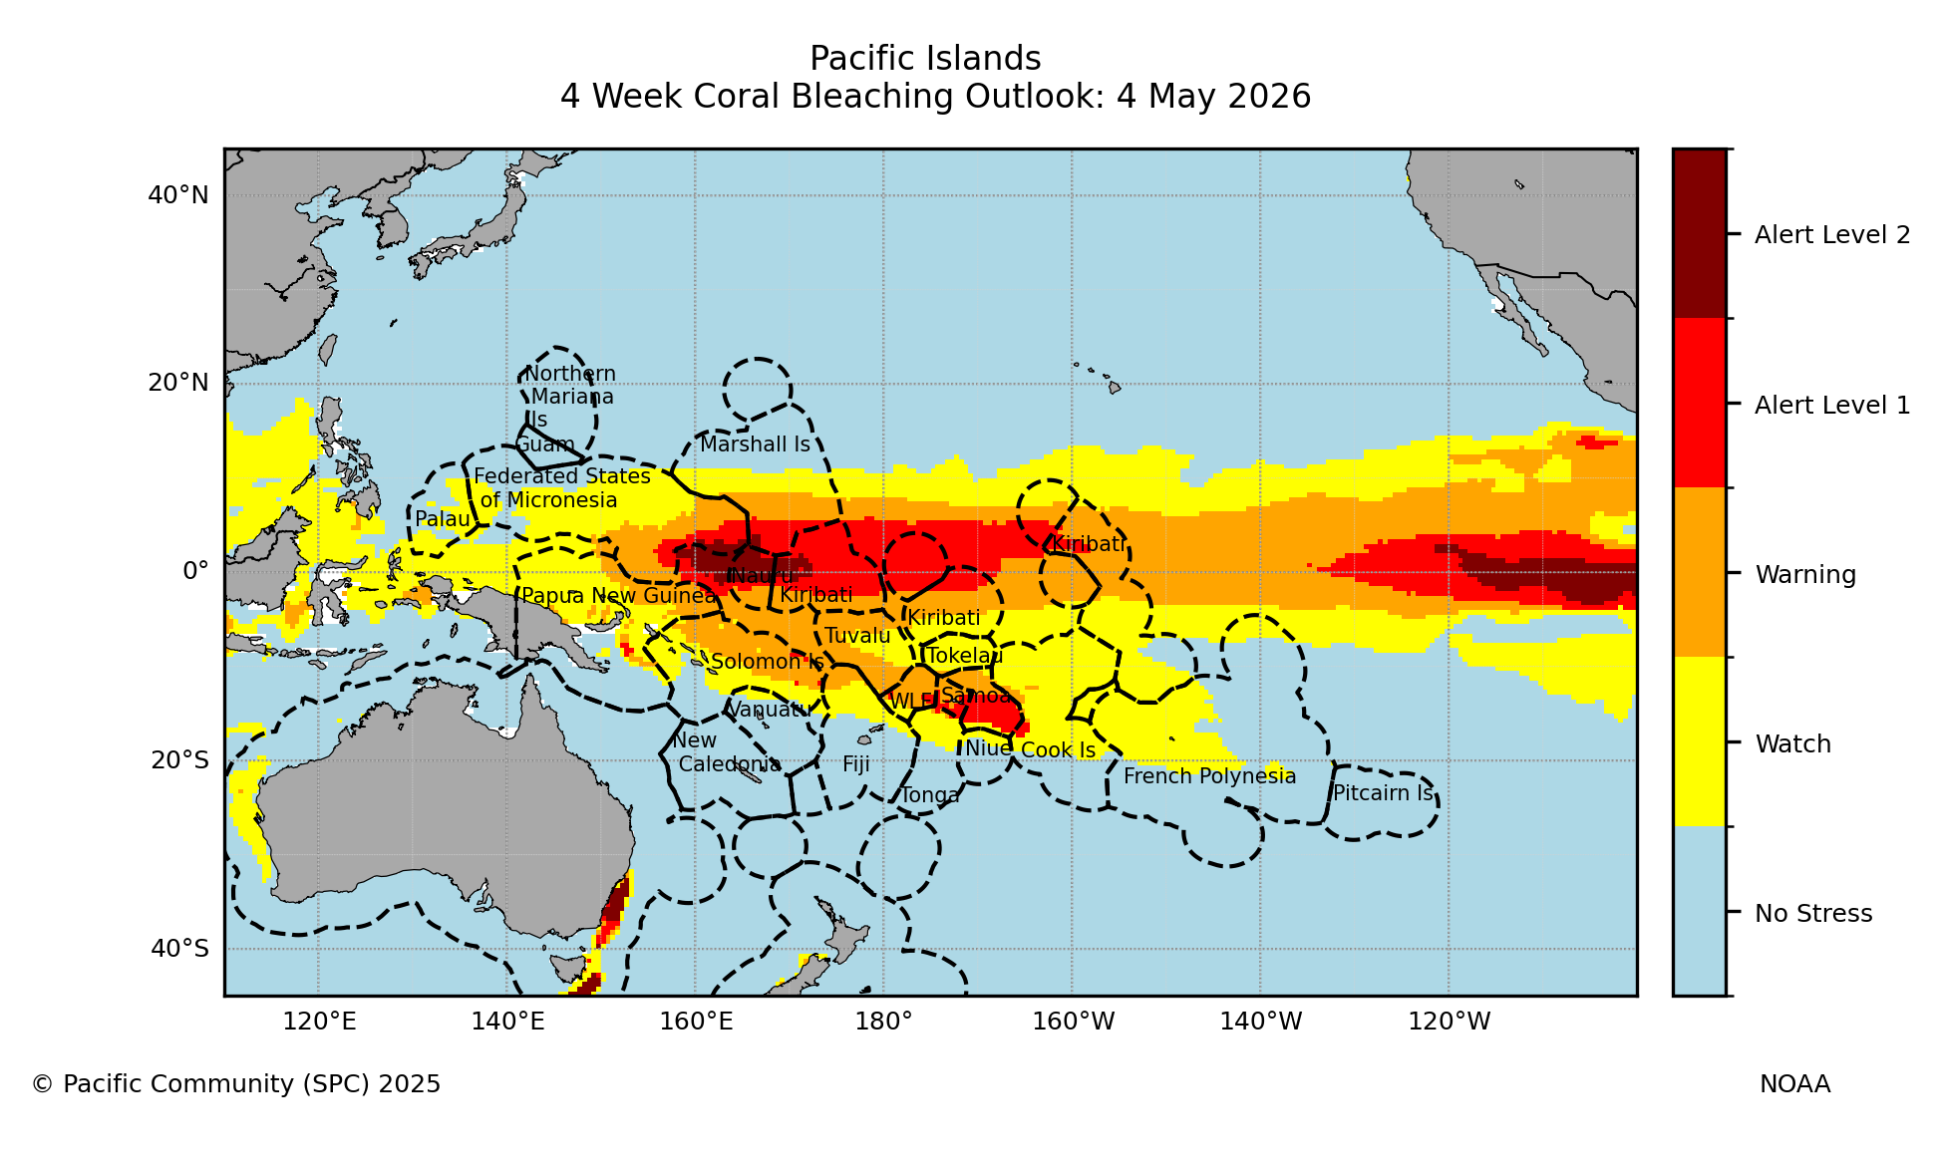
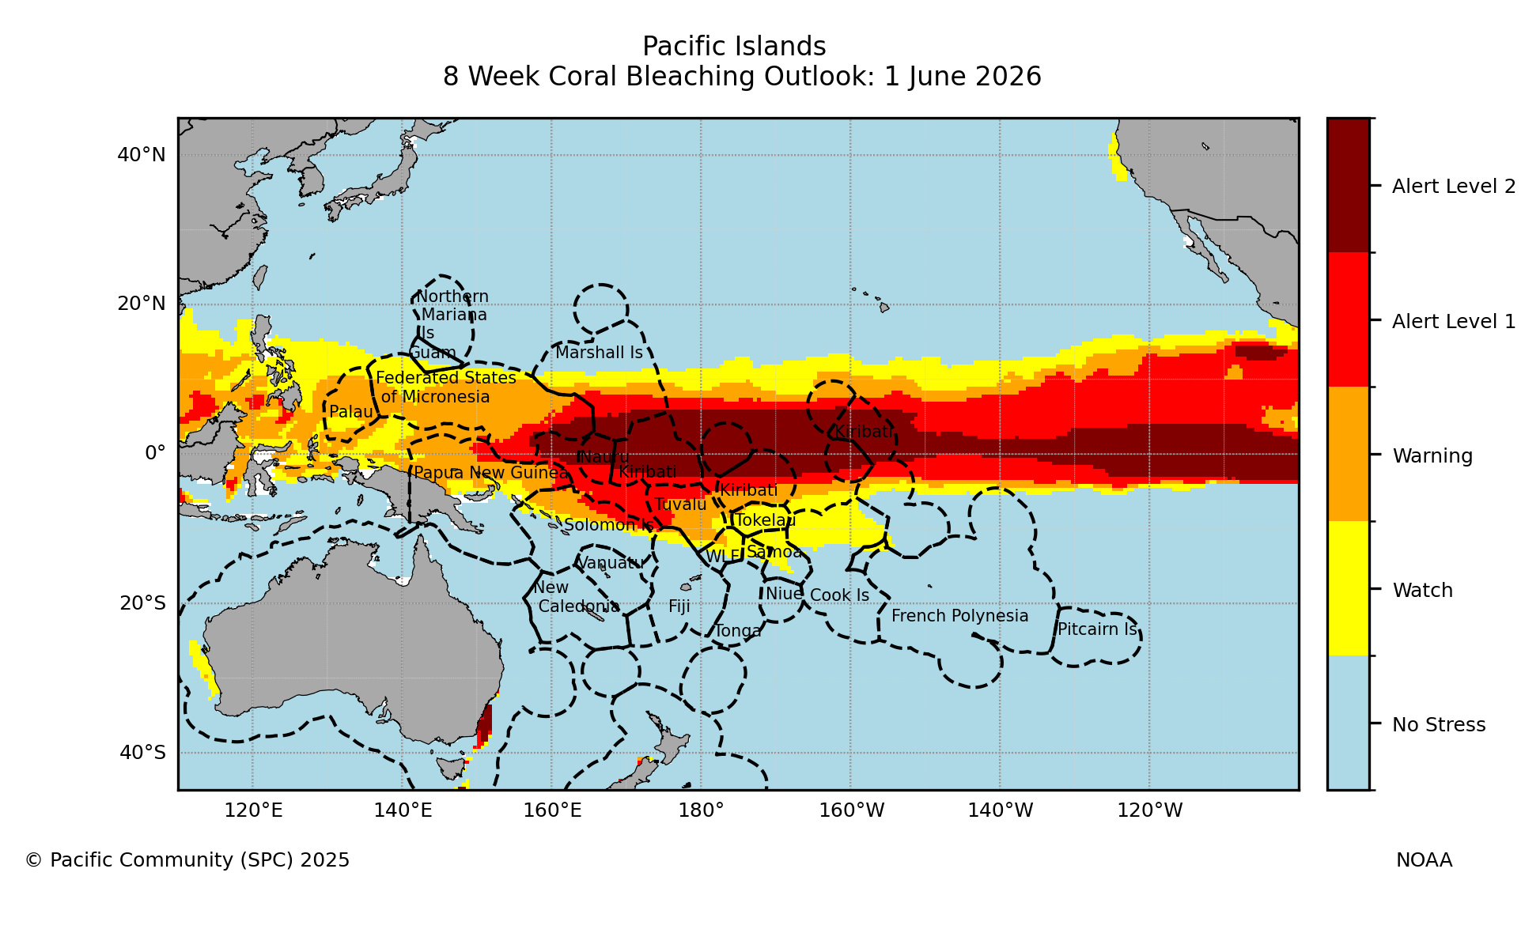
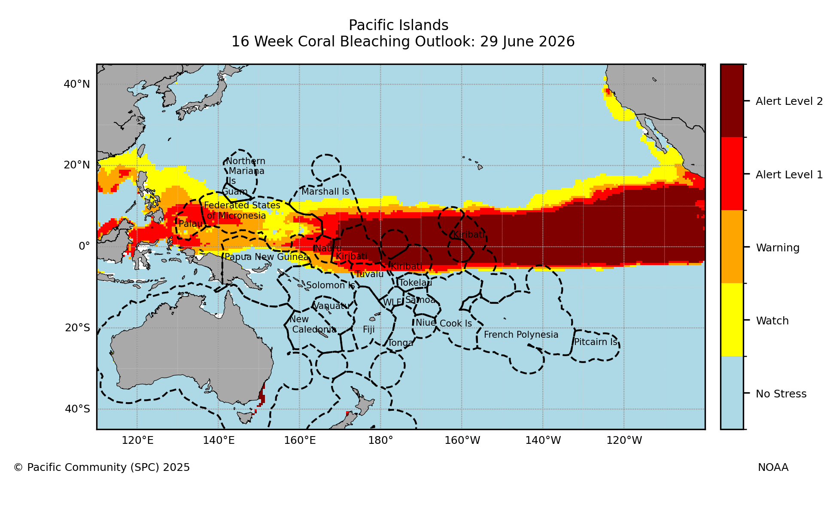
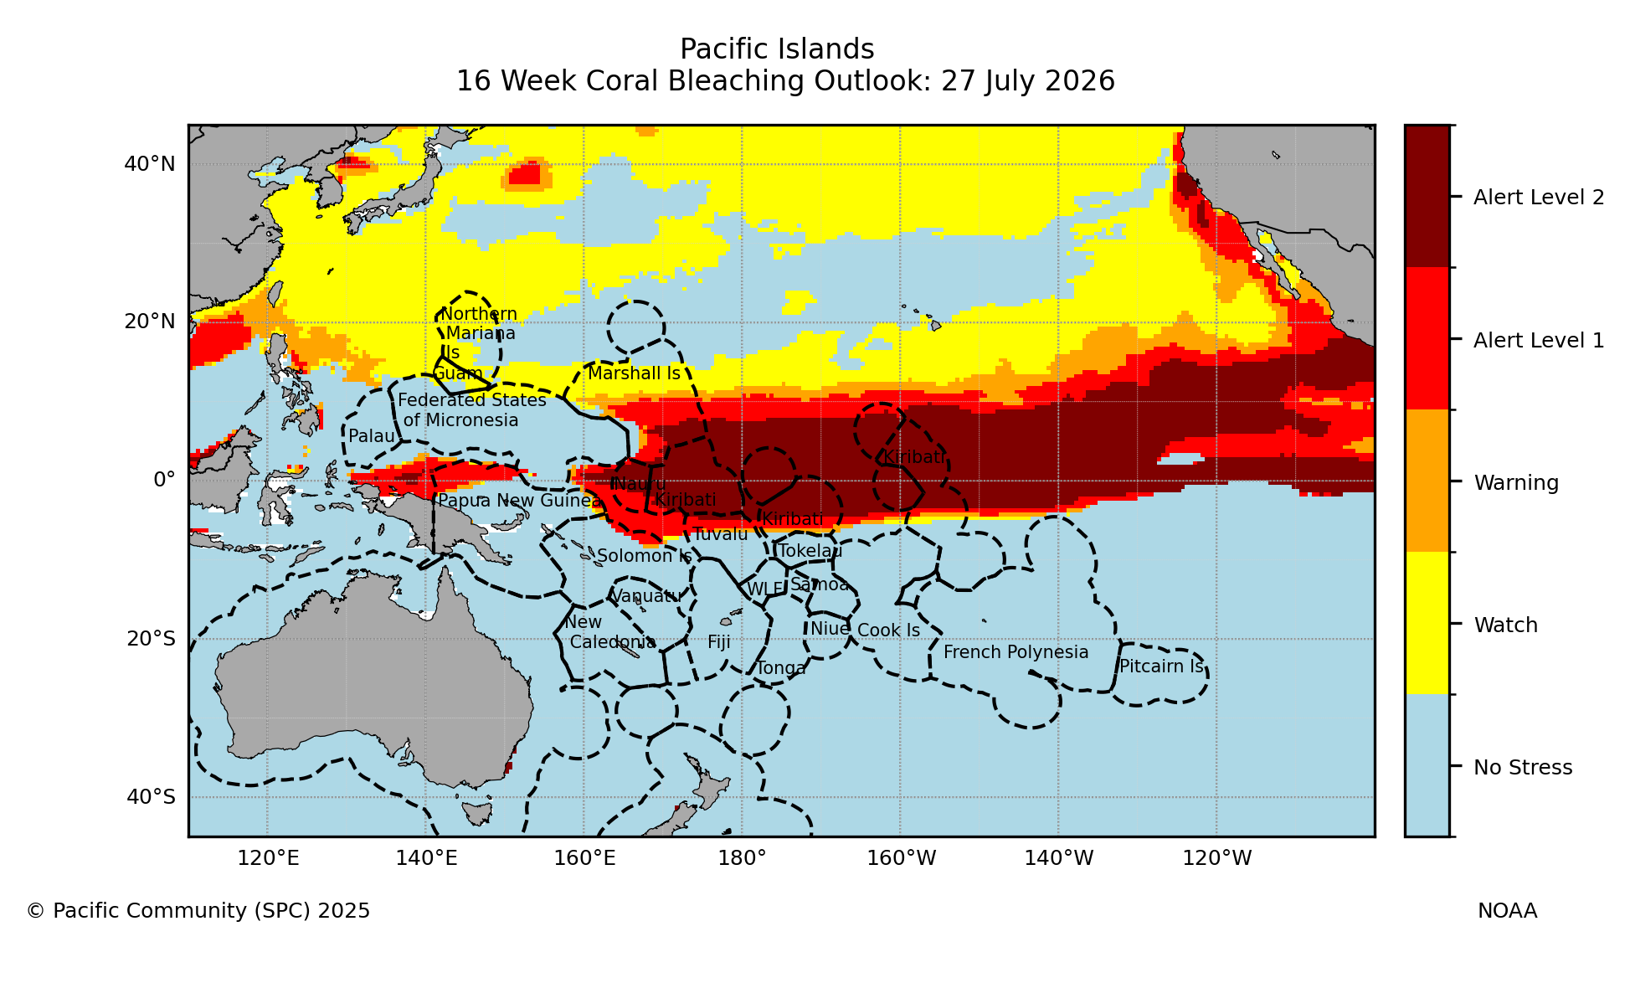
4. Coral Bleaching – Ocean Portal
May: Alert Level 2 is expected for Nauru; Alert Level 1 affects the Kiribati and Samoa
June: Heat stress intensifies.
  Alert Level 2 expands across Kiribati and Nauru.
  Alert Level 2 forms a continuous band across the equatorial Pacific.
July: Thermal stress persists. Alert Level 2 still covers the equatorial region from Nauru to Kiribati
Coral Bleaching Outlook
Source: https://oceanportal.spc.int/explorer

Slide 11
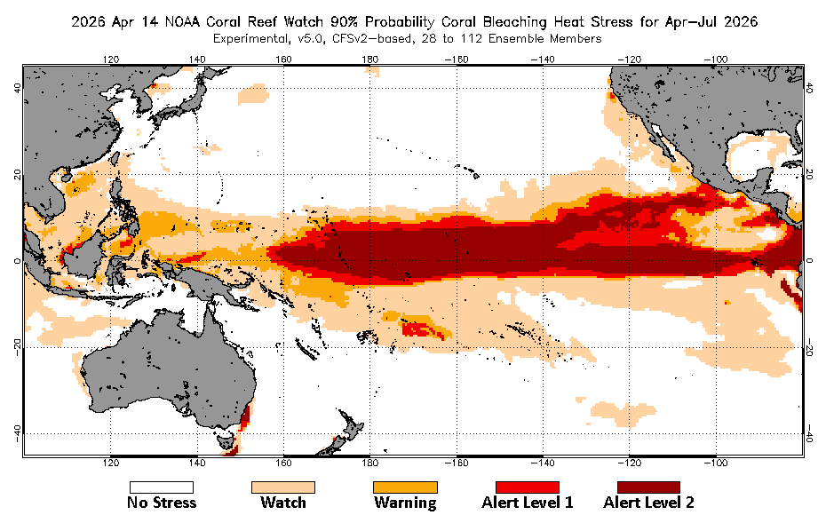
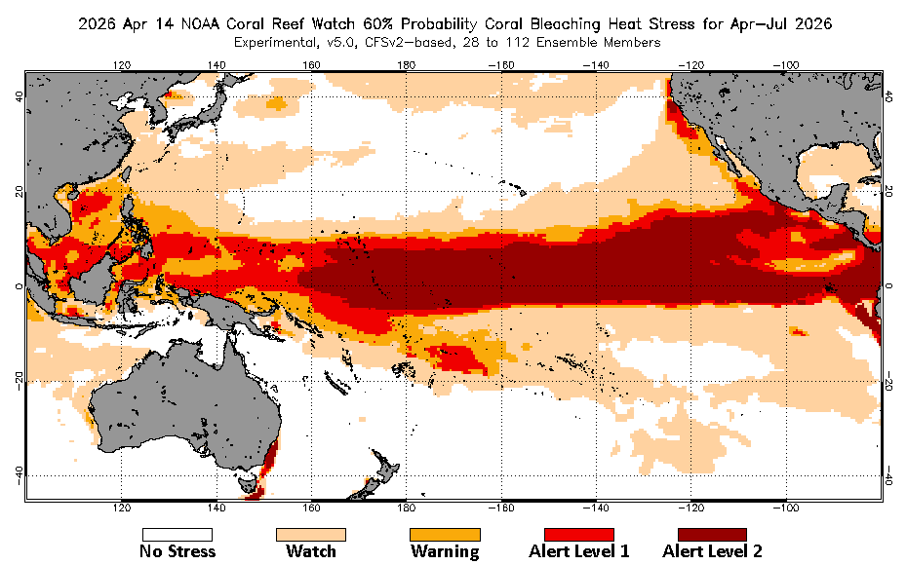
4. Coral Bleaching – NOAA
Stress level predicted by 90% of ensemble members
Stress level predicted by 60% of ensemble members
Probability of Coral Bleaching Heat Stress
Source: https://coralreefwatch.noaa.gov/satellite/bleachingoutlook_cfs/archive_webpage/outlook_icwk20260301.php

Slide 12
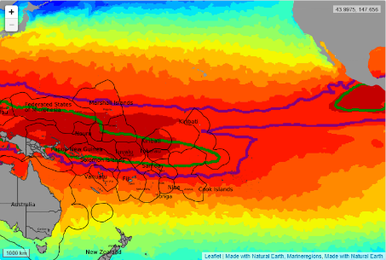
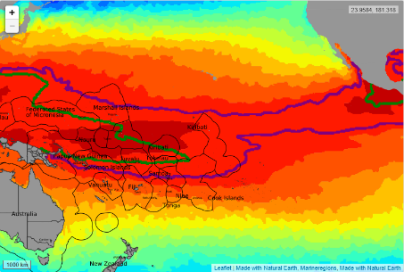
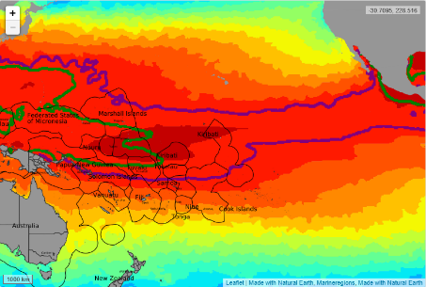
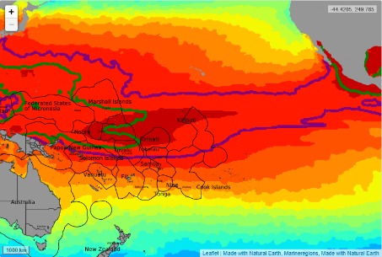
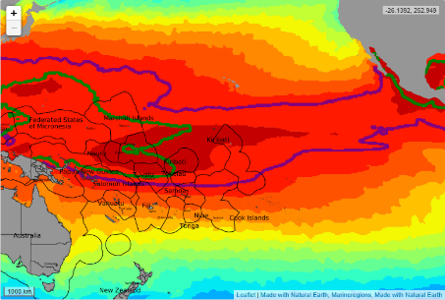
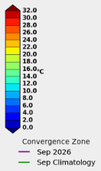
5. Fisheries Convergence Zone – Ocean Portal
The fisheries Convergence Zone is displaced from its climatological position, generally shifting eastward and slightly equatorward.
This shift is consistent across months.
Fisheries Convergence Zone
Source: https://legacy-oceanportal.spc.int/portal/ocean.html

Slide 13


Summary
SST: mostly above normal across the equatorial Pacific
SSH: Highs for Kiribati/Nauru; Lows for Micronesia and the southwestern Pacific.
MHW: Widespread moderate-to-strong intensity; eastward expansion through July
Coral Bleaching: Escalation to Alert Level 2 across the equatorial region (Nauru to Kiribati).
Fisheries: Eastward and equatorward shift of the convergence zone.

Slide 14
Thank You
downy@apcc21.org

