Slide 1
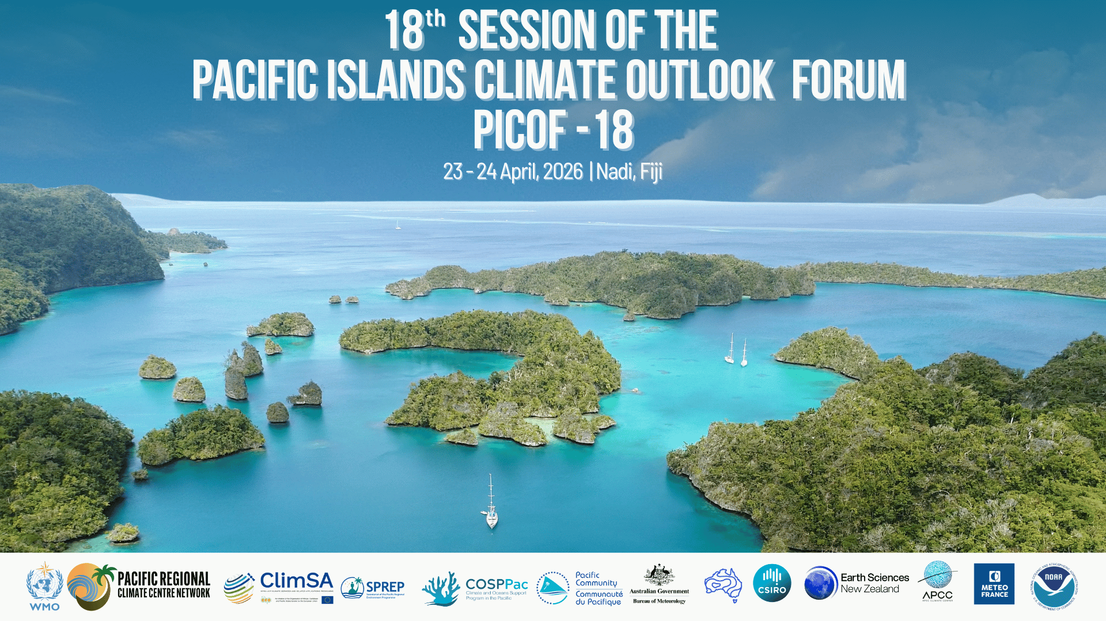

Slide 2
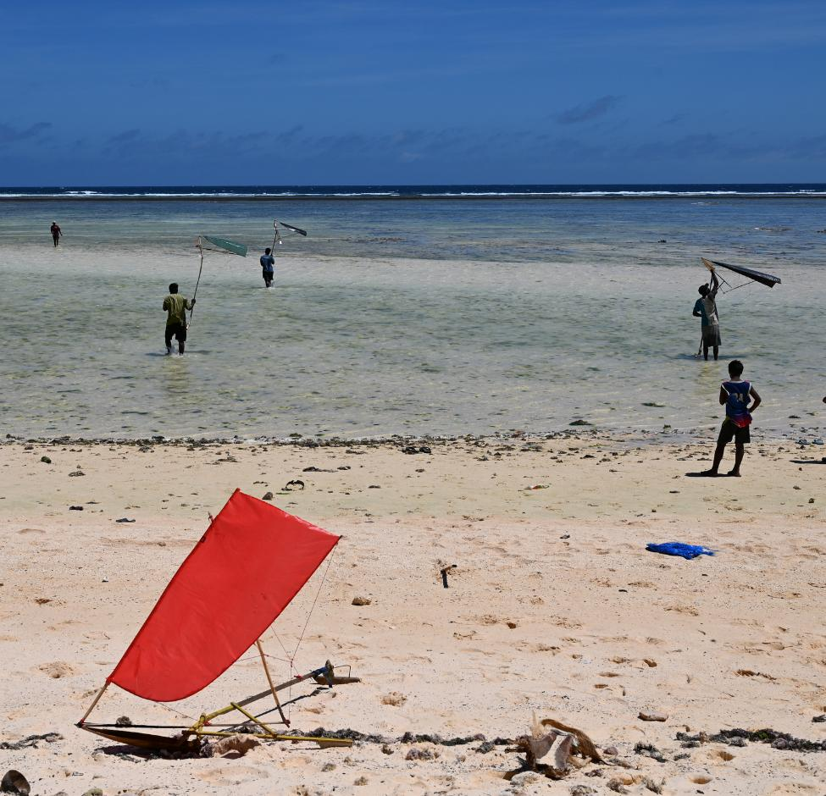
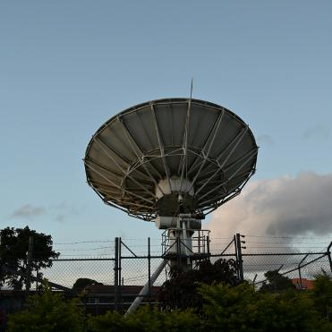

Session 3iii
Looking Forward:
Tropical
Cyclones
Presenter's Name: Landon Aydlett
Organization: NOAA

Slide 3
Outline
WFO Guam and NWS Pacific Region
Quick summary of the 2025 Western North Pacific (WNP)
ENSO & Typical TC Genesis Zones
2026 WNP Activity So Far
*Unofficial 2026 WNP Outlook
  *Official outlook set for around June 1 for the WNP

Slide 4
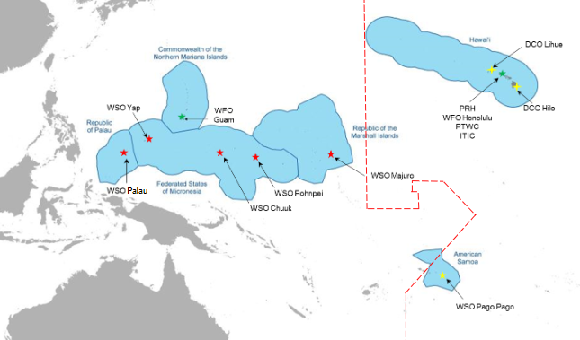
Map of the U.S. National Weather Service (NWS) Pacific Region and the Weather Forecast Office (WFO) Guam Area of Responsibility

Slide 5
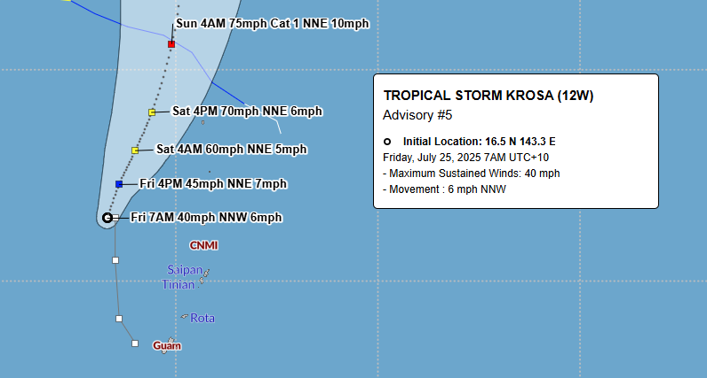
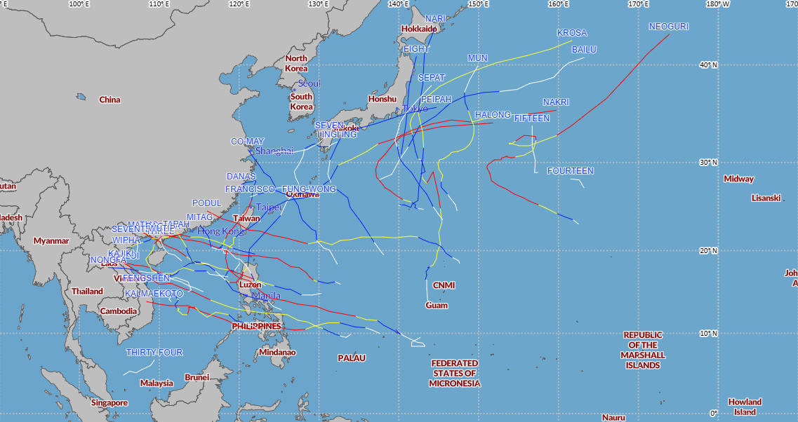
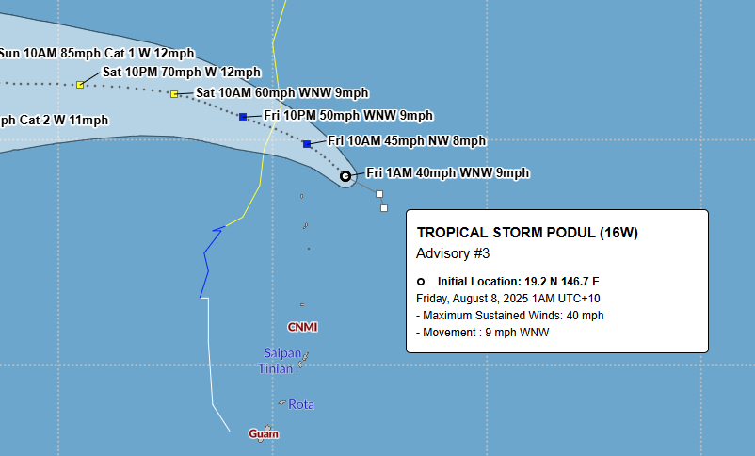
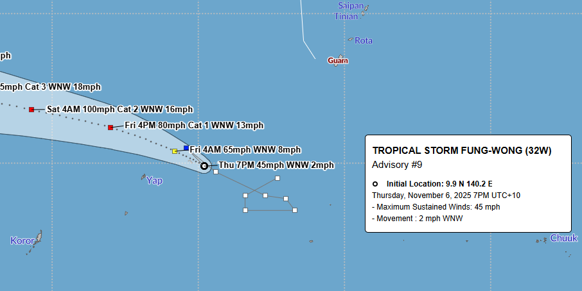
2025 Western North Pacific Tropical Cyclones
& Key Storm Threats to USAPI
(Weak La Nina)
Tropical Storm Krosa (12W)
July 2025
Tropical Storm Podul (164W)
August 2025
Tropical Storm Fung-Wong (32W)
November 2025

Slide 6
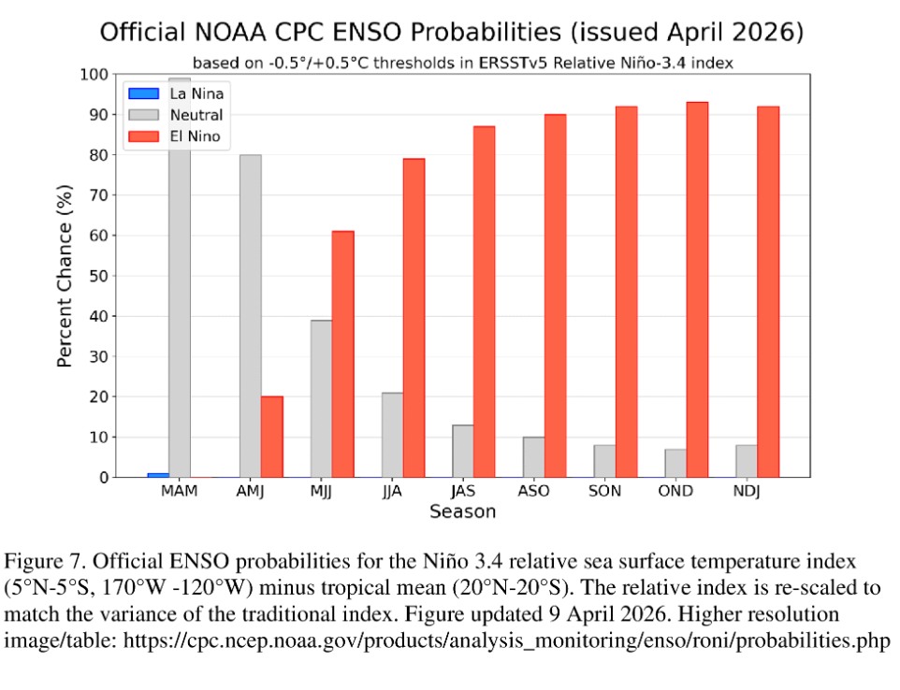
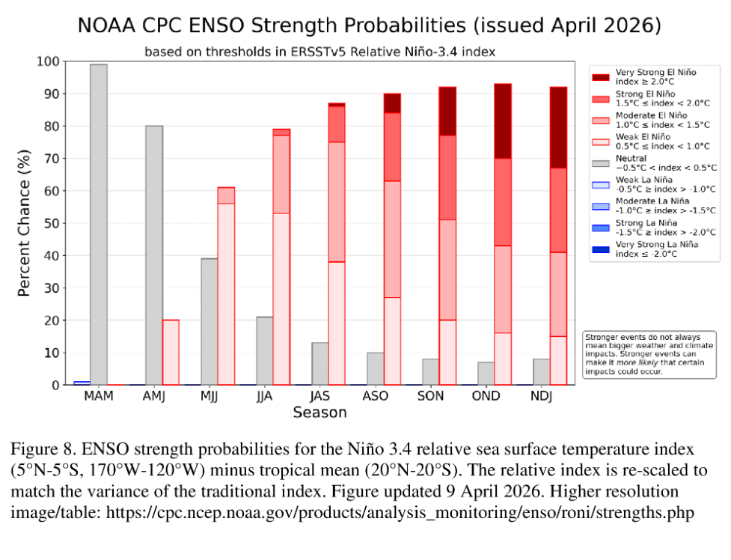
Current ENSO Status
Climate Prediction Center: Final La Nina Advisory / El Nino Watch
https://www.cpc.ncep.noaa.gov/products/analysis_monitoring/enso_advisory/ensodisc.shtml

Slide 7
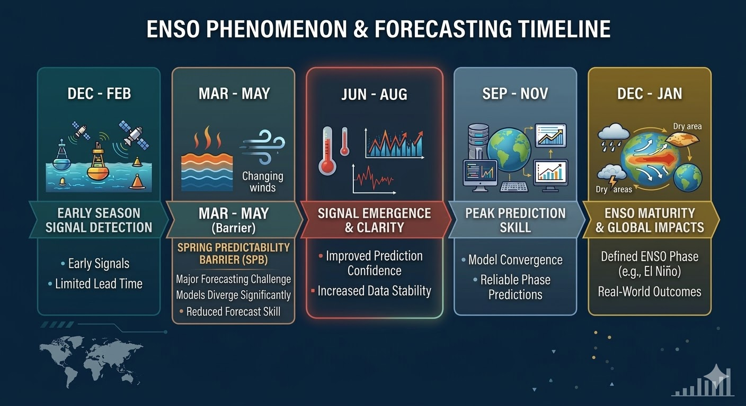

Slide 8
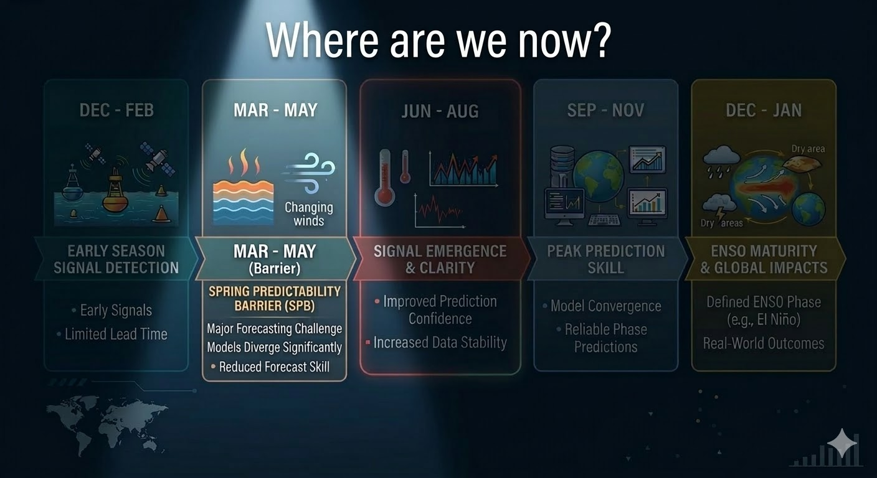
Spring Predictability Barrier

Slide 9

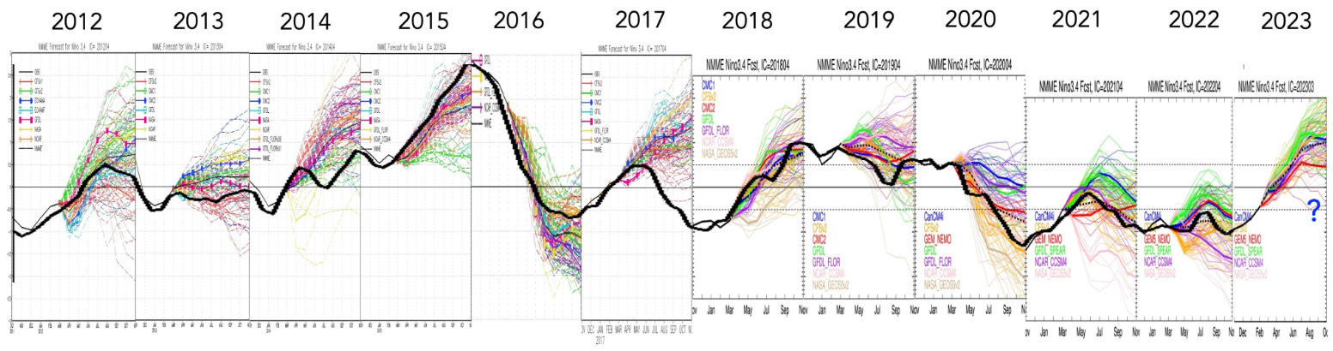
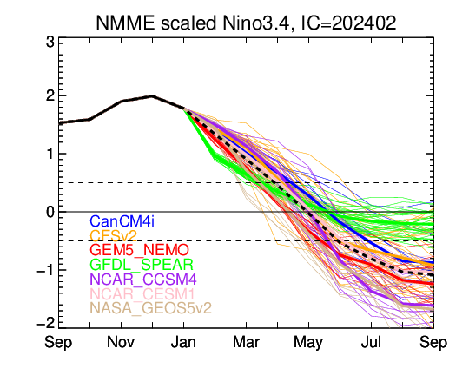
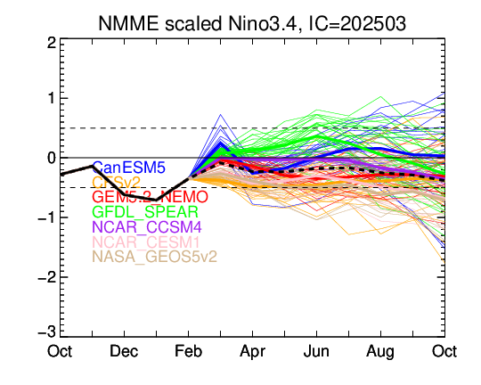
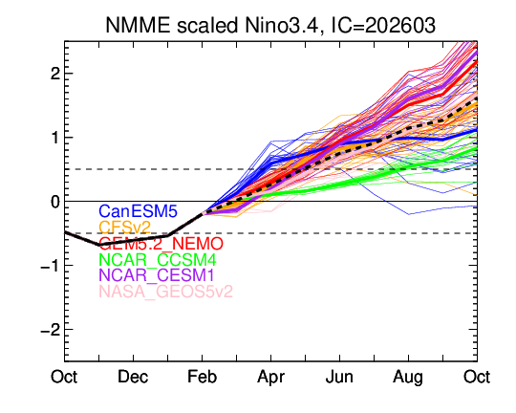
ENSO Outlook - The Famous Bust of 2014…!
?
Colored curves: Ensemble member predictions
Black curve: observed Nino3.4 value
2024 2025 2026
Image adapted from Ken Takahashi

Slide 10
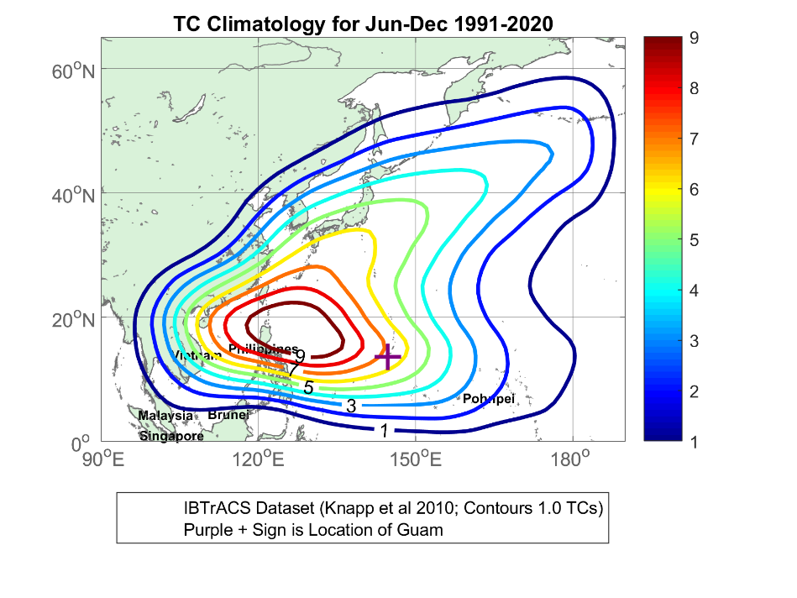
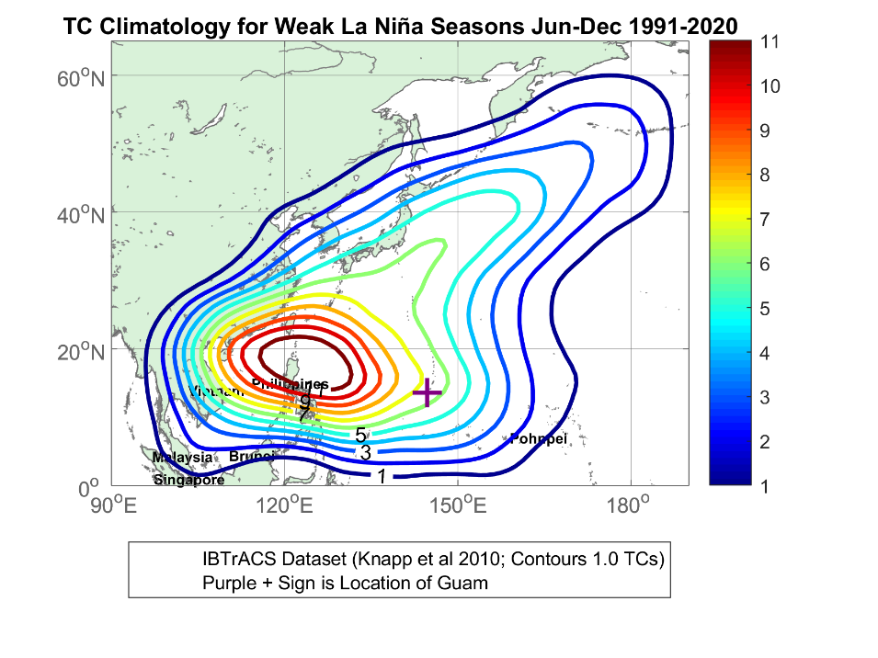
Map of the U.S. National Weather Service (NWS) Pacific Region and the Weather Forecast Office (WFO) Guam Area of Responsibility

Slide 11

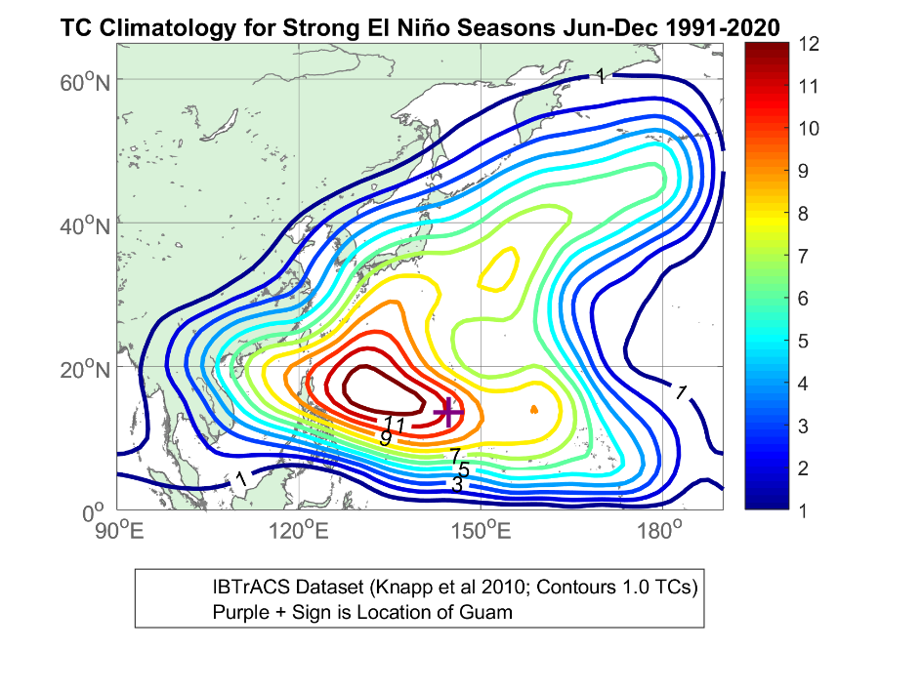

Slide 12
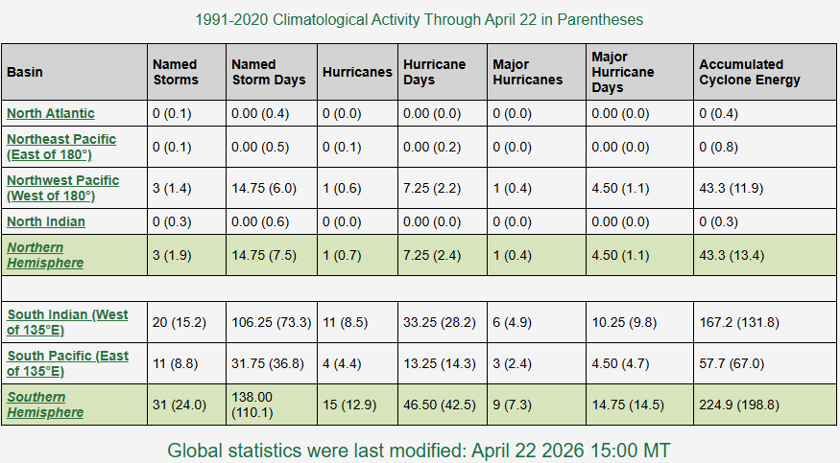
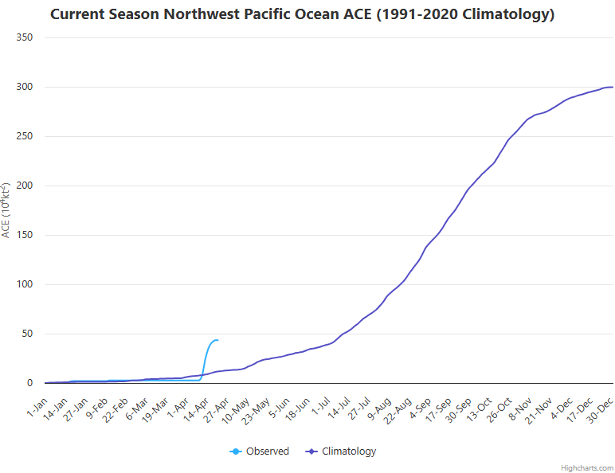
Where Are We Now?
2026 TC Activity So Far (1991-2020 Climatology in Parenthesis)
https://tropical.atmos.colostate.edu/Realtime/

Slide 13
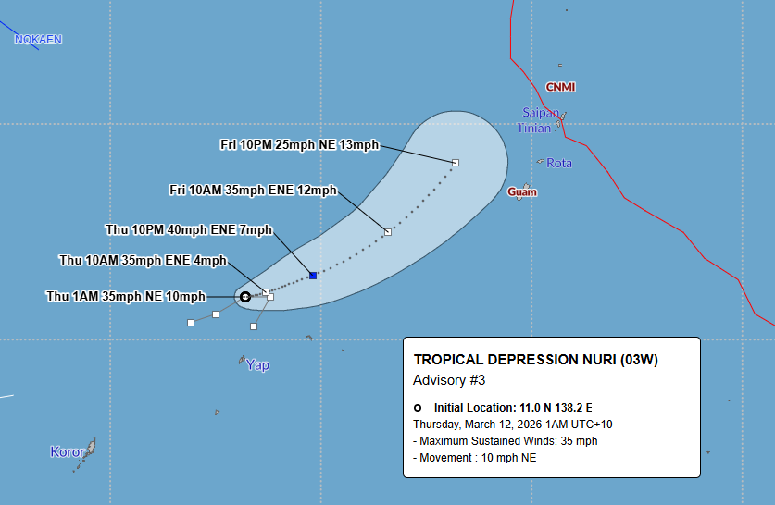
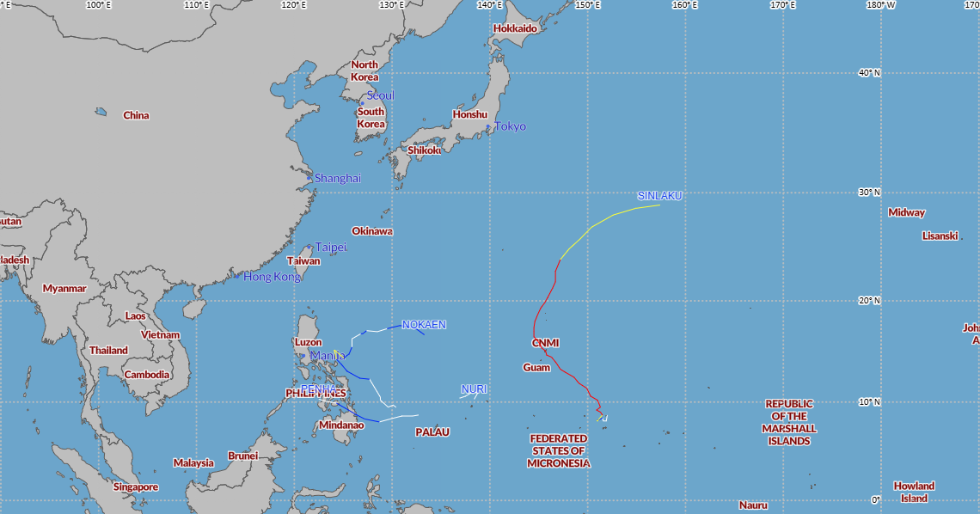
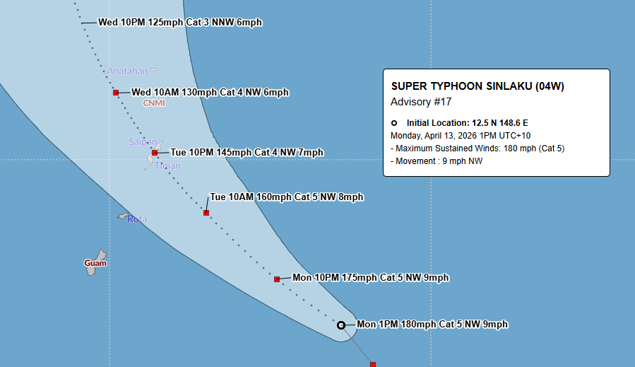
2026 Western North Pacific Tropical Cyclones
& Key Storm Threats to USAPI…So Far
Tropical Depression Nuri (03W)
March 2026
Super Typhoon Sinlaku (04W)
April 2026

Slide 14
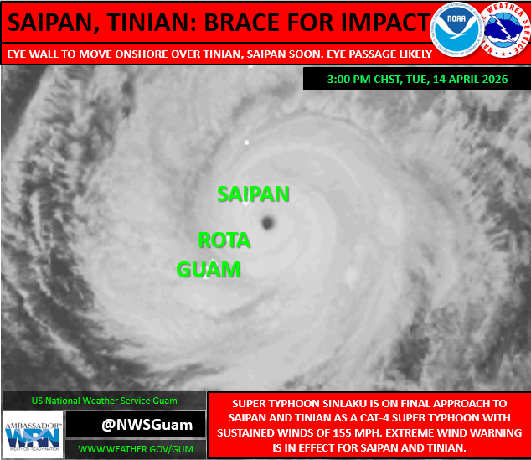
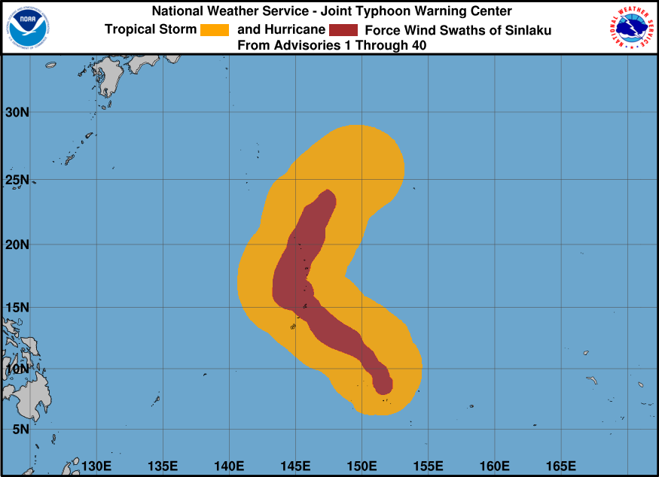
2026 Western North Pacific Tropical Cyclones
& Key Storm Threats to USAPI…So Far: Super Typhoon Sinlaku
Weather.gov/gum/cyclones
NWS Guam Facebook: @NWSGuam

Slide 15
Looking Ahead for the Rest of 2026
Most favored scenario…. El Nino, possibly a strong El Nino favored
***Caution: the ongoing spring predictability barrier.
WNP Basin (Micronesia)
Average to above average activity for the Marianas, central and eastern Micronesia
Overall eastward shift in TC genesis region
Below-normal activity for western Micronesia and Palau.

Slide 16
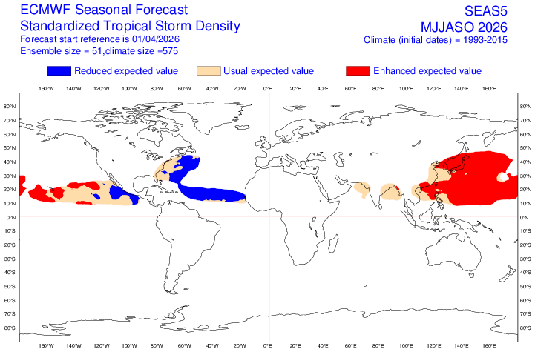
Looking Ahead for the Rest of 2026
https://charts.ecmwf.int/products/seasonal_system5_tstorm_density_standard?base_time=202604010000

Slide 17
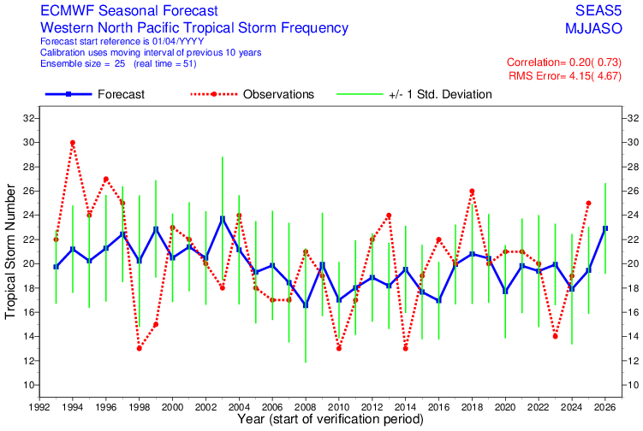
Looking Ahead for the Rest of 2026
https://charts.ecmwf.int/products/seasonal_system5_tstorm_verification?base_time=202604010000&zone=wnp

Slide 18
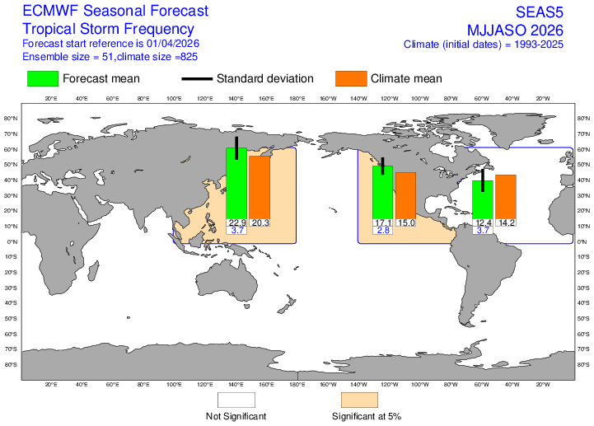
Looking Ahead for the Rest of 2026
https://charts.ecmwf.int/products/seasonal_system5_tstorm_frequency?base_time=202604010000

Slide 19
Summary
Tropical cyclone activity in the western North Pacific shows an early start with 4 tropical cyclones by April 21, 2026, one, of which, attained super typhoon status.
Each of the first 4 months of 2026 has had a tropical cyclone.
With a strong El Nino favored for 2026 following the ongoing transition from ENSO-neutral, overall tropical cyclone activity and genesis region is expected to shift eastward.
Above-normal tropical cyclone activity is anticipated for the western North Pacific through the end of 2026
Below-normal tropical cyclone activity is likely for far-western Micronesia and Palau
The official NOAA Western North Pacific Tropical Cyclone outlook will be released around June 1, 2026

Slide 20









Thank You
Marcus.aydlett@noaa.gov

