Slide 1


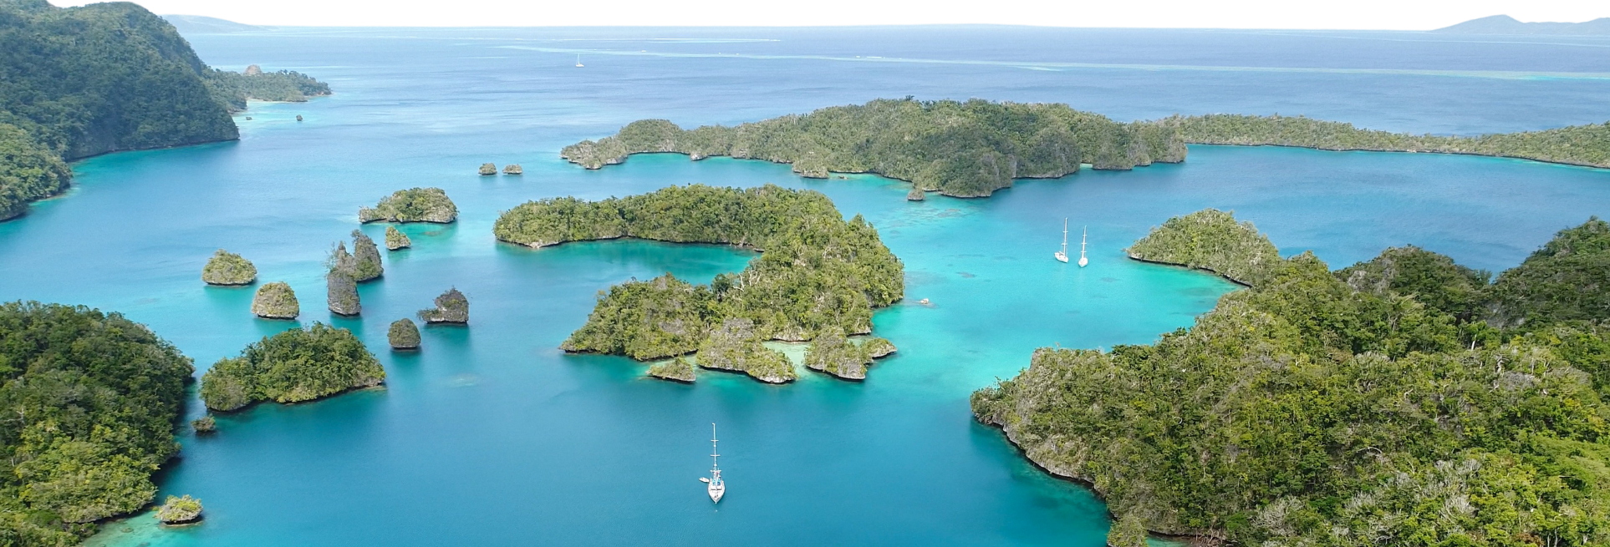










Slide 2
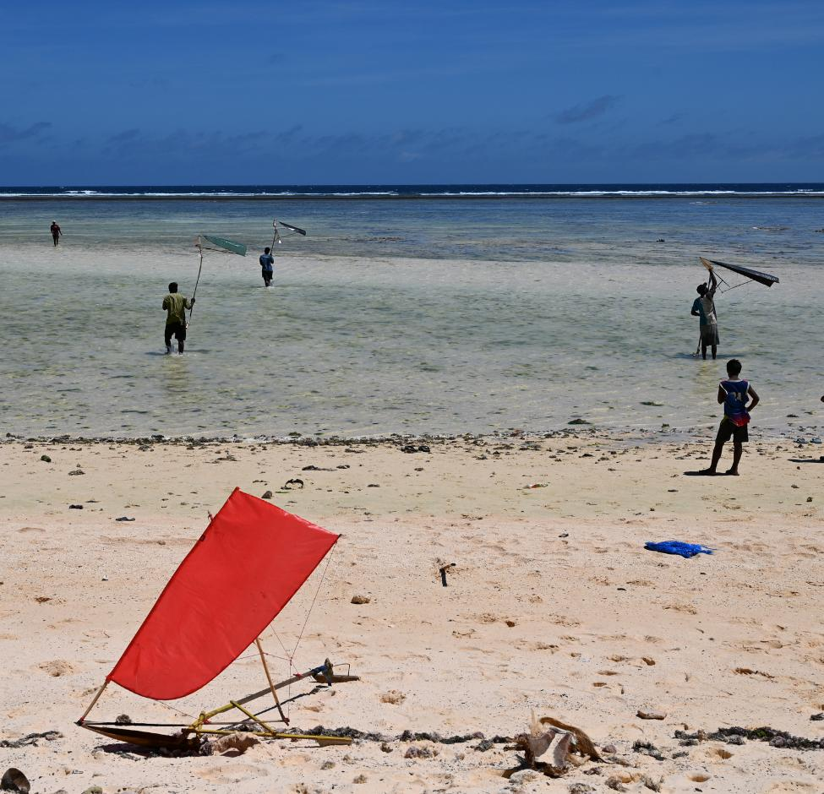
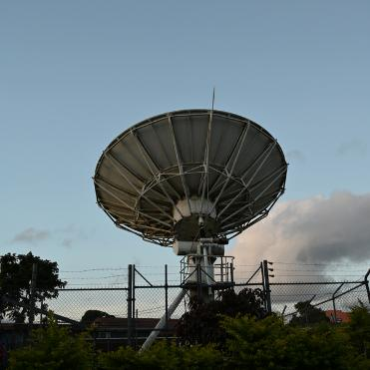

Session 3: Looking Forward – Monthly and Seasonal Outlooks for May to October 2026
3.1-Atmosphere
Presenter's Name: Philip Malsale
Organization: SPREP
Notes:
Good Afternoon/Morning from where you are joining across the Pacific and around the world. I will be presenting on session 3.i on looking forward on Atmosphere.
On the outset, I want to acknowledge our climate monitoring nodes for contributing to this presentation– BoM, ESNZ, APCC, NOAA, meteoFrance in providing support for this presentation.

Slide 3
.
Presentation Outline
  Precipitation Outlook
  ‘Air Temperature Outlook
  MSLP outlook
  Wind Forecast
  Velocity Potential
  Summary
Notes:
This presentation will focus mainly on the atmosphere variables providing precipitation, air temperature, Mean Sea Level Pressure, wind and velocity potential Outlook.
And a slide at the end on the summary that provide guidance to the regional statement to be issue by RCC and national statement from the NMHS

Slide 4
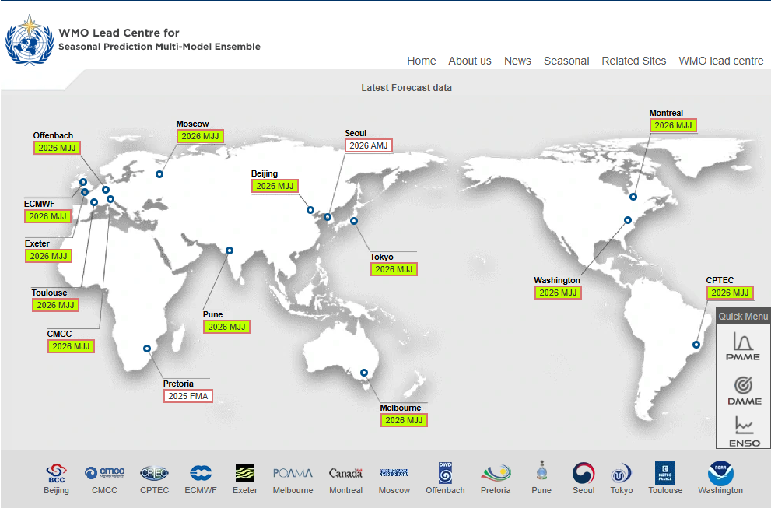
DELETE THIS BOX.
WMO Lead Centre for LRF MME
  WMO LC MME official outlooks for PICOF
  • WMO LC MME based on 13 GPC LRF models
  • Model skill varies significantly from model to model depending on a range of factors
Source:WMO SP MME
Notes:
The information use in this presentation will be based on the WMO lead centre for LRF MME.
WMO LC MME official outlooks for PICOF
• WMO LC MME based on 13 GPC LRF models
• Model skill varies significantly from model to model depending on a range of factors

Slide 5
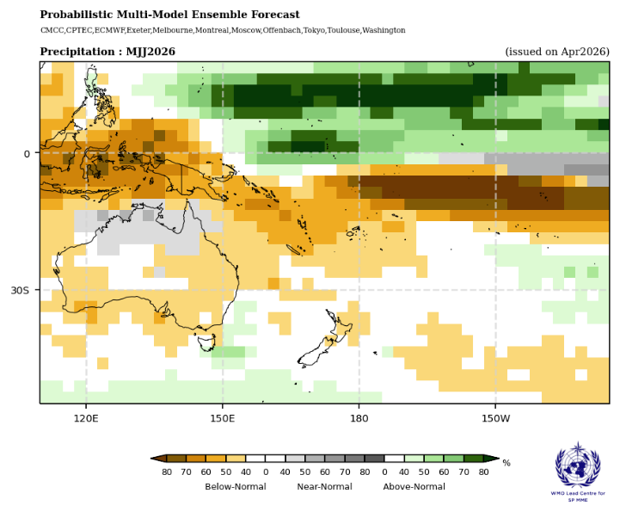
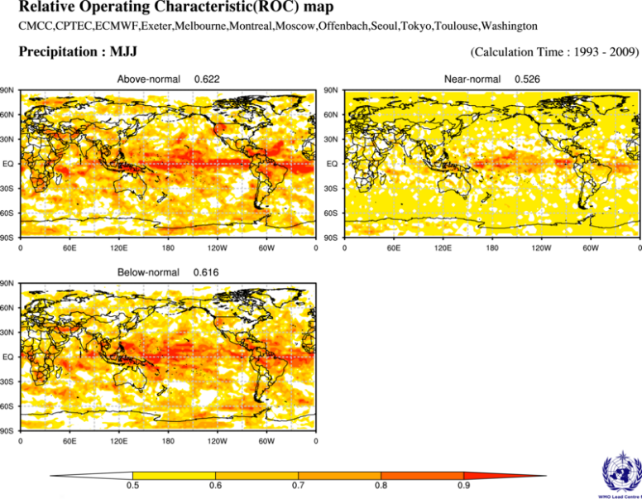
Precipitation forecast: May – July 2026
POOR
OK
GOOD
The rainfall outlook is being driven by a ENSO neutral phase in the Pacific, with a contribution from the current neutral Indian Ocean Dipole event.
Above normal rainfall is favoured for Guam , CNMI, FSM, RMI, Nauru, Gilbert and northern Line Islands (Kiribati), and southern French Polynesia. Near normal rainfall is favoured for most of the central Line Islands (Kiribati). Below normal rainfall is forecast for Palau, PNG, Solomon Islands, Vanuatu, New Caledonia, Fiji, Tonga, Tuvalu, Kiribati (southern Line Is.), Niue, Wallis and Futuna, Samoa, American Samoa, northern Cook Islands and northern French Polynesia.
Hindcast skill is good for PNG, Palau, northern FSM, RMI, southern Solomon Islands, New Caledonia, Vanuatu, Fiji, Kiribati, Tuvalu, Tokelau, American Samoa, Niue, northern Cook Is., and northern French Polynesia. Skill is considered acceptable for Guam, CNMI, most of Solomon Is., Tonga, Samoa,, and poor for the southern Cook Islands, and southern French Polynesia.
Source:WMO SP MME
Notes:
The rainfall outlook is being driven by a ENSO neutral phase in the Pacific, with a contribution from the current neutral Indian Ocean Dipole event.
Above normal rainfall is favoured for Guam , CNMI, FSM, RMI, Nauru, Gilbert and northern Line Islands (Kiribati), and southern French Polynesia. Near normal rainfall is favoured for most of the central Line Islands (Kiribati). Below normal rainfall is forecast for Palau, PNG, Solomon Islands, Vanuatu, New Caledonia, Fiji, Tonga, Tuvalu, Kiribati (southern Line Is.), Niue, Wallis and Futuna, Samoa, American Samoa, northern Cook Islands and northern French Polynesia.
Hindcast skill is good for PNG, Palau, northern FSM, RMI, southern Solomon Islands, New Caledonia, Vanuatu, Fiji, Kiribati, Tuvalu, Tokelau, American Samoa, Niue, northern Cook Is., and northern French Polynesia. Skill is considered acceptable for Guam, CNMI, most of Solomon Is., Tonga, Samoa,, and poor for the southern Cook Islands, and southern French Polynesia.

Slide 6
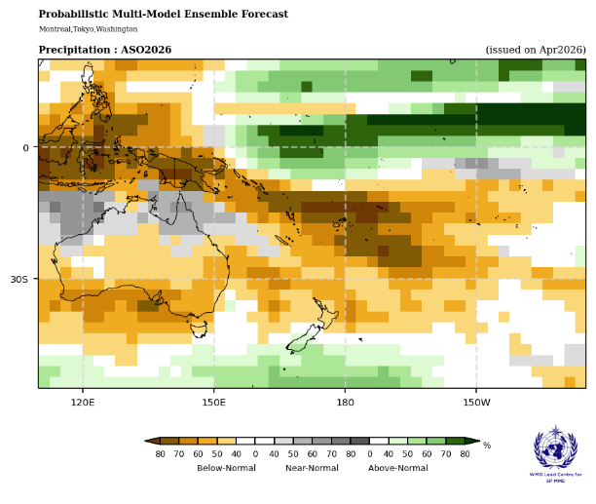
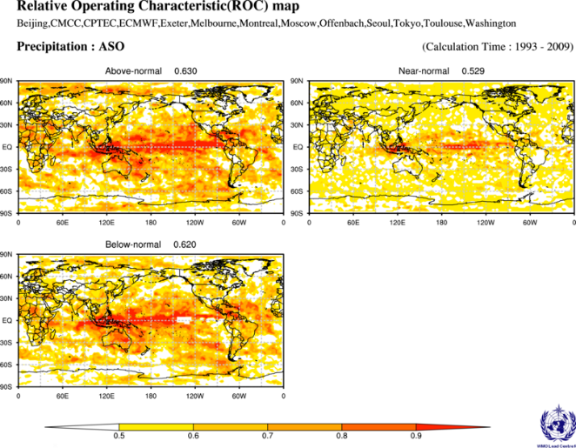
Precipitation forecast: August – October 2026
POOR
OK
GOOD
Tercile rainfall outlook for August – October 2026 continues with the same pattern as the previous outlook. The strength of the probabilities are generally reduced for as would be expected with a longer lead time forecast.
Below normal rainfall is forecast over Palau, CNMI, Central RMI, PNG, Solomon Is., New Caledonia, Vanuatu, Fiji, Tonga, Niue, Wallis and Futuna, Samoa, American Samoa, Kiribati (southern Line Is.), Tokelau, Cook Islands, and northern French Polynesia. Above normal rainfall is forecast for eastern FSM, northern and southern RMI, Nauru, Kiribati (Gilbert, and northern Line Is.), and Tuvalu. Near normal rainfall is predicted for part of the central Line Islands (Kiribati), elsewhere there is no clear guidance.
Hindcast skill is good for Palau, northern FSM, RMI, Nauru, Kiribati, Tuvalu, PNG mainland, New Caledonia, Vanuatu, southern Fiji, Tokelau, northern Cook Islands, and northern French Polynesia. Skill is acceptable for CNMI, southern FSM, PNG Is., Solomon Islands, Tonga, Niue, southern Cook Islands, French Polynesia, and Pitcairn Islands. Skill is considered poor over central FSM, northern Fiji, Samoa, and central French Polynesia.
Source:WMO SP MME
Notes:
Tercile rainfall outlook for August – October 2026 continues with the same pattern as the previous outlook. The strength of the probabilities are generally reduced for as would be expected with a longer lead time forecast.
Below normal rainfall is forecast over Palau, CNMI, Central RMI, PNG, Solomon Is., New Caledonia, Vanuatu, Fiji, Tonga, Niue, Wallis and Futuna, Samoa, American Samoa, Kiribati (southern Line Is.), Tokelau, Cook Islands, and northern French Polynesia. Above normal rainfall is forecast for eastern FSM, northern and southern RMI, Nauru, Kiribati (Gilber, and northern Line Is.), Tuvalu. Near normal rainfall is predicted for part of the central Line Islands (Kiribati), elsewhere there is no clear guidance.
Hindcast skill is good for Palau, northern FSM, RMI, Nauru, Kiribati, Tuvalu, PNG mainland, New Caledonia, Vanuatu, southern Fiji, Tokelau, northern Cook Islands, and northern French Polynesia. Skill is acceptable for CNMI, southern FSM, PNG Is., Solomon Islands, Tonga, Niue, southern Cook Islands, French Polynesia, and Pitcairn Islands. Skill is considered poor over central FSM, northern Fiji, Samoa, and central French Polynesia.

Slide 7
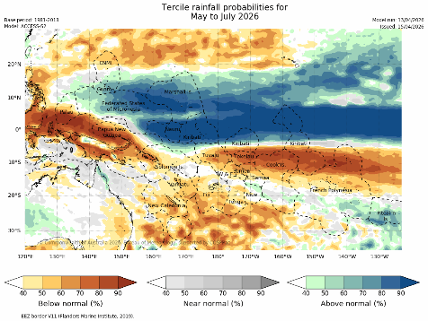
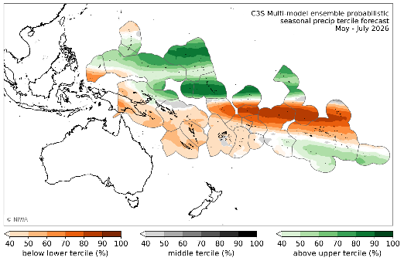
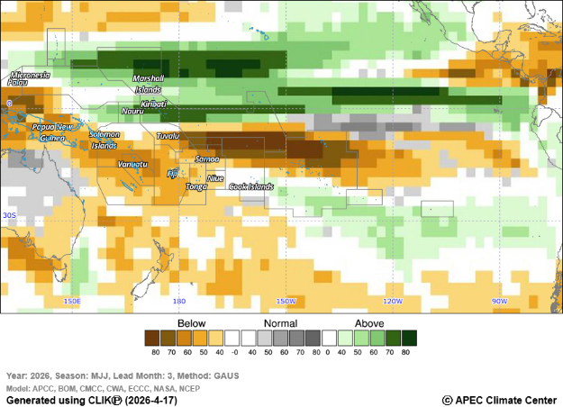
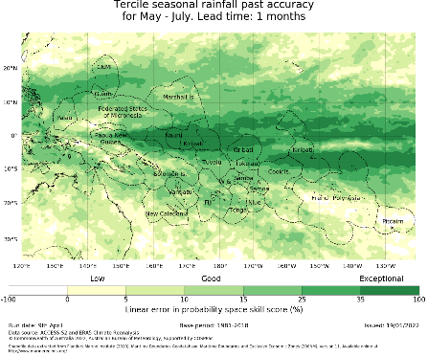
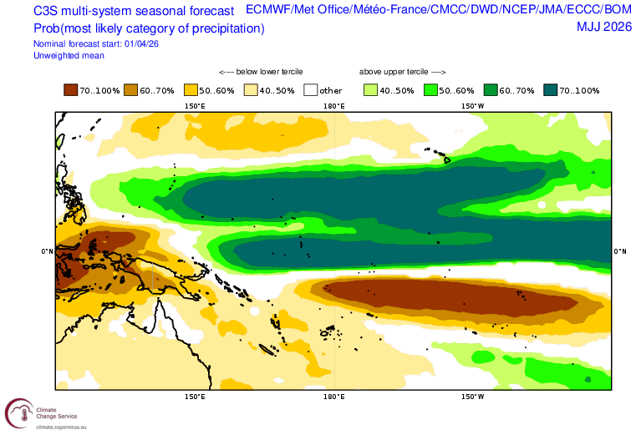
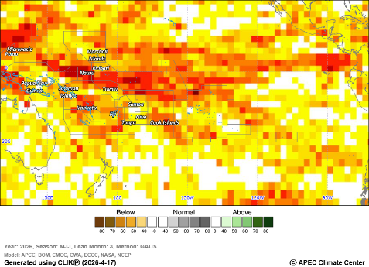









DELETE THIS BOX.
Node lead precipitation forecasts: May – July 2026
ACCESS-S2
CLIKP
C3S
130°E
140°E
160°E
170°E
170°W
160°W
140°W
130°W
20°N
20°N
10°N
10°N
10°S
10°S
20°S
20°S
130°E
140°E
160°E
170°E
170°W
160°W
140°W
130°W
Source:
http://clikp.sprep.org/
https://niwa.co.nz/climate-and-weather/island-climate-update
https://access-s.clide.cloud/
Notes:
ACCESS-S2, CLIKP and C3S are forecasts for MJJ. All models show a similar tercile distribution for the Pacific for May-July, with strong probabilities for above normal rainfall covering Guam, southern CNMI, FSM, RMI, Nauru and most of Kiribati (excluding far southern Phoenix and Line Islands). There is also a strong forecast for below normal rainfall for southern Palau, PNG, Solomon Is., and for Tuvalu eastwards to northern French Polynesia, weaker scattered probabilities for below normal rainfall are forecast south of the typical movement of the SPCZ over New Caledonia, through to Niue, with no strong probabilities present for the southern Cook Islands and the southern half of French Polynesia.
CLIKP MME:
http://clikp.sprep.org/
ACCESS-S:
C3S:
https://climate.copernicus.eu/charts/packages/c3s_seasonal/products/c3s_seasonal_spatial_mm_rain_3m?area=area31&base_time=202509010000&type=tsum&valid_time=202510010000

Slide 8
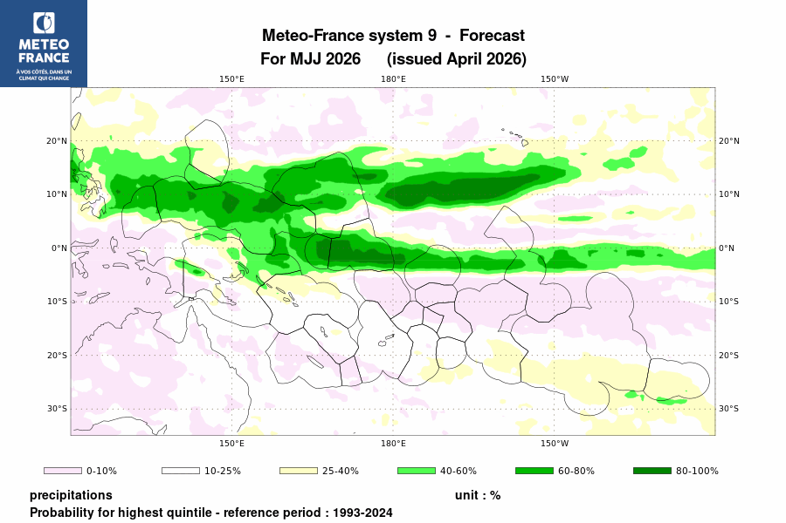
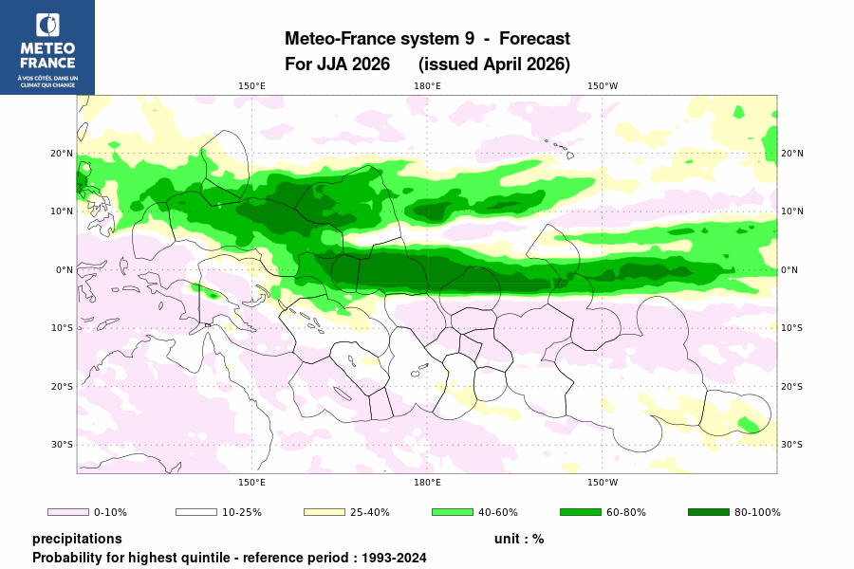
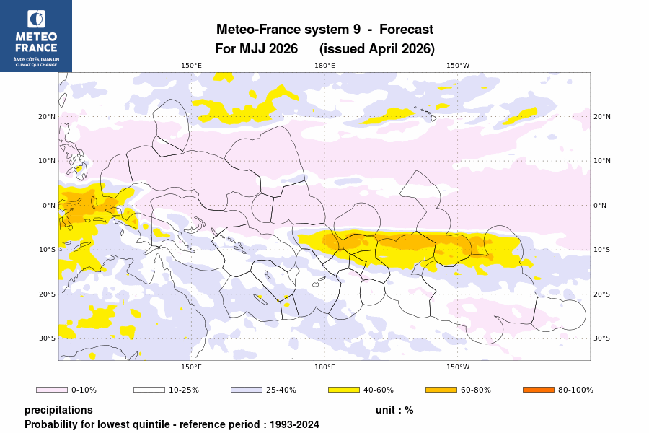
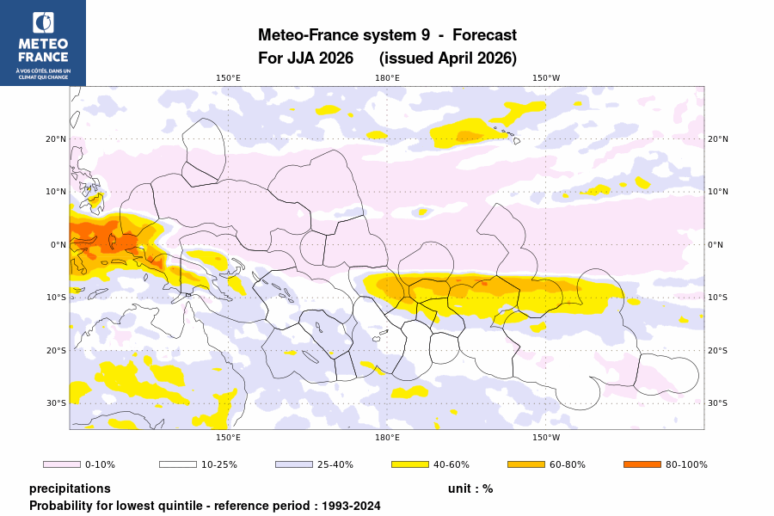
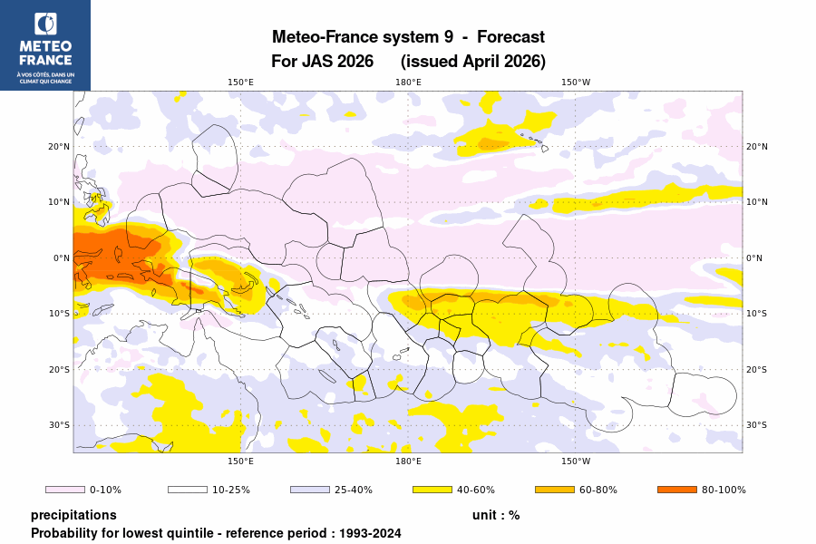
Node lead precipitation forecasts: May – August 2026
The pattern of above-normal rainfall is more limited in scope. It affects islands near the equator (<5°) as well as the northern tropical Pacific. Rainfall is expected to be below average across a band stretching from Tuvalu to the Marquesas Islands on either side of 10°S. This is also the most likely scenario for New Caledonia, Wallis, Samoa, American Samoa and parts of French Polynesia although there is greater uncertainty.
Source: http://seasonal.meteo.fr/node/177?language=en
Notes:
Summary : Temperatures are expected to be well above normal in the entirenorthern tropical Pacific.
Further south, this region extends as far as the Solomon Islands to the east and includes roughly all the islands of the South Pacific up to 10–15°S The most likely scenario for New Caledonia, Vanuatu, Papua New Guinea and parts French Polynesia is that temperatures will be close to normals on average.
The pattern of above-normal rainfall is more limited in scope. It affects islands near the equator (<5°) as well as the northern tropical Pacific. Rainfall is expected to be below average across a band stretching from Tuvalu to the Marquesas Islands on either side of 10°S. This is also the most likely scenario for New Caledonia, Wallis, Samoa, American Samoa and parts of French Polynesia although there is greater uncertainty.
Above normal rainfall covering Guam, southern CNMI, FSM, RMI, Nauru and most of Kiribati (excluding far southern Phoenix and Line Islands). There is also a strong forecast for below normal rainfall for southern Palau, PNG, Solomon Is., and for Tuvalu eastwards to northern French Polynesia, weaker scattered probabilities for below normal rainfall are forecast south of the typical movement of the SPCZ over New Caledonia, through to Niue, with no strong probabilities present for the southern Cook Islands and the southern half of French Polynesia

Slide 9
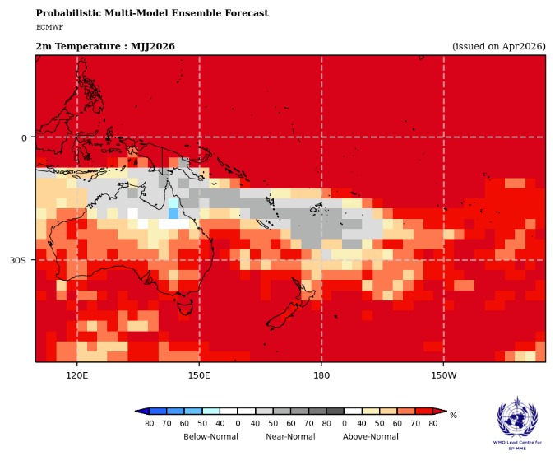
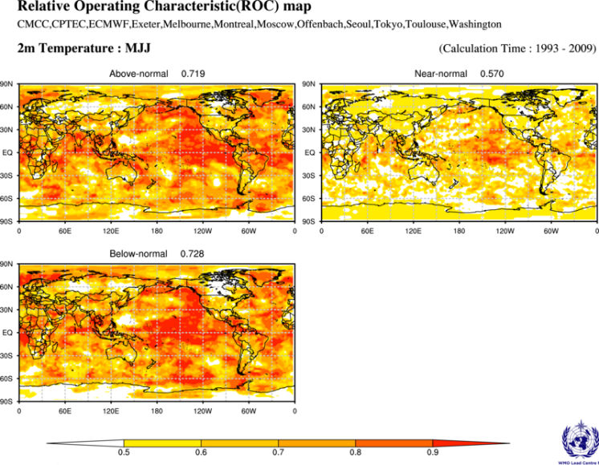
Air Temperature: May – July 2026
POOR
OK
GOOD
Tercile air temperature outlook for May – July 2026 has a similar pattern as the underlying sea surface temperatures.
Near normal air temperatures are forecast for eastern PNG mainland, New Caledonia, Vanuatu, Fiji, Tonga, and Niue. Above normal temperatures are forecast for Palau, Guam, CNMI, FSM, RMI islands, most of PNG, Solomon Islands, Nauru, Kiribati, Tuvalu, Tokelau, Wallis and Futuna, Samoa, American Samoa, Cook Is., French Polynesia, and Pitcairn Islands.
Hindcast skill is good over Solomon Is., New Caledonia, Vanuatu, northern FSM, central RMI, Kiribati, Tuvalu, Fiji (Rotuma), northern Cook Islands, northern and southern French Polynesia. Skill is considered acceptable over Palau, most of FSM and most of RMI, PNG, most of Fiji, northern Tonga, Wallis and Futuna, Samoa, American Samoa, Niue, the southern Cook Islands. Hindcast skill is considered poor over Guam, CNMI, eastern Fiji, and southern Tonga.
Source:WMO SP MME
Notes:
Tercile air temperature outlook for May – July 2026 has a similar pattern pattern as the underlying sea surface temperatures.
Near normal air temperatures are forecast for eastern PNG mainland, New Caledonia, Vanuatu, Fiji, Tonga, and Niue. Above normal temperatures are forecast for Palau, Guam, CNMI, FSM, RMI islands, most of PNG, Solomon Islands, Nauru, Kiribati, Tuvalu, Tokelau, Wallis and Futuna, Samoa, American Samoa, Cook Is., French Polynesia, and Pitcairn Islands.

Slide 10
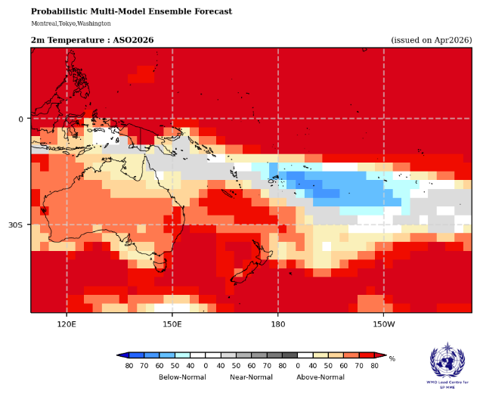
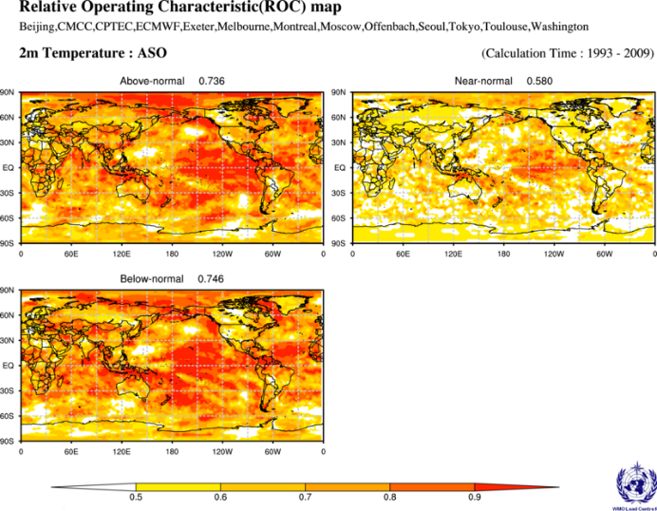
Air Temperature: August – October 2026
POOR
OK
GOOD
Tercile air temperature outlook for August – October 2026 has a similar pattern to the previous season with the inclusion of the cool anomalies being forecast along the subtropical Pacific over most of Fiji, Tonga, Wallis and Futuna, Samoa, American Samoa, Niue, central Cook Islands, and western French Polynesia.
Near normal air temperatures are forecast for eastern PNG , southern Solomon Is., northern Vanuatu, southern Fiji, southern Tonga, eastern French Polynesia., and Pitcairn Islands Above normal temperatures are forecast for Palau, Guam, CNMI, FSM, RMI, most of PNG, Nauru, Kiribati. most of Solomon Islands, New Caledonia, southern Vanuatu, Tuvalu, Tokelau, , the northern Cook Islands, and northern French Polynesia.
Hindcast skill is considered good over Vanuatu, Fiji, Tonga, Niue, Kiribati (Line Is),Tokelau, norther Cook Islands. Northern and southern French Polynesia Skill is considered acceptable over most of RMI, PNG, Solomon Islands, New Caledonia,, Samoa, central Cook Islands, central French Polynesia, and Pitcairn Islands.
Source:WMO SP MME
Notes:
Tercile air temperature outlook for August – October 2026 has a similar pattern to the previous season with the inclusion of the cool anomalies being forecast along the subtropical Pacific over Fiji, Tonga, Wallis and Futuna, Samoa, American Samoa, Niue, central Cook Islands, and western French Polynesia.
Near normal air temperatures are forecast for eastern PNG , southern Solomon Is., northern Vanuatu, southern Fiji, southern Tonga, eastern French Polynesia., and Pitcairn Islands Above normal temperatures are forecast for Palau, Guam, CNMI, FSM, RMI, most of PNG, Nauru, Kiribati. most of Solomon Islands, New Caledonia, southern Vanuatu, Tuvalu, Tokelau, , the northern Cook Islands, and northern French Polynesia.
Hindcast skill is considered good over Vanuatu, Fiji, Tonga, Niue, Kiribati (Line Is),Tokelau, norther Cook Islands. Northern and southern French Polynesia Skill is considered acceptable over most of RMI, PNG, Solomon Islands, New Caledonia,, Samoa, central Cook Islands, central French Polynesia, and Pitcairn Islands.

Slide 11
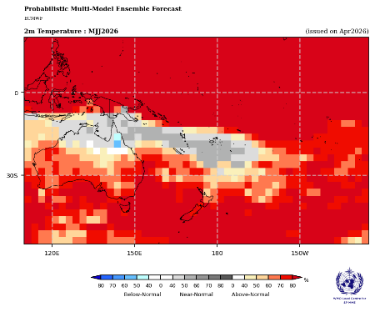
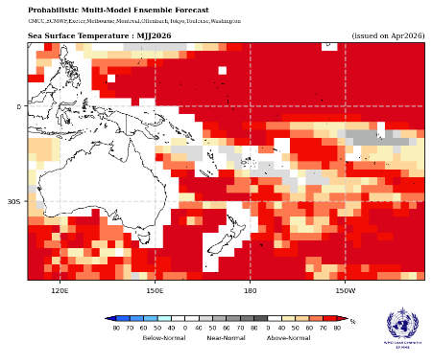
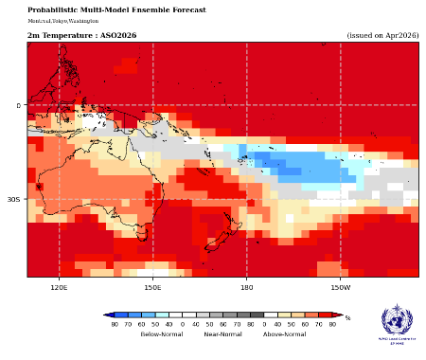
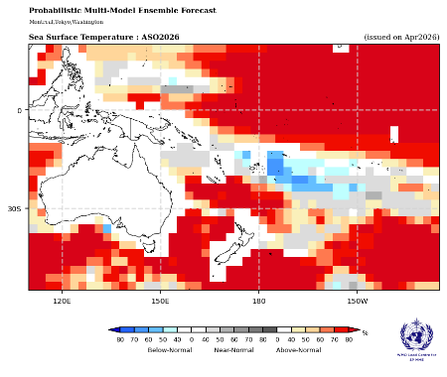
Air Temperature and Sea Surface Temperature
May – July 2026
August – October 2026
Source:WMO SP MME
Notes:
The air and sea surface temperature shows a similar patterns across the south Pacific moving towards October 2026

Slide 12
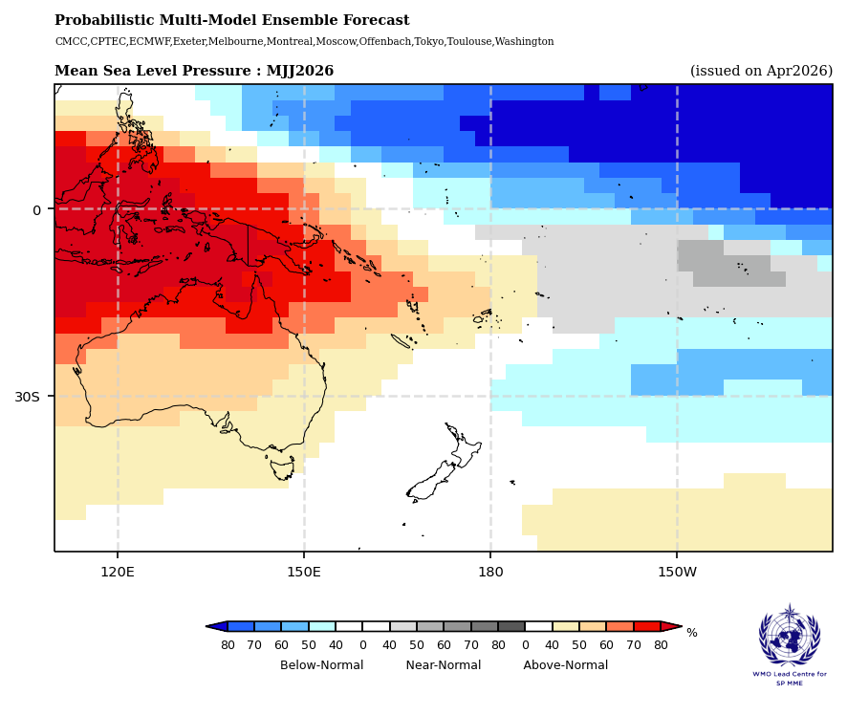
Forecast Mean Sea Level Pressure: May – July 2026
  Above normal (red) mean sea level pressure (MSLP) anomalies (higher pressure; stable weather) are favoured over Palau, PNG, southern FSM, Solomon Islands, Vanuatu, New Caledonia, Fiji, northern Tonga, and Wallis and Futuna.
  Below normal (lower pressure; blue) MSLP is favoured over CNMI, northern FSM, RMI, Kiribati (Gilbert and northern Line Is.) , southern Cook Islands, southern French Polynesia, and Pitcairn Islands associated with converging winds and increased cloudiness.
Source:https://www.wmolc.org/seasonPmmeUI/view?winName=PlotView1776814669036
Notes:
Above normal (red) mean sea level pressure (MSLP) anomalies (higher pressure; stable weather) are favoured over Palau, PNG, southern FSM, Solomon Islands, Vanuatu, New Caledonia, Fiji, northern Tonga, and Wallis and Futuna.
Below normal (lower pressure; blue) MSLP is favoured over CNMI, northern FSM, RMI, Kiribati (Gilbert and northern Line Is.) , southern Cook Islands, southern French Polynesia, and Pitcairn Islands associated with converging winds and increased cloudiness.

Slide 13
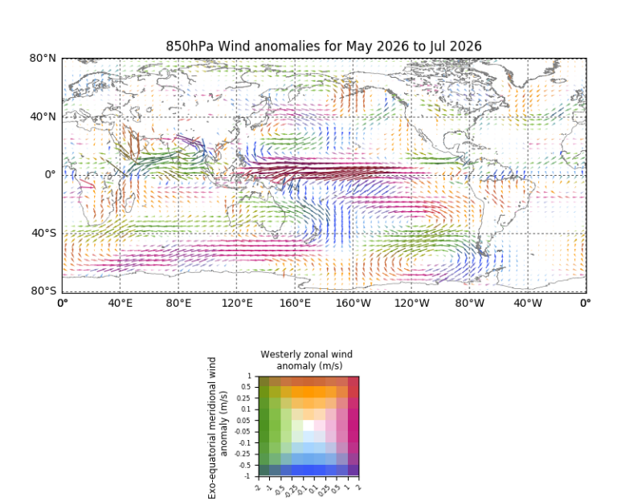
Forecast wind anomalies: May– July 2026
The forecast 850hPa wind anomalies for May to July support a developing El Nino in the atmosphere with weakened or reversed winds along the equator .
In the South Pacific off-equatorial regions the forecast is showing blue arrows pointing in a northerly direction bring less-moist air from the subtropical regions further north and contributing to the forecast reduced rainfall for the countries impacted.
North of the equator in the off-equatorial region east there's a region of orange/green lines indicating winds from further northwards are forecasted to bring drier air southwards into the region to the north of FSM and RMI. The winds over Guam, FSM, and RMI are located in the broad region of easterly wind anomalies (pink arrows) carrying warm, moist air along the equator.
Source:BOM
Notes:
The forecast 850hPa wind anomalies for May to July support a developing El Nino in the atmosphere with weakened or reversed winds along the equator being forecast in the pink shading. In the South Pacific off-equatorial regions the forecast is showing blue arrows pointing in a northerly direction bring less-moist air from the subtropical regions further north and contributing to the forecast reduced rainfall for the countries impacted.
North of the equator in the off-equatorial region centred on around 160degrees east there's a region of orange/green lines indicating winds from further northwards are forecasted to bring drier air southwards into the region to the north of FSM and RMI. The winds over Guam, FSM, and RMI are located in the broad region of easterly wind anomalies (pink arrows) carrying warm, moist air along the equator.

Slide 14
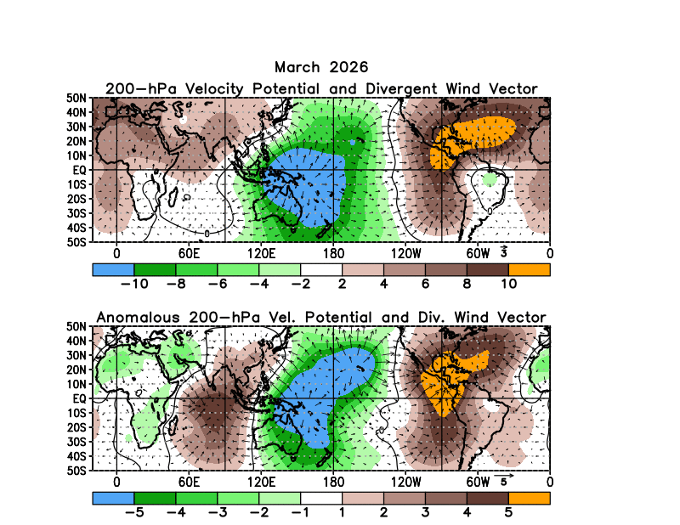
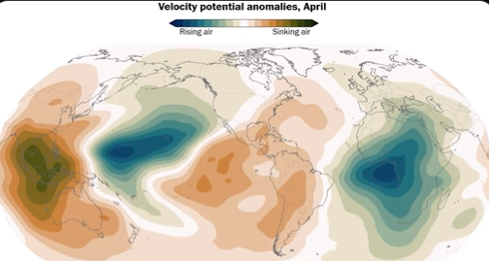
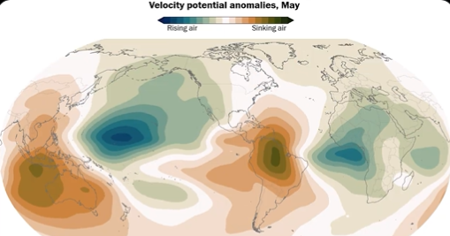
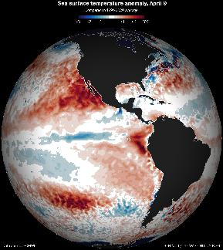
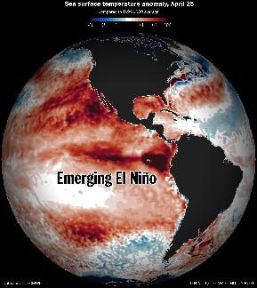
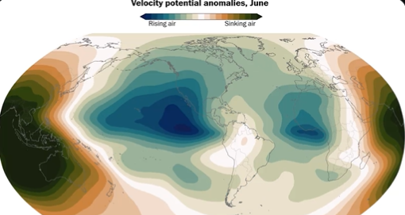
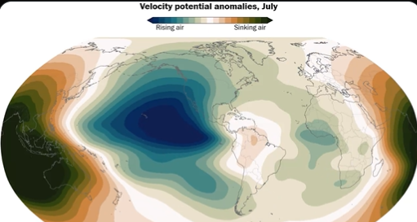
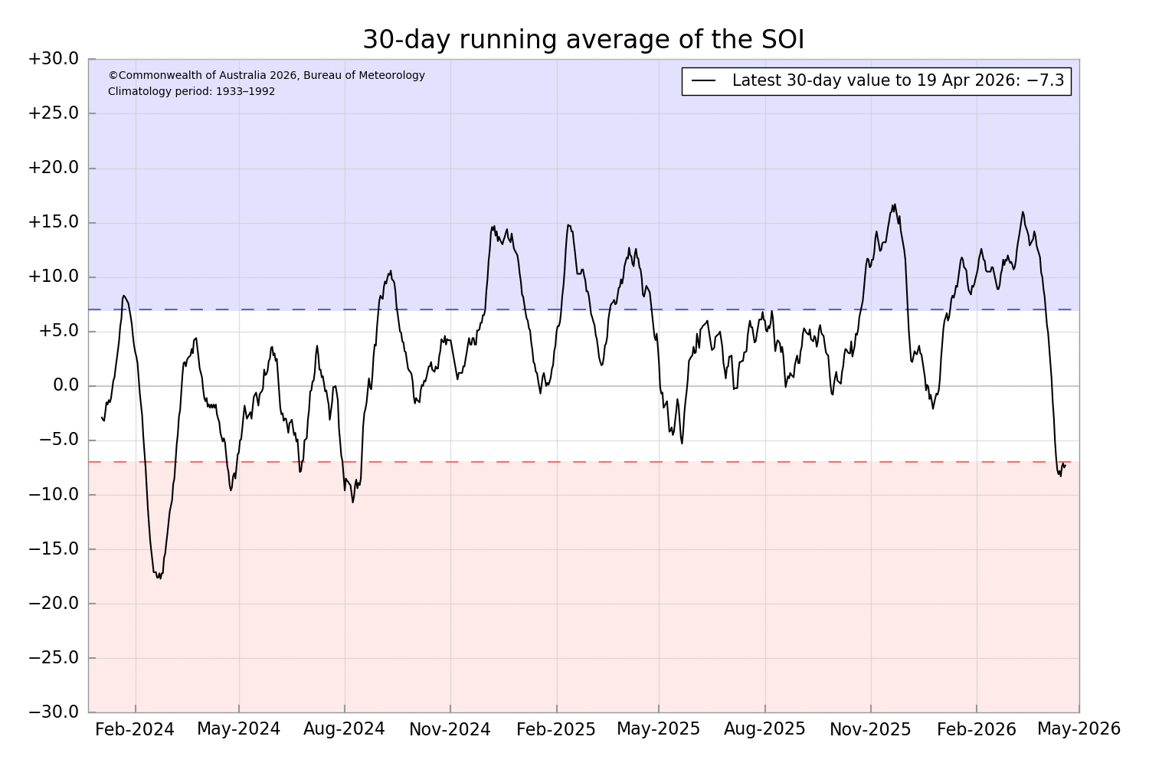
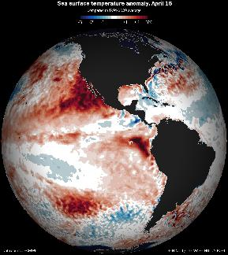
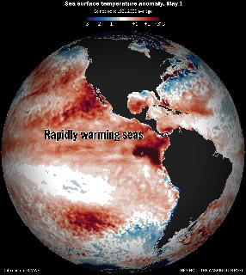
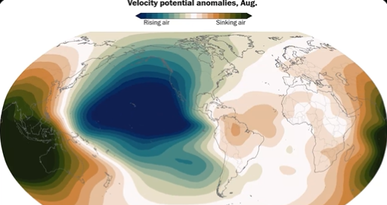
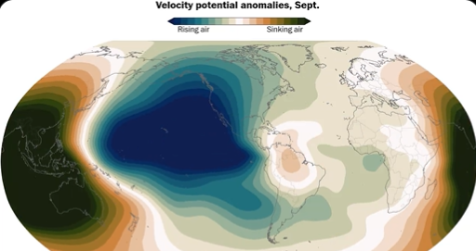
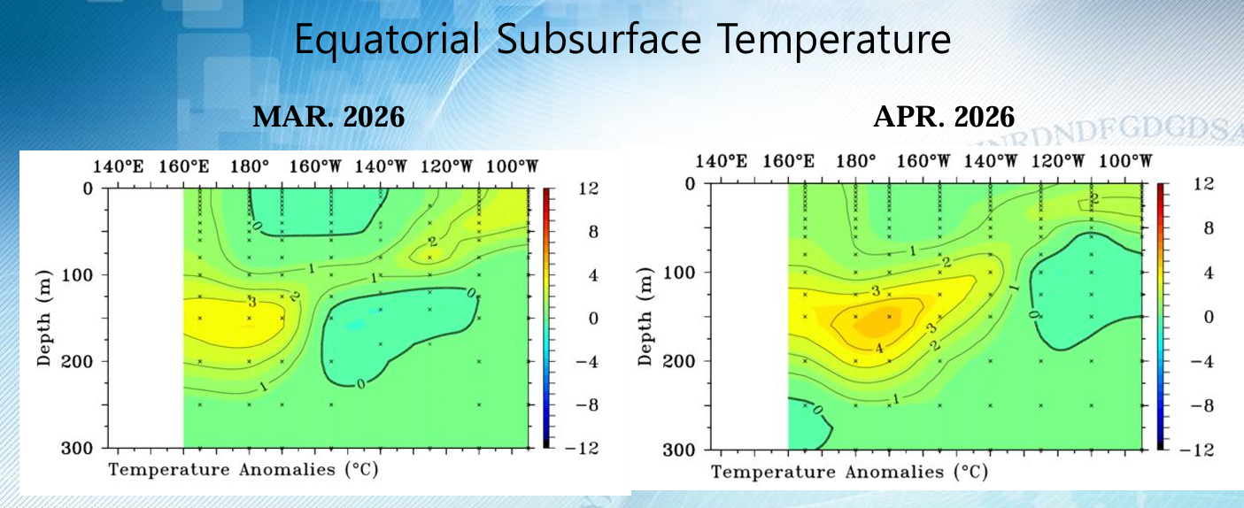
Velocity potential forecast: April – September 2026
Source:https://www.cpc.ncep.noaa.gov/products/CDB/Tropics/figt24.shtml
Notes:
When it comes to El Niño, atmospheric changes matter just as much as changes in sea temperatures. As you may have notice rapid development in the sub- surface temperature and so the atmosphere where the SOI value for the last 30 days since 19 April is -7.3 – a big drop from 11.6 on 1st of March.

Slide 15
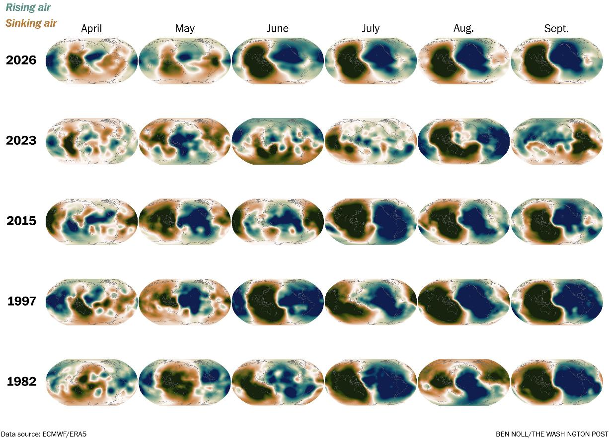
Velocity potential comparing past El Nino events
Source: Ben Noll - https://x.com/BenNollWeather/status/2041191703663583601?s=20
Notes:
That's because it's a coupled ocean-atmosphere phenomenon.
Looking at velocity potential, which marks areas of rising air (green) and sinking air (brown) in response to warming and cooling tropical seas, a strong atmospheric El Niño response is forecast this year starting in June.
That response is predicted to be quite similar to past big El Niño events, such as in 2015, 1997, and 1982.
However, the atmospheric response in 2026 is forecast to be much different — and much stronger — than in 2023.
These changes in the Walker Circulation arise from warm seas shifting from west to east across the tropical Pacific, which causes more thunderstorms in the east and fewer toward the west.
This ultimately has flow-on effects on weather patterns across the planet due to changes in jet streams, as those thunderstorms release heat into the atmosphere.
Its probably a bit early to try and pick a flavour of El Nino yet while things still develop. The forecasts or obs probably don't suggest a CP El Nino that I've seen yet but I'm not sure how well they are at forecasting this aspect especially given its still only April.

Slide 16
Summary
Add key points which will be included in the PICOF outcomes statement
Predictions of air temperature and rainfall for May to July and August to October 2026 seasons are typical of El Niño-like patterns when compared to observations of the same periods across past events.
The rainfall outlook over May to July 2026 favours above normal rainfall between Guam , CNMI, FSM, RMI, Nauru, Gilbert and northern Line Islands (Kiribati), and southern French Polynesia. Below normal rainfall is forecast over Palau, PNG, Solomon Islands, Vanuatu, New Caledonia, Fiji, Tonga, Tuvalu, Kiribati (southern Line Is.), Niue, Wallis and Futuna, Samoa, American Samoa, northern Cook Islands and northern French Polynesia. Confidence in this outlook highest along the equator and in the far western Pacific, although there is acceptable skill for most of the off-equatorial Pacific region.
The El Niño-like rainfall outlook pattern continues over August to October 2026, albeit with reduced confidence due to the longer lead time of the forecast period. Below normal rainfall is forecast to persist over Palau, CNMI, Central RMI, PNG, Solomon Is., New Caledonia, Vanuatu, Fiji, Tonga, Niue, Wallis and Futuna, Samoa, American Samoa, Kiribati (southern Line Is.), Tokelau, Cook Islands, and northern French Polynesia, with above normal rainfall forecast over eastern FSM, northern and southern RMI, Nauru, Kiribati (Gilber, and northern Line Is.), and Tuvalu.
Above normal air temperatures are favoured across the Pacific for May to July 2026 for all countries except for near normal air temperatures are predicted eastern PNG mainland, New Caledonia, Vanuatu, Fiji, Tonga, and Niue.
Notes:
Predictions of air temperature and rainfall for May to July and August to October 2026 seasons are typical of El Niño-like patterns when compared to observations of the same periods across past events.
The rainfall outlook over May to July 2026 favours above normal rainfall between Guam , CNMI, FSM, RMI, Nauru, Gilbert and northern Line Islands (Kiribati), and southern French Polynesia. Below normal rainfall is forecast over Palau, PNG, Solomon Islands, Vanuatu, New Caledonia, Fiji, Tonga, Tuvalu, Kiribati (southern Line Is.), Niue, Wallis and Futuna, Samoa, American Samoa, northern Cook Islands and northern French Polynesia. Confidence in this outlook highest along the equator and in the far western Pacific, although there is acceptable skill for most of the off-equatorial Pacific region.
The El Niño-like rainfall outlook pattern continues over August to October 2026, albeit with reduced confidence due to the longer lead time of the forecast period. Below normal rainfall is forecast to persist over Palau, CNMI, Central RMI, PNG, Solomon Is., New Caledonia, Vanuatu, Fiji, Tonga, Niue, Wallis and Futuna, Samoa, American Samoa, Kiribati (southern Line Is.), Tokelau, Cook Islands, and northern French Polynesia, with above normal rainfall forecast over eastern FSM, northern and southern RMI, Nauru, Kiribati (Gilber, and northern Line Is.), and Tuvalu.
Above normal air temperatures are favoured across the Pacific for May to July 2026 for all countries except for near normal air temperatures are predicted eastern PNG mainland, New Caledonia, Vanuatu, Fiji, Tonga, and Niue.

Slide 17
Summary
Add key points which will be included in the PICOF outcomes statement
The air temperature outlook for August to October 2026 is a similar pattern as for the previous season, with the inclusion of the cool anomalies being forecast along the subtropical Pacific over most of Fiji, Tonga, Wallis and Futuna, Samoa, American Samoa, Niue, central Cook Islands, and western French Polynesia
There is excellent agreement between the Pacific Regional Climate Centre node for long range forecasting lead models and the WMO lead centre multi-model ensemble over the coming six months. Good agreement between high quality models is common during phases of El Niño and La Niña.
The forecasts for both the mean sea level pressure and wind patterns for the coming season indicate the atmosphere is reflecting a El Niño-like pattern and aligns well with forecasted rainfall and air temperature patterns.
Notes:
The air temperature outlook for August to October 2026 is a similar pattern as for the previous season, with the inclusion of the cool anomalies being forecast along the subtropical Pacific over most of Fiji, Tonga, Wallis and Futuna, Samoa, American Samoa, Niue, central Cook Islands, and western French Polynesia
There is excellent agreement between the Pacific Regional Climate Centre node for long range forecasting lead models and the WMO lead centre multi-model ensemble over the coming six months. Good agreement between high quality models is common during phases of El Niño and La Niña.
The forecasts for both the mean sea level pressure and wind patterns for the coming season indicate the atmosphere is reflecting a El Niño-like pattern and aligns well with forecasted rainfall and air temperature patterns.

Slide 18
Thank You
philipm@sprep.org

