Slide 1

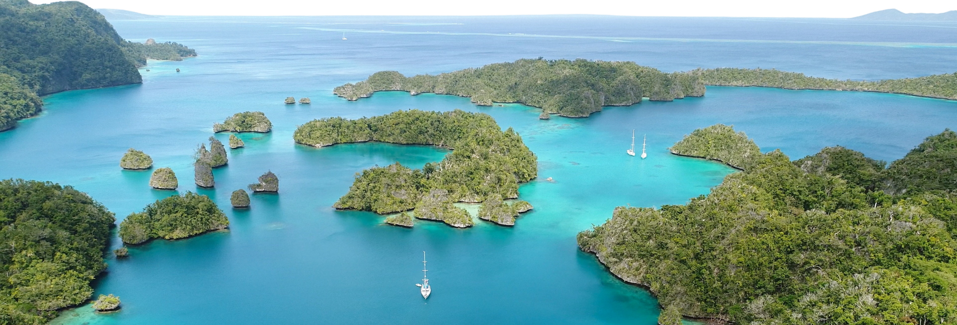









th
18 session of the
pacific islands climate outlook Forum
PICOF -18
23 - 24 April, 2026 | Nadi, Fiji

Slide 2
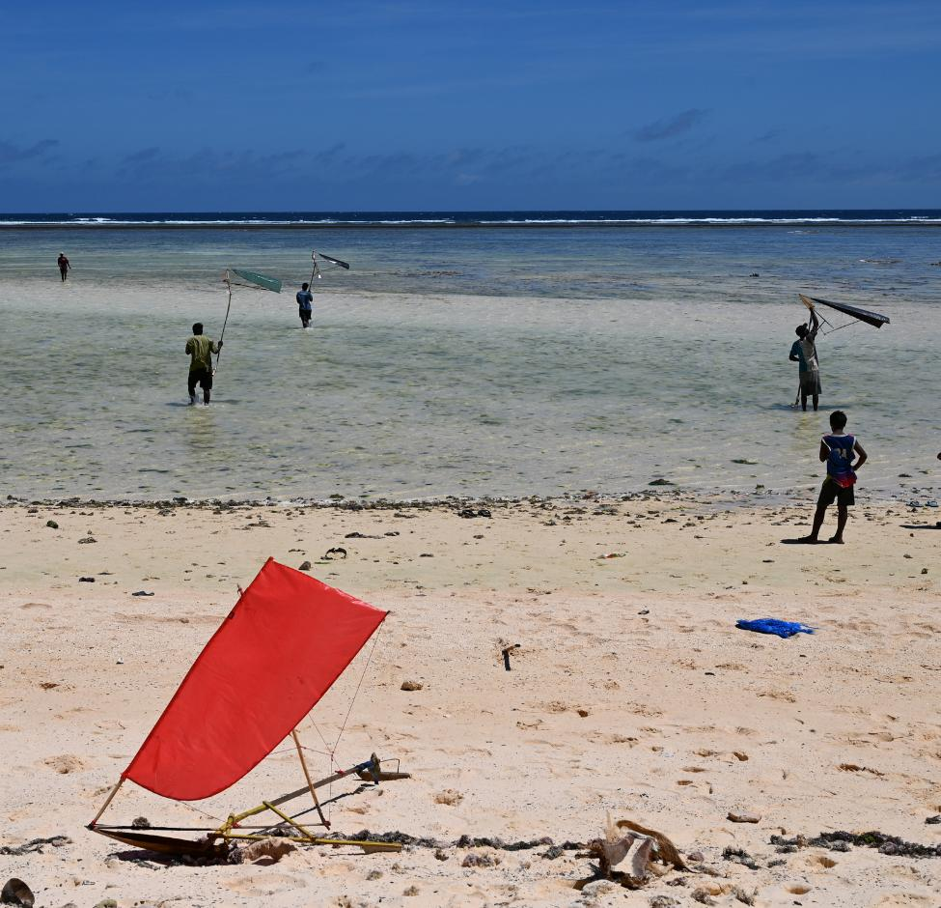
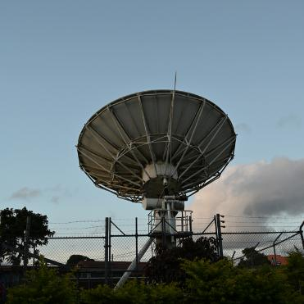

Session 4ii:
Looking Forward Long Term
Ocean Conditions
John Marra, Laura Cagigal¹, Malcolm King², Leanne Webb²
Universidad de Cantabria¹ & CSIRO²

Slide 3
Emissions Scenarios
Sea Surface Temperature
Marine Heat Waves
Ocean Acidity
Aragonite Saturation State
Salinity
Application of information

Slide 4
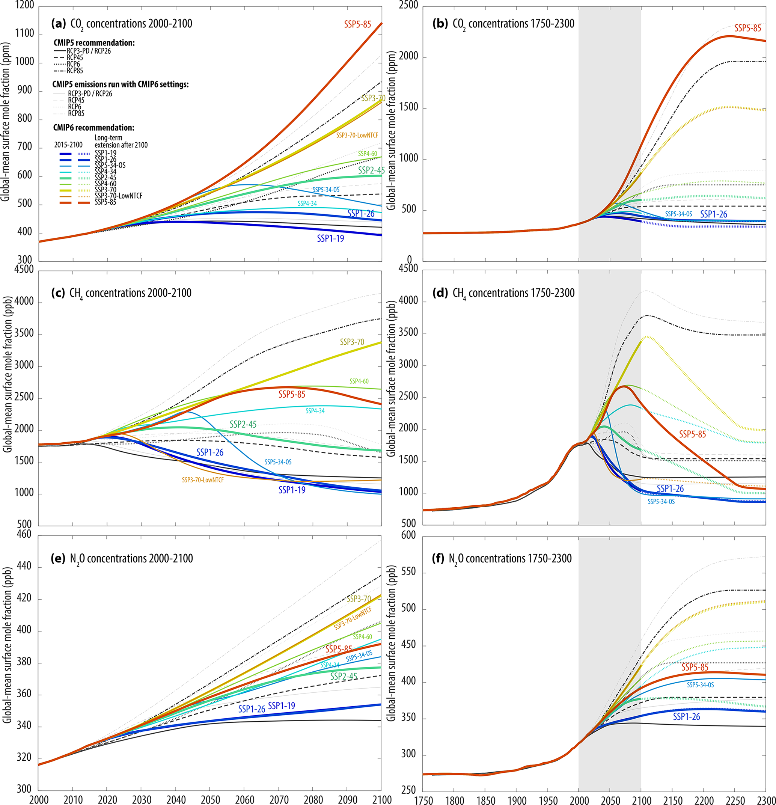
Emissions Scenarios
Climate change projections are based on global greenhouse gas/emissions scenarios.
An ensemble of models – GCM’s – are run for a range of projections scenarios.
CMIP6
Meinshausen, M., Nicholls, Z. R. J., Lewis, J., Gidden, M. J., Vogel, E., Freund, M., Beyerle, U., Gessner, C., Nauels, A., Bauer, N., Canadell, J. G., Daniel, J. S., John, A., Krummel, P. B., Luderer, G., Meinshausen, N., Montzka, S. A., Rayner, P. J., Reimann, S., … Wang, R. H. J. (2020). The shared socio-economic pathway (SSP) greenhouse gas concentrations and their extensions to 2500. Geoscientific Model Development, 13(8), 3571–3605. https://doi.org/10.5194/gmd-13-3571-2020

Slide 5
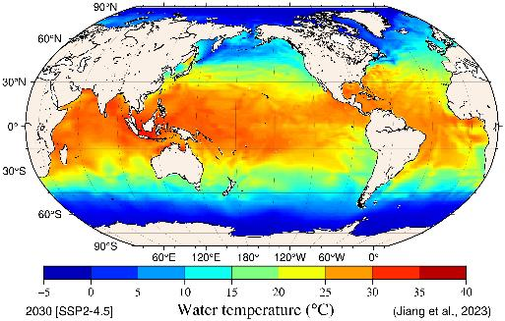
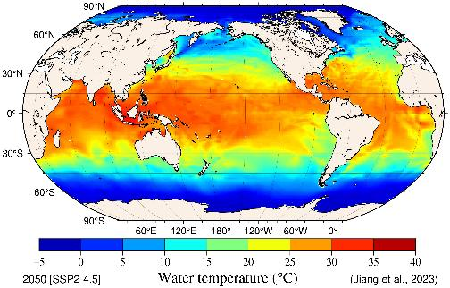
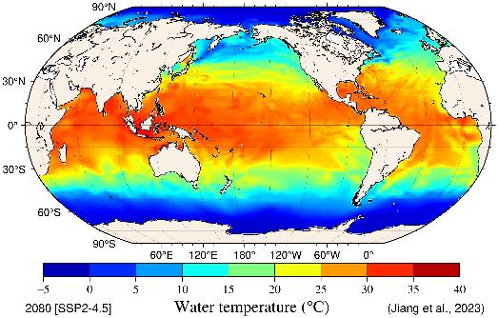
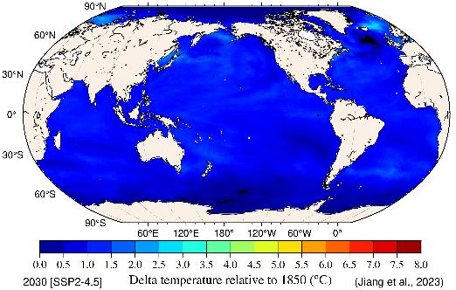
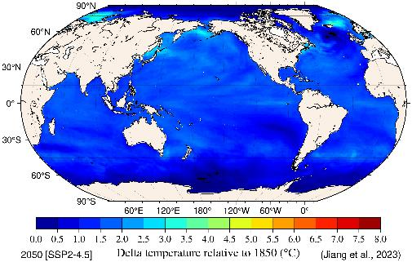
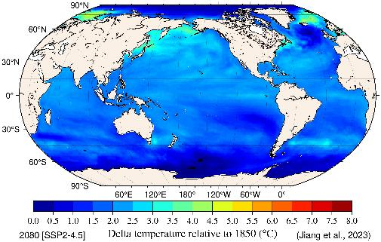
Sea Surface Temperature (SST)
Water temp degrees C, absolute values, average of the decade …SSP2-4.5
Water temp degrees C, relative values, average of the decade … SSP2-4.5
2030 2050 2080
Jiang, L.-Q., Dunne, J., Carter, B. R., Tjiputra, J. F., Terhaar, J., Sharp, J. D., Olsen, A., Alin, S., Bakker, D. C. E., Feely, R. A., Gattuso, J.-P., Hogan, P., Ilyina, T., Lange, N., Lauvset, S. K., Lewis, E. R., Lovato, T., Palmieri, J., Santana-Falcón, Y., Schwinger, J., Séférian, R., Strand, G., Swart, N., Tanhua, T., Tsujino, H., Wanninkhof, R., Watanabe, M., Yamamoto, A., and Ziehn, T. (2023). Global surface ocean acidification indicators from 1750 to 2100. Journal of Advances in Modeling Earth Systems, 15, e2022MS003563. https://doi.org/10.1029/2022MS003563.

Slide 6
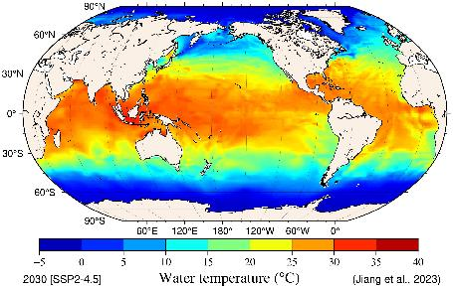
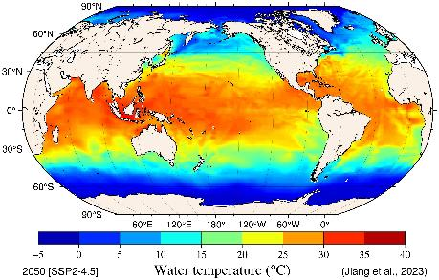
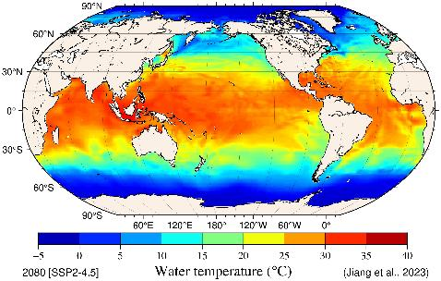



Sea Surface Temperature (SST)
Water temp degrees C, absolute values, average of the decade …SSP2-4.5
Water temp degrees C, absolute values, average of the decade … SSP3-7.0
2030 2050 2080
Jiang, L.-Q., Dunne, J., Carter, B. R., Tjiputra, J. F., Terhaar, J., Sharp, J. D., Olsen, A., Alin, S., Bakker, D. C. E., Feely, R. A., Gattuso, J.-P., Hogan, P., Ilyina, T., Lange, N., Lauvset, S. K., Lewis, E. R., Lovato, T., Palmieri, J., Santana-Falcón, Y., Schwinger, J., Séférian, R., Strand, G., Swart, N., Tanhua, T., Tsujino, H., Wanninkhof, R., Watanabe, M., Yamamoto, A., and Ziehn, T. (2023). Global surface ocean acidification indicators from 1750 to 2100. Journal of Advances in Modeling Earth Systems, 15, e2022MS003563. https://doi.org/10.1029/2022MS003563.

Slide 7
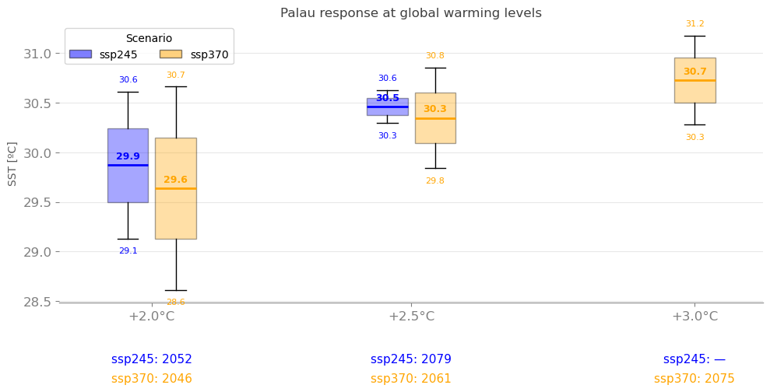
Sea Surface Temperature (SST)
Courtesy: Laura Cagigal Gil (University of Cantabria) & Malcolm King (CSIRO)

Slide 8
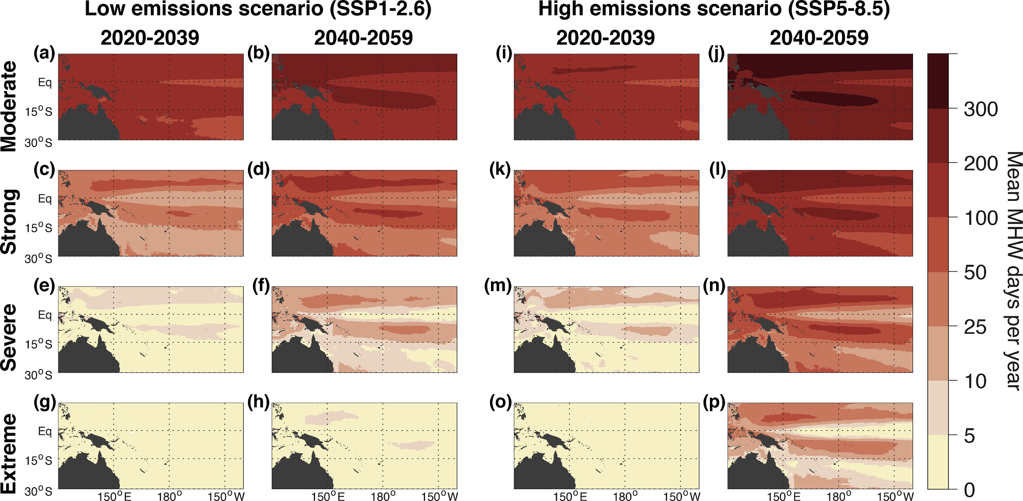
Marine Heat Waves (MHW)
CMIP6 multi-model mean average number of MHW days per year in each intensity category under the two future greenhouse gas emissions scenarios. Mean MHW days per year in the SSP1–2.6 scenario (a-h) and SSP5–8.5 scenario (i-p)
Holbrook, N. J., Hernaman, V., Koshiba, S., Lako, J., Kajtar, J. B., Amosa, P., & Singh, A. (2022). Impacts of marine heatwaves on tropical western and central Pacific Island nations and their communities. Global and Planetary Change, 208, 103680.

Slide 9
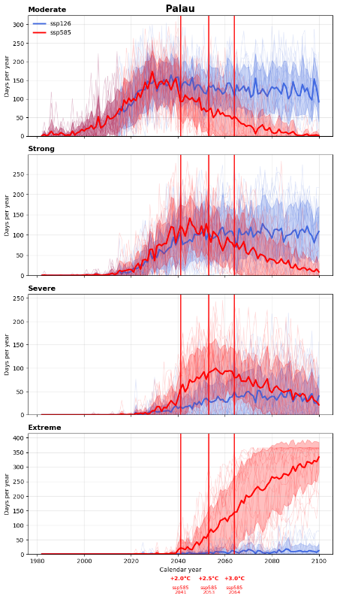
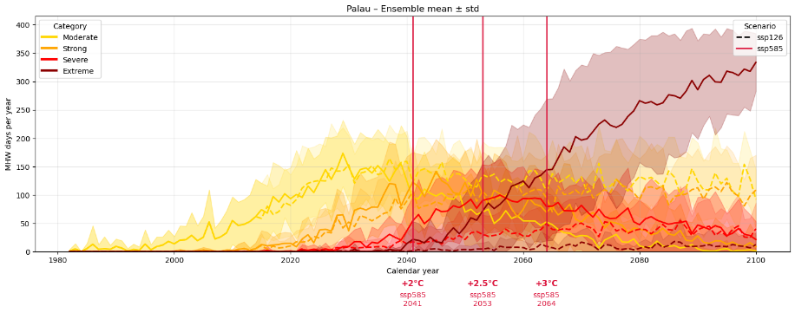
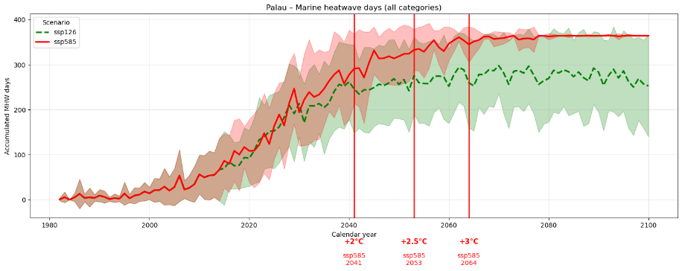
Marine Heat Waves (MHW)
Holbrook, N. J., Hernaman, V., Koshiba, S., Lako, J., Kajtar, J. B., Amosa, P., & Singh, A. (2022). Impacts of marine heatwaves on tropical western and central Pacific Island nations and their communities. Global and Planetary Change, 208, 103680.

Slide 10
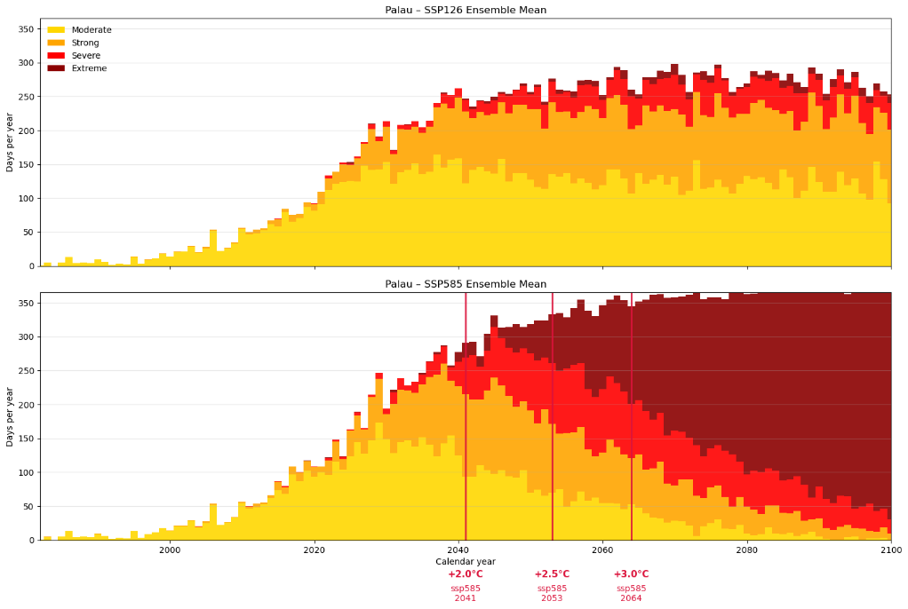
Marine Heat Waves (MHW)
Holbrook, N. J., Hernaman, V., Koshiba, S., Lako, J., Kajtar, J. B., Amosa, P., & Singh, A. (2022). Impacts of marine heatwaves on tropical western and central Pacific Island nations and their communities. Global and Planetary Change, 208, 103680.

Slide 11
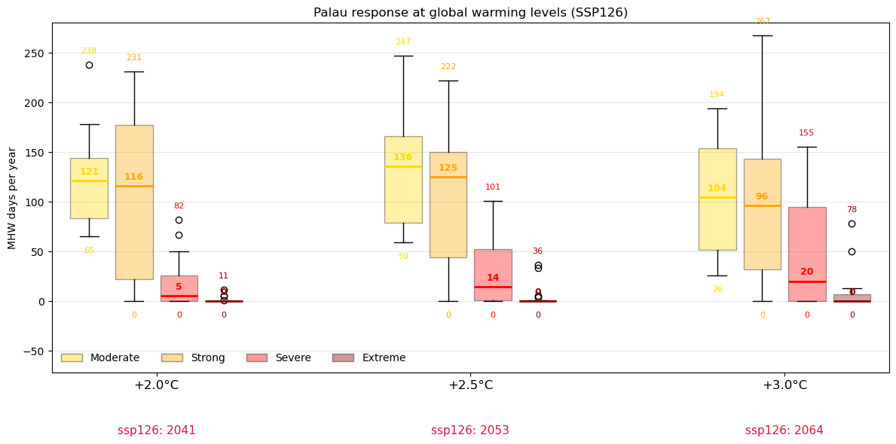
Marine Heat Waves (MHW)
Holbrook, N. J., Hernaman, V., Koshiba, S., Lako, J., Kajtar, J. B., Amosa, P., & Singh, A. (2022). Impacts of marine heatwaves on tropical western and central Pacific Island nations and their communities. Global and Planetary Change, 208, 103680.

Slide 12
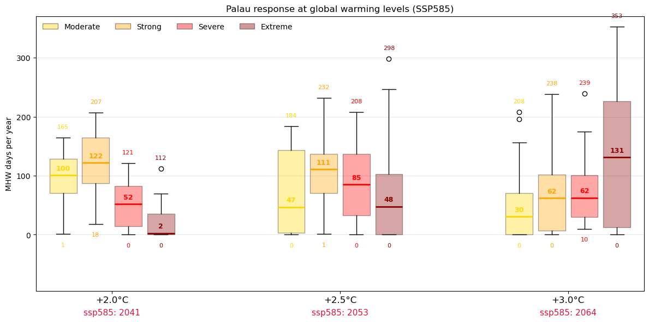
Marine Heat Waves (MHW)
Holbrook, N. J., Hernaman, V., Koshiba, S., Lako, J., Kajtar, J. B., Amosa, P., & Singh, A. (2022). Impacts of marine heatwaves on tropical western and central Pacific Island nations and their communities. Global and Planetary Change, 208, 103680.

Slide 13
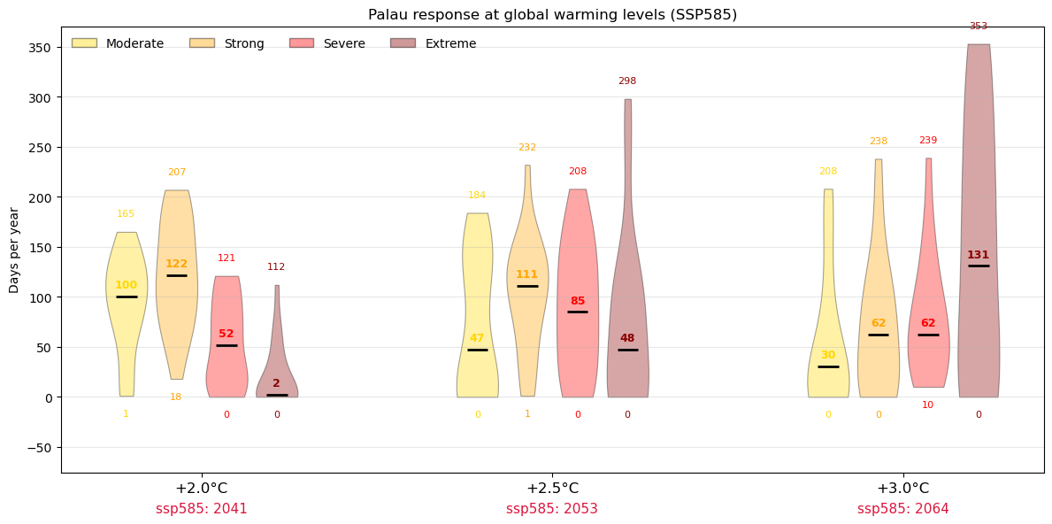
Marine Heat Waves (MHW)
Holbrook, N. J., Hernaman, V., Koshiba, S., Lako, J., Kajtar, J. B., Amosa, P., & Singh, A. (2022). Impacts of marine heatwaves on tropical western and central Pacific Island nations and their communities. Global and Planetary Change, 208, 103680.

Slide 14
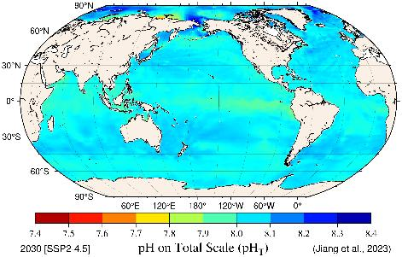
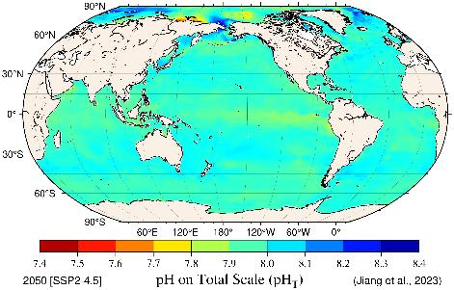
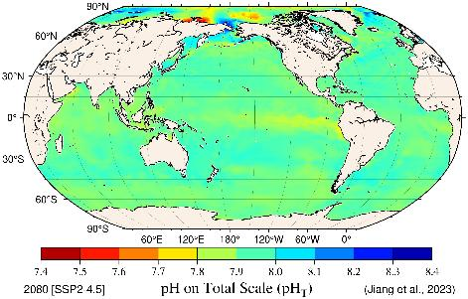
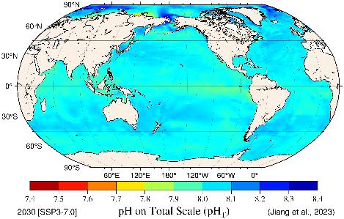
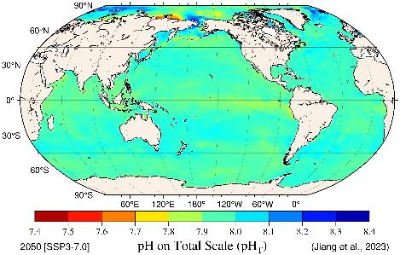
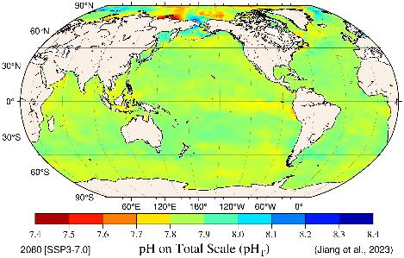
Ocean Acidity pHT (Total Scale)
average of the decade …SSP2-4.5
average of the decade … SSP3-7.0
2030 2050 2080
Jiang, L.-Q., Dunne, J., Carter, B. R., Tjiputra, J. F., Terhaar, J., Sharp, J. D., Olsen, A., Alin, S., Bakker, D. C. E., Feely, R. A., Gattuso, J.-P., Hogan, P., Ilyina, T., Lange, N., Lauvset, S. K., Lewis, E. R., Lovato, T., Palmieri, J., Santana-Falcón, Y., Schwinger, J., Séférian, R., Strand, G., Swart, N., Tanhua, T., Tsujino, H., Wanninkhof, R., Watanabe, M., Yamamoto, A., and Ziehn, T. (2023). Global surface ocean acidification indicators from 1750 to 2100. Journal of Advances in Modeling Earth Systems, 15, e2022MS003563. https://doi.org/10.1029/2022MS003563.

Slide 15
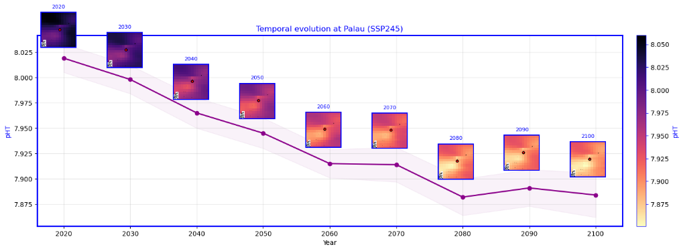
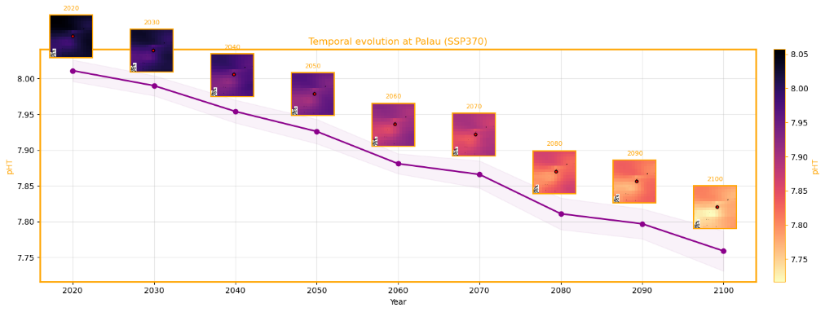
Ocean Acidity pHT (Total Scale)
Jiang, L.-Q., Dunne, J., Carter, B. R., Tjiputra, J. F., Terhaar, J., Sharp, J. D., Olsen, A., Alin, S., Bakker, D. C. E., Feely, R. A., Gattuso, J.-P., Hogan, P., Ilyina, T., Lange, N., Lauvset, S. K., Lewis, E. R., Lovato, T., Palmieri, J., Santana-Falcón, Y., Schwinger, J., Séférian, R., Strand, G., Swart, N., Tanhua, T., Tsujino, H., Wanninkhof, R., Watanabe, M., Yamamoto, A., and Ziehn, T. (2023). Global surface ocean acidification indicators from 1750 to 2100. Journal of Advances in Modeling Earth Systems, 15, e2022MS003563. https://doi.org/10.1029/2022MS003563.

Slide 16
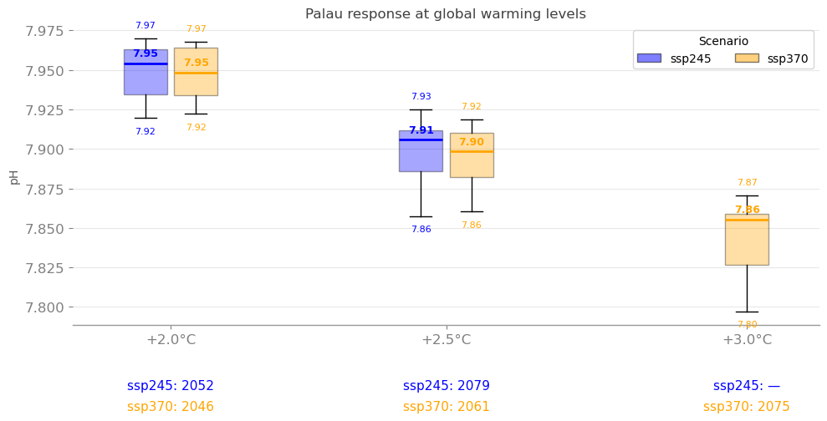
Ocean Acidity pHT (Total Scale)
Courtesy: Laura Cagigal Gil (University of Cantabria) & Malcolm King (CSIRO)

Slide 17
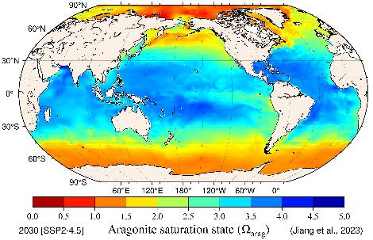
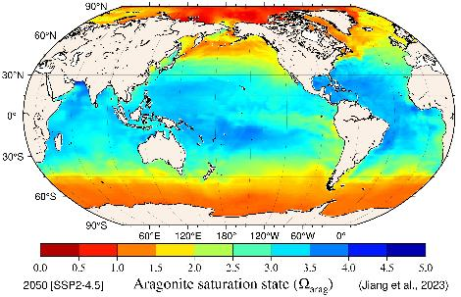
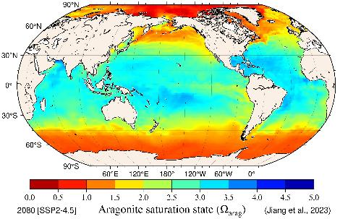

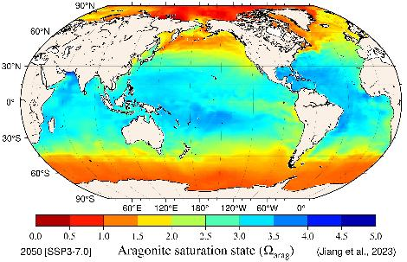
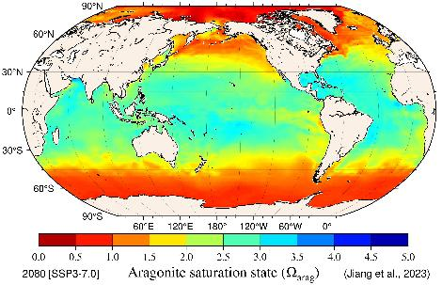
Aragonite Saturation State
Ω
arag
average of the decade …SSP2-4.5
average of the decade … SSP3-7.0
2030 2050 2080
Jiang, L.-Q., Dunne, J., Carter, B. R., Tjiputra, J. F., Terhaar, J., Sharp, J. D., Olsen, A., Alin, S., Bakker, D. C. E., Feely, R. A., Gattuso, J.-P., Hogan, P., Ilyina, T., Lange, N., Lauvset, S. K., Lewis, E. R., Lovato, T., Palmieri, J., Santana-Falcón, Y., Schwinger, J., Séférian, R., Strand, G., Swart, N., Tanhua, T., Tsujino, H., Wanninkhof, R., Watanabe, M., Yamamoto, A., and Ziehn, T. (2023). Global surface ocean acidification indicators from 1750 to 2100. Journal of Advances in Modeling Earth Systems, 15, e2022MS003563. https://doi.org/10.1029/2022MS003563.

Slide 18
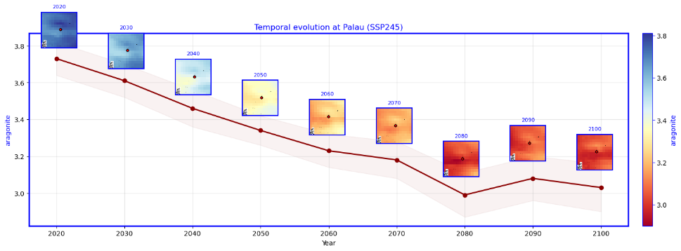
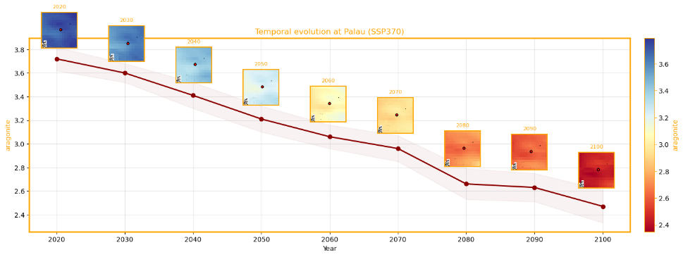
Aragonite Saturation State
Ω
arag
Jiang, L.-Q., Dunne, J., Carter, B. R., Tjiputra, J. F., Terhaar, J., Sharp, J. D., Olsen, A., Alin, S., Bakker, D. C. E., Feely, R. A., Gattuso, J.-P., Hogan, P., Ilyina, T., Lange, N., Lauvset, S. K., Lewis, E. R., Lovato, T., Palmieri, J., Santana-Falcón, Y., Schwinger, J., Séférian, R., Strand, G., Swart, N., Tanhua, T., Tsujino, H., Wanninkhof, R., Watanabe, M., Yamamoto, A., and Ziehn, T. (2023). Global surface ocean acidification indicators from 1750 to 2100. Journal of Advances in Modeling Earth Systems, 15, e2022MS003563. https://doi.org/10.1029/2022MS003563.

Slide 19
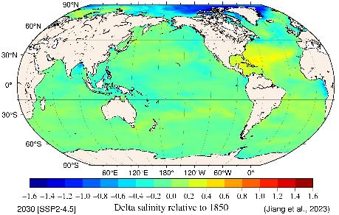
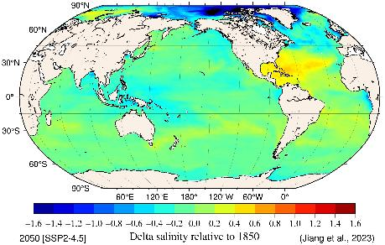
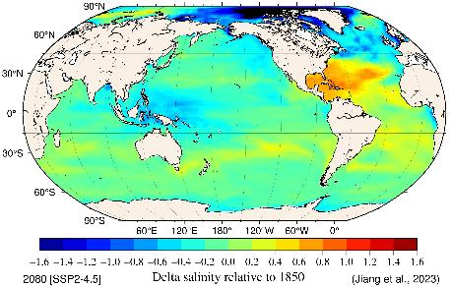
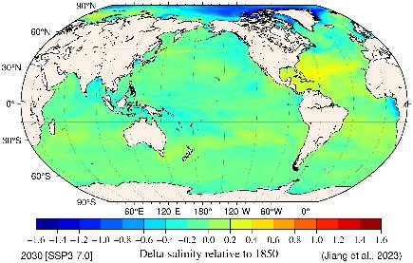
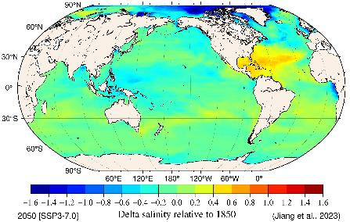
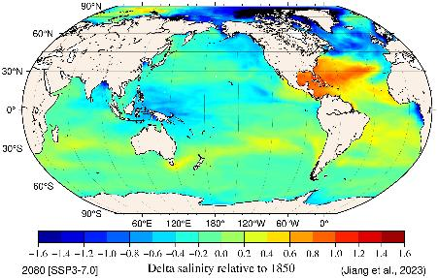
Salinity (delta values)
average of the decade …SSP2-4.5
average of the decade … SSP3-7.0
2030 2050 2080
Jiang, L.-Q., Dunne, J., Carter, B. R., Tjiputra, J. F., Terhaar, J., Sharp, J. D., Olsen, A., Alin, S., Bakker, D. C. E., Feely, R. A., Gattuso, J.-P., Hogan, P., Ilyina, T., Lange, N., Lauvset, S. K., Lewis, E. R., Lovato, T., Palmieri, J., Santana-Falcón, Y., Schwinger, J., Séférian, R., Strand, G., Swart, N., Tanhua, T., Tsujino, H., Wanninkhof, R., Watanabe, M., Yamamoto, A., and Ziehn, T. (2023). Global surface ocean acidification indicators from 1750 to 2100. Journal of Advances in Modeling Earth Systems, 15, e2022MS003563. https://doi.org/10.1029/2022MS003563.

Slide 20
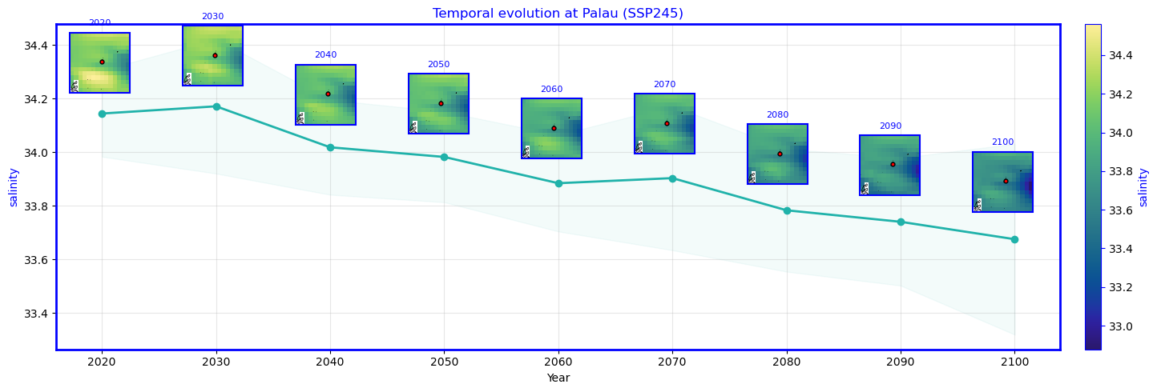
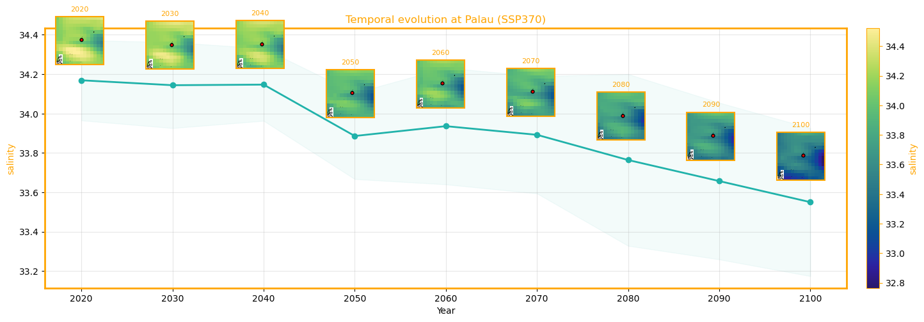
Salinity (delta values)
Courtesy: Laura Cagigal Gil (University of Cantabria)

Slide 21
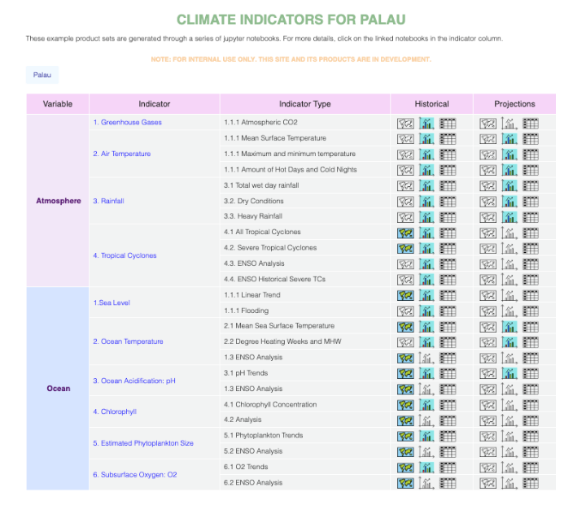
Jupyter Notebooks in a GitHub Repository
Collaboratively developed, shared repository of open-source, documented computer code assets that generates climate information products.
Automates development of an update to the PICC Monitor and National Reports consistent with the Monitor, as well as provides content for assorted documents, bulletins, portals and dashboards used by Pacific Island communities.
National Climate Indicator Report Template (NCIRT) roll out and accompanying training planned for October 2026.
Courtesy: John Marra, Laura Cagigal Gil (University of Cantabria) & Malcolm King, Leanne Webb (CSIRO)

Slide 22
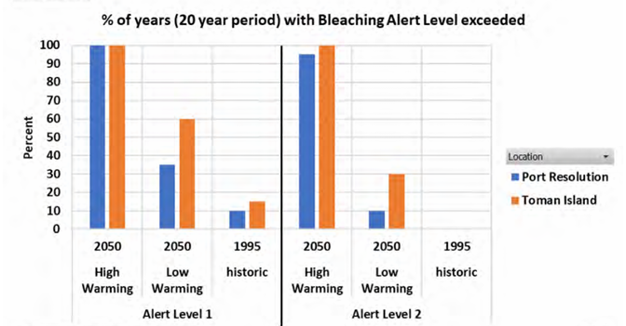
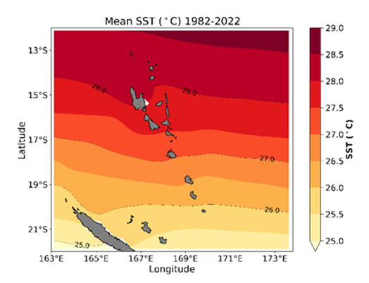

Marine heatwave / coral bleaching applications
Regional differences in coral bleaching were explored for Vanuatu:
  current (20 years centred on 1995)
  future climate (20years centred on 2050).
Identifying less exposed reefs as potential marine refuges e.g. Marine Protected Areas
*
* Alert Level 2 relates to likely occurrence of severe bleaching and significant coral mortality
Source: VanKIRAP case study and Explainer: Coral Bleaching.pdf and Marine Heat Waves.pdf

Slide 23
Summary
Add key points which will be included in the PICOF outcomes statement
Sea Surface Temperature – warmer
Marine Heat Waves – more frequent, more intense
Ocean Acidity – more acidic
Aragonite Saturation State – lowered
Salinity – less saline?

Slide 24
Summary
Sea Surface Temperature – warmer
Marine Heat Waves – more frequent, more intense
Ocean Acidity – more acidic
Aragonite Saturation State – lowered
Salinity – less saline?
Content shown here can be readily created, updated, and modified to support national climate change monitoring and reporting.

Slide 25
Thank You
Leanne.webb@csiro.au

