Slide 1











th
18 session of the
pacific islands climate outlook Forum
PICOF -18
23 - 24 April, 2026 | Nadi, Fiji

Slide 2
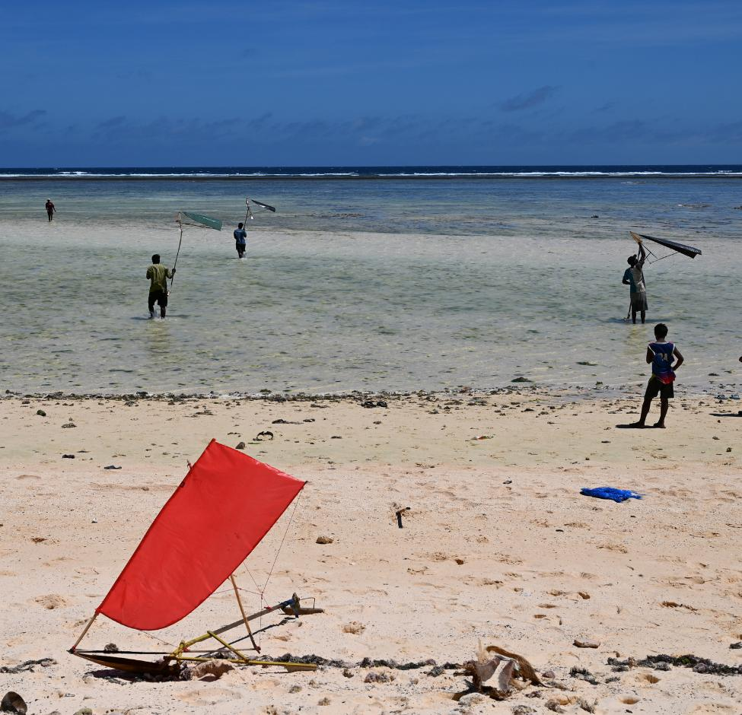
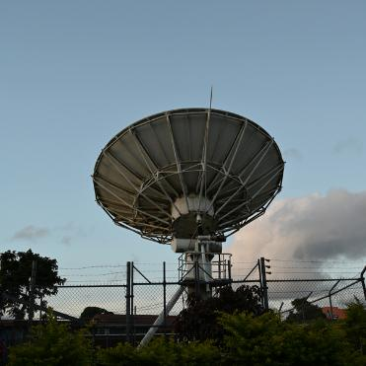

PICOF-18 Day 2 Objectives of the Day
Sunny Seuseu
RCC Coordinator, SPREP

Slide 3
d
Recap Day 1
Opening Session: Setting the Scene
The forum opened with official remarks from the Fiji Met Service, the World Meteorological Organization (WMO), and the Secretariat of the Pacific Regional Environment Programme (SPREP). Speakers set a sobering tone, acknowledging the recent loss of life and destruction across the region while underscoring the critical importance of PICOF in strengthening early warning systems and community resilience.
Session 1: ENSO Status and Outlook
Technical experts from ESNZ, the Australian Bureau of Meteorology (BOM), Meteo-France, NOAA, the University of Hawaii, APCC, SPREP, and the Pacific Community (SPC) presented the current status and forecast for El Niño-Southern Oscillation (ENSO). Highlights from the Global Seasonal Climate Update (GSCU) provided the regional context for understanding climate drivers influencing the Pacific.

Slide 4
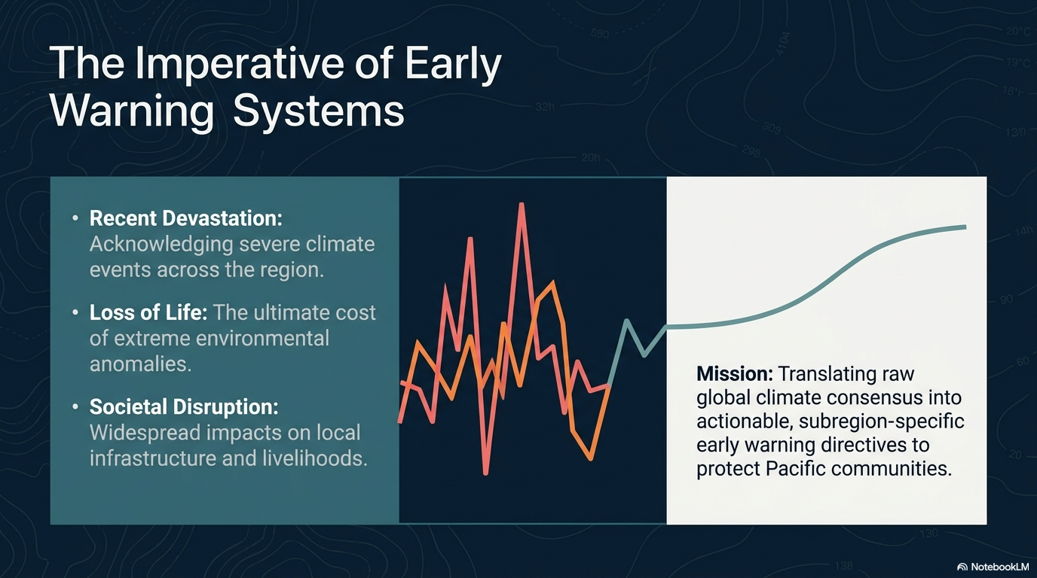

Slide 5
d
Recap Day 1_(1)
Session 2: Looking Back – Review of November to April
This extended session examined the recent climate season across five thematic areas:
i. Atmosphere: An overview of regional atmospheric conditions from November to April, including an evaluation of how well the previous PICOF outlook performed.
ii. Ocean: A review of ocean conditions, including sea surface temperatures and marine heatwave activity, with a similar evaluation of the last outlook.
iii. Tropical Cyclones: A summary of tropical cyclone activity over the six-month period.
iv. Impacts: Country-led reports from Kiribati, New Caledonia, and Tuvalu detailing extreme events and their environmental and societal consequences.
v. Attribution of Impacts: A session linking extreme events (flooding, heatwaves, coastal hazards) to major climate drivers such as ENSO.

Slide 6
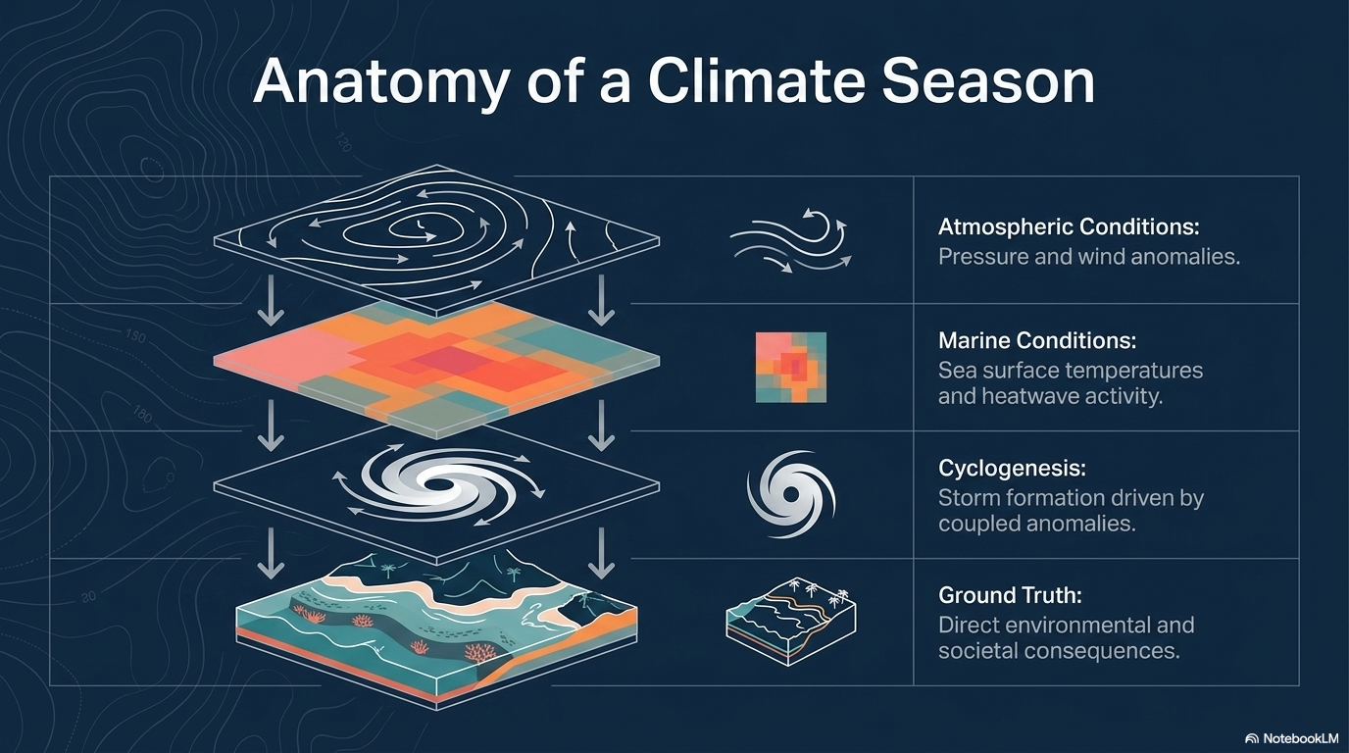

Slide 7
d
Recap Day 1_(2)
Session 3: Looking Forward – May to October 2025 Outlook
The afternoon focused on the upcoming season, beginning with:
Session 3i – Atmosphere: Presentation of monthly and seasonal outlooks for May to October 2025, drawing on individual model and multi-model ensemble (MME) guidance from multiple agencies.
Session 3ii – Ocean: Outlook for oceanic conditions over the same period, including model guidance and skill comparisons.
Impacts Group Work (Atmosphere and Ocean): Participants identified potential impacts of forecasted anomalous climate and anomalous oceanic conditions (e.g., marine heatwaves, coral bleaching risk) on Pacific communities and ecosystems across each Pacific subregion (Melanesia, Micronesia, Polynesia).

Slide 8
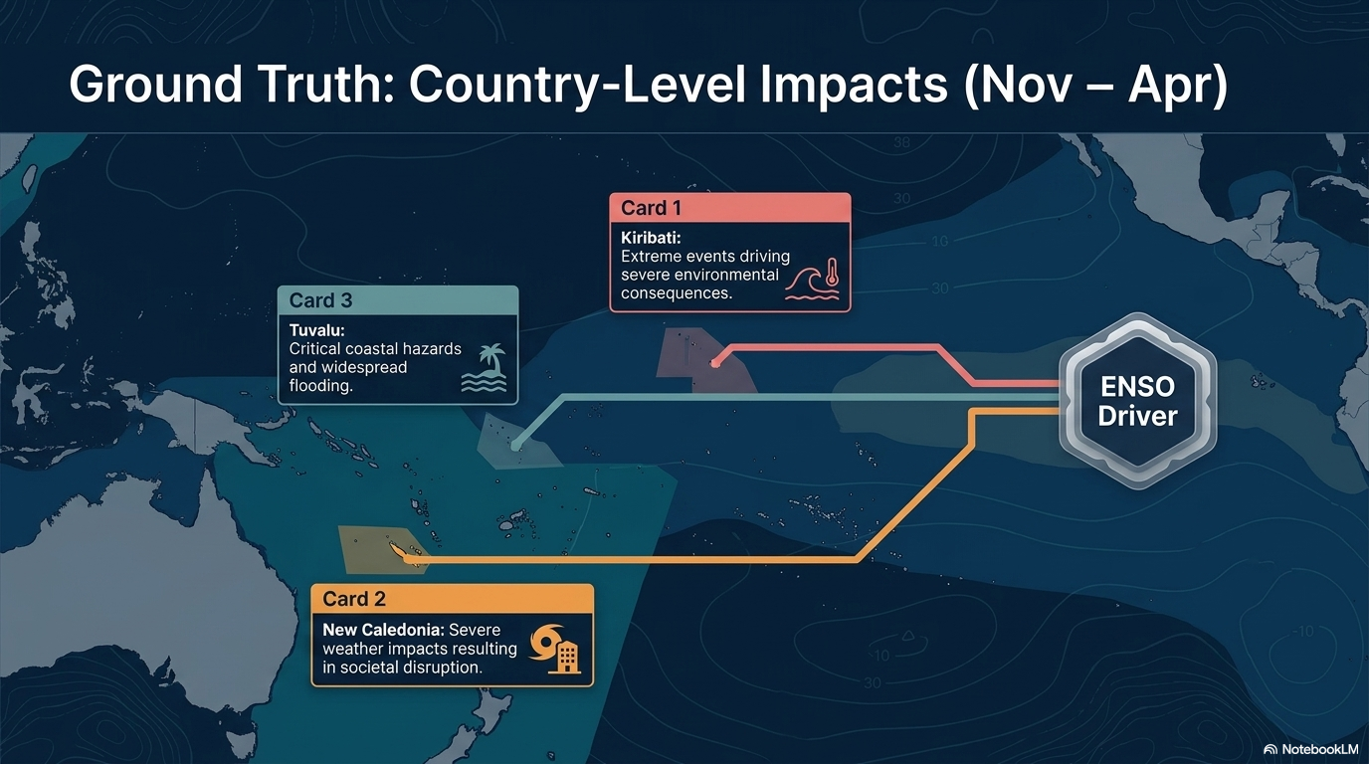

Slide 9
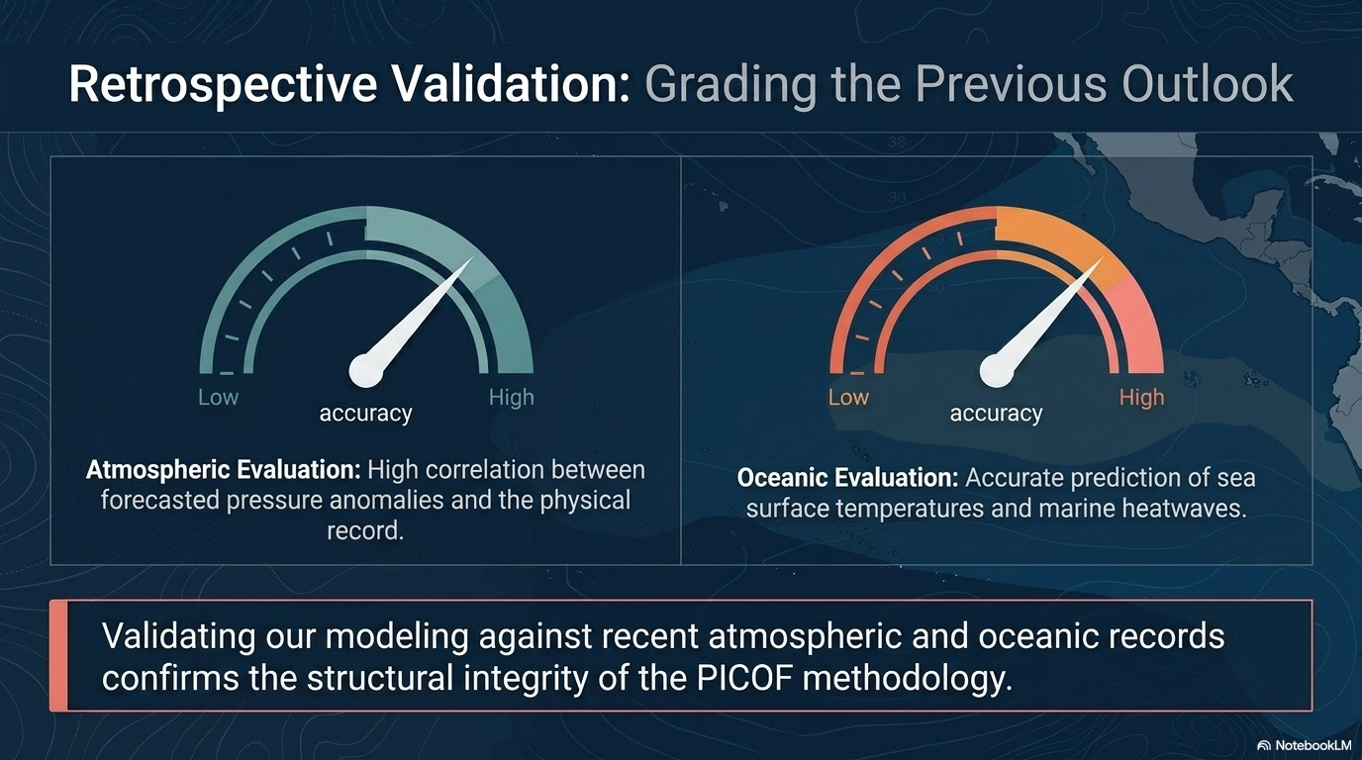

Slide 10
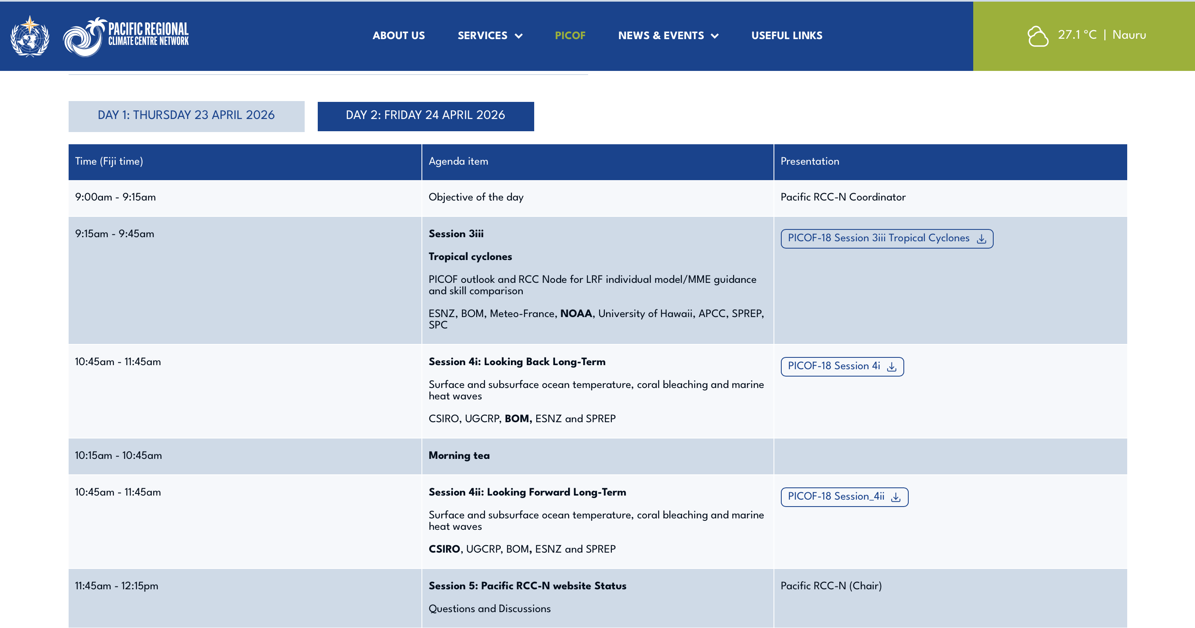

Slide 11
d
Summary
Day one of PICOF-18 balanced a somber review of recent losses with forward-looking collaboration, as experts worked to translate climate data into actionable, subregion-specific outlooks.
The day reinforced the PICOF’s role in bridging global climate science and local decision-making across the Pacific.

Slide 12
Thank You
sunnys@sprep.org

