Slide 1

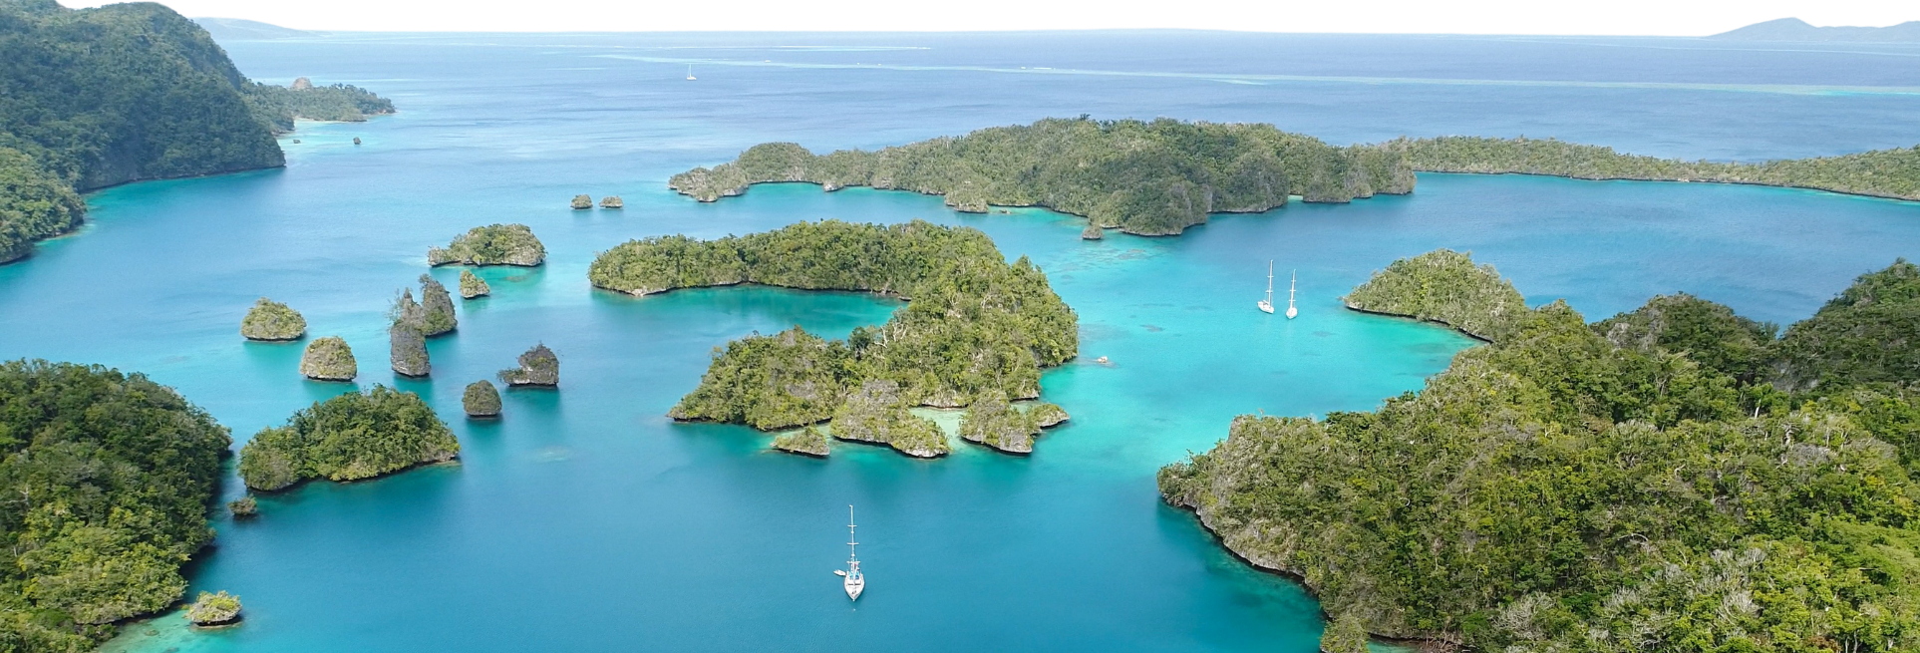









th
18 session of the
pacific islands climate outlook Forum
PICOF -18
23 - 24 April, 2026 | Nadi, Fiji

Slide 2
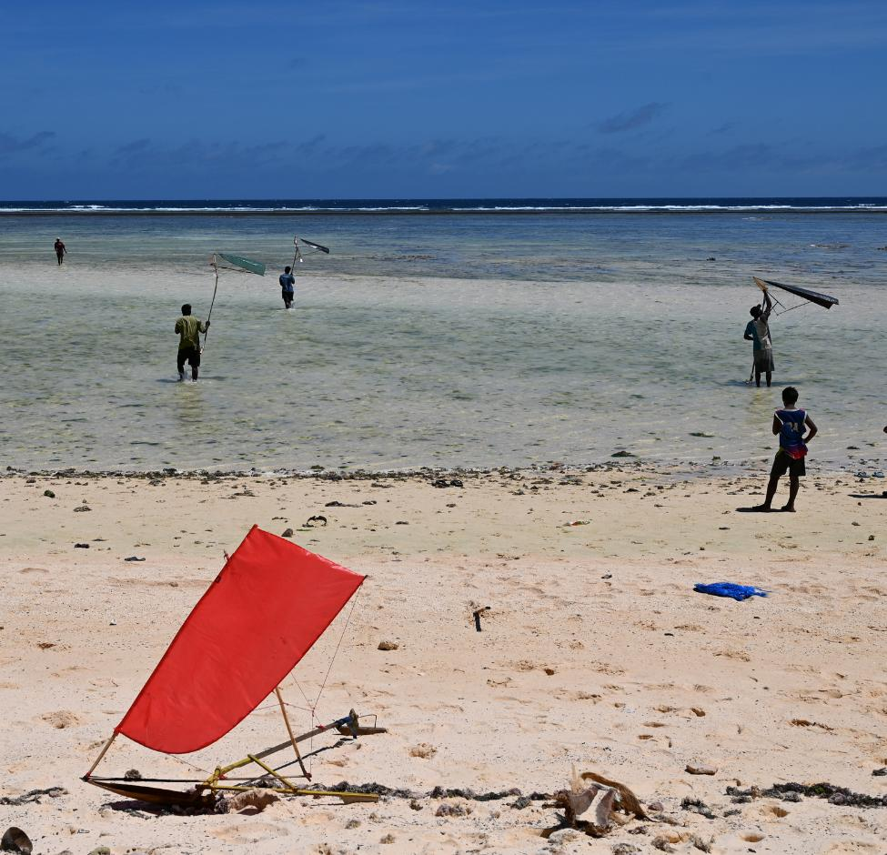
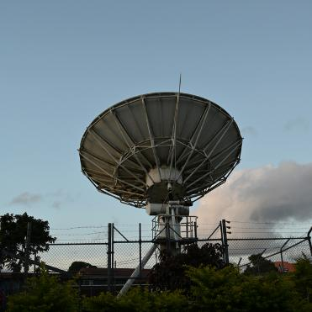

Overview of November to April state of the climate, plus evaluation of the last PICOF outlook
Dr Nicolas Fauchereau
Hannah Marley
Earth Sciences New Zealand

Slide 3
Presentation outline
Review of PICOF – 17 Outlook
ENSO outlooks vs observations
Large scale circulation (trade winds, Walker circulation)
Cloudiness / Convection
Rainfall
  Rainfall observations
  Rainfall outlooks vs observations
  Rainfall observations vs typical La Nina conditions
Temperature outlooks vs observations
Key Points /takeaways

Slide 4
Review of PICOF-17 outlook
ENSO (El Nino Southern Oscillation) Outlook
Rainfall and Air Temperature
Normal air temperatures are forecast in the central equatorial Pacific, aligning with the seasonal breakdown of a La Niña-like pattern.
The rainfall outlook over November 2025 to January 2026 favours below normal rainfall between Nauru and the Phoenix Islands (Kiribati), extending southwards between Tuvalu and northern French Polynesia, and a small region over the central Federated States of Micronesia and the Republic of the Marshall Islands. Above normal rainfall is forecast over Palau, Papua New Guinea and then in a band south-eastwards to southern French Polynesia. Confidence in this outlook highest along the equator and in the far western Pacific, although there is acceptable skill for most of the off-equatorial Pacific region.
The La Niña-like rainfall outlook pattern continues over February to April 2026, albeit with reduced confidence due to the longer lead time of the forecast period. Below normal rainfall is forecast to persist over Nauru eastwards to northern French Polynesia, with above normal rainfall forecast over Palau and eastwards to the Republic of the Marshall Islands, as well as in a broad band from Papua New Guinea south-eastwards to the southern Cook Islands
Above normal air temperatures are favoured across the Pacific for November 2025 to January 2026 for all countries excluding a small band along the equator from Nauru eastwards to the Phoenix Islands (Kiribati) where near normal air temperatures are predicted, and for the Line Islands (Kiribati) south-eastwards over the northern Cook Islands and northern French Polynesia where below normal air temperatures are favoured.
La Niña conditions very likely to become established over the next three month period (November 2025 – January 2026)
Consensus is that this event will be short-lived, with a return to Neutral conditions likely in the first quarter of 2026
Green: statement broadly consistent with observations
Red: statement less consistent with observations

Slide 5
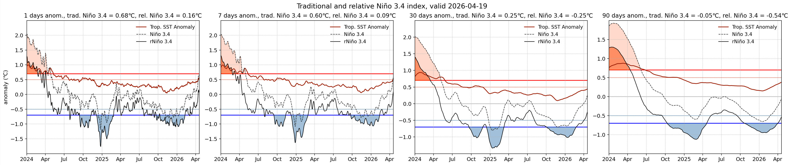
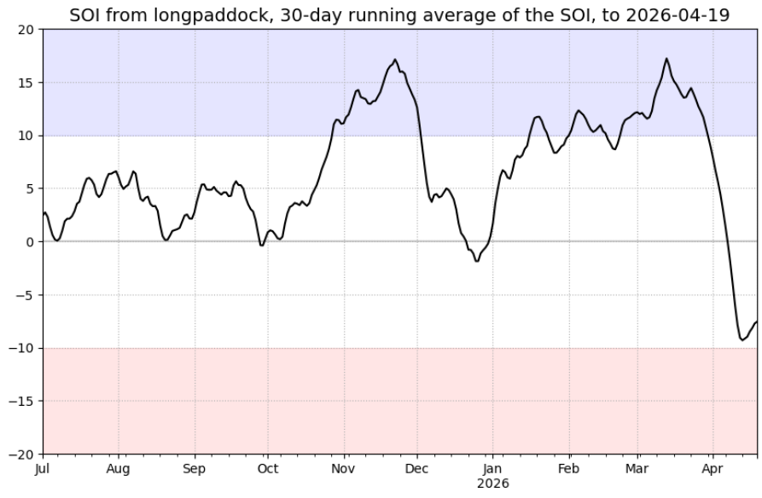
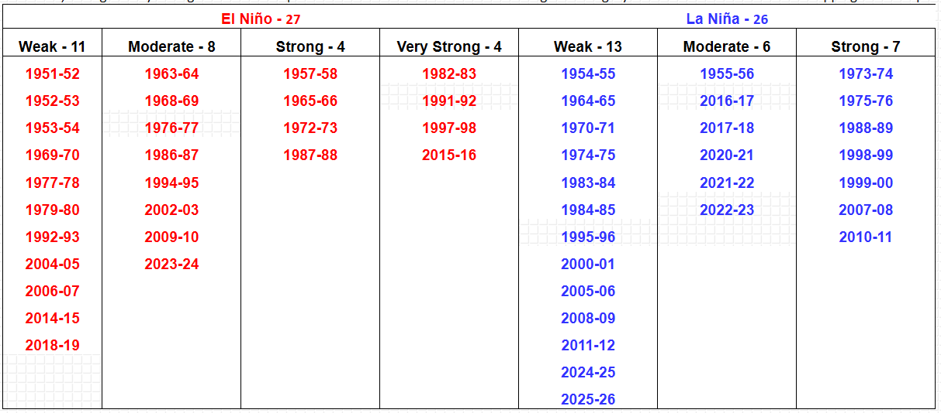
ENSO outlook vs observations
La Niña conditions very likely to become established over the next three month period (November 2025 – January 2026)
Consensus is that this event will be short-lived, with a return to Neutral conditions likely in the first quarter of 2026
Evolution of the RONI (Relative Oceanic Nino Index) and SOI consistent with weak La Nina conditions between about October 2025 and March 2026

Slide 6
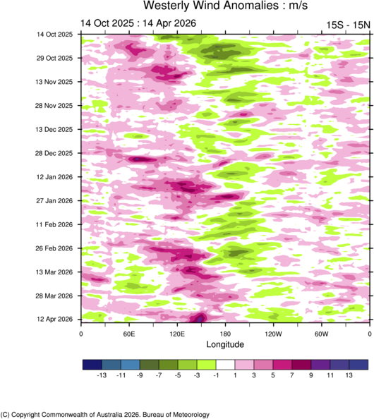
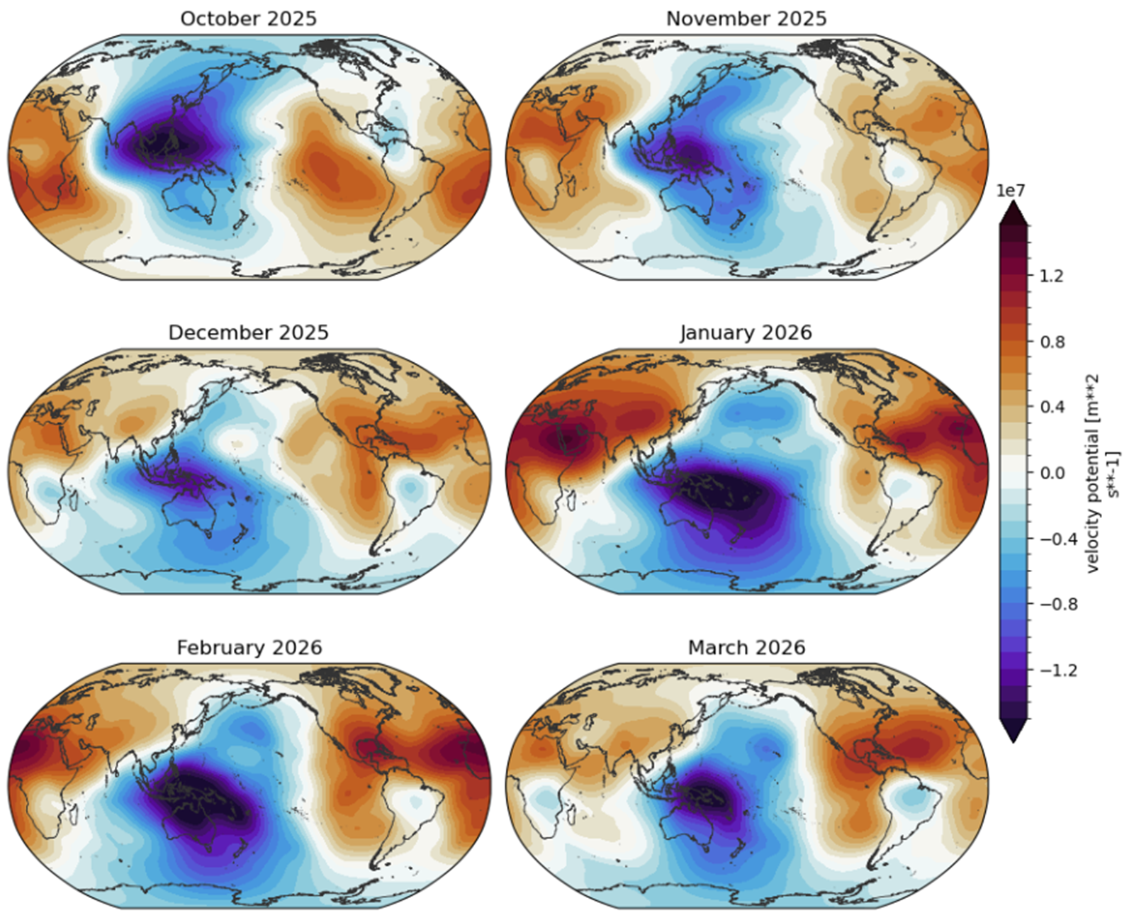
Zonal Wind / Walker circulation
Velocity Potential (ERA5)
Enhanced trade winds west of the International Dateline, and VP anomalies consistent with a regionally enhanced Walker Circulation

Slide 7
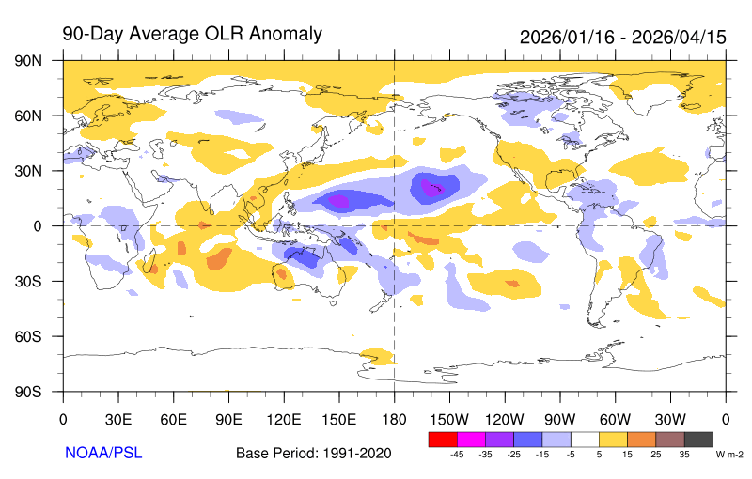
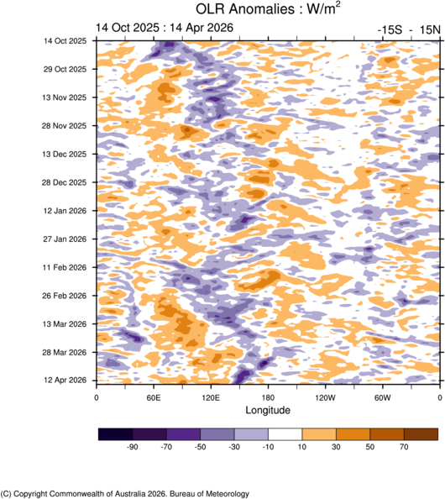
Cloudiness / convection
Decreased convection east of the International Dateline, increased convection over the Maritime Continent

Slide 8
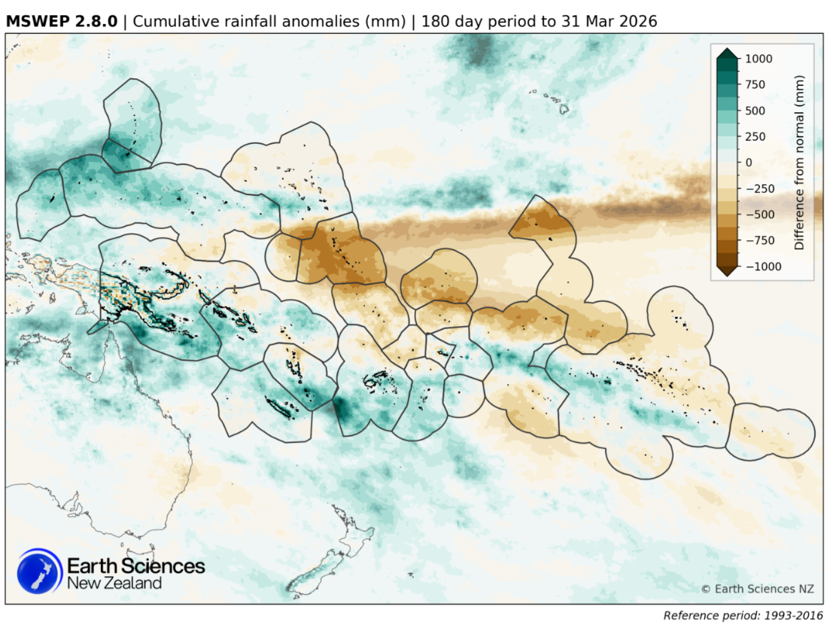
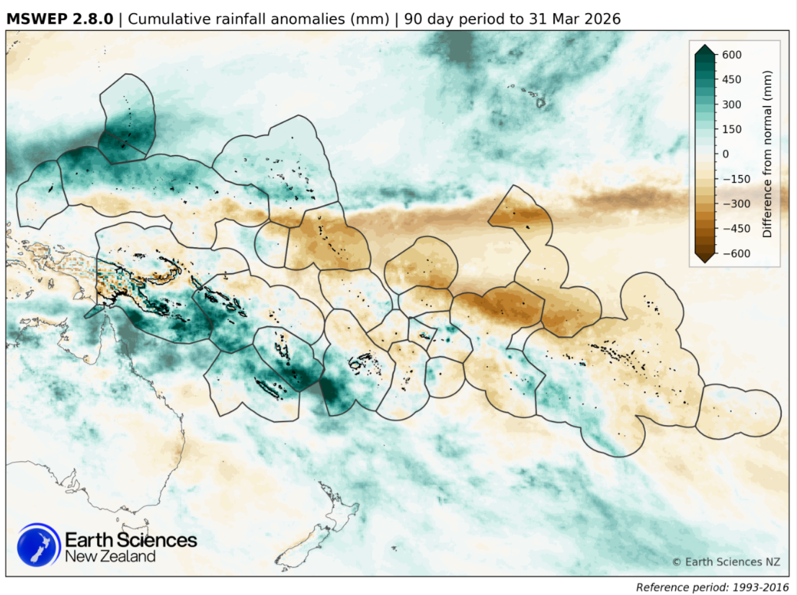
past
Rainfall
Past 6 months
Past 3 months

Slide 9
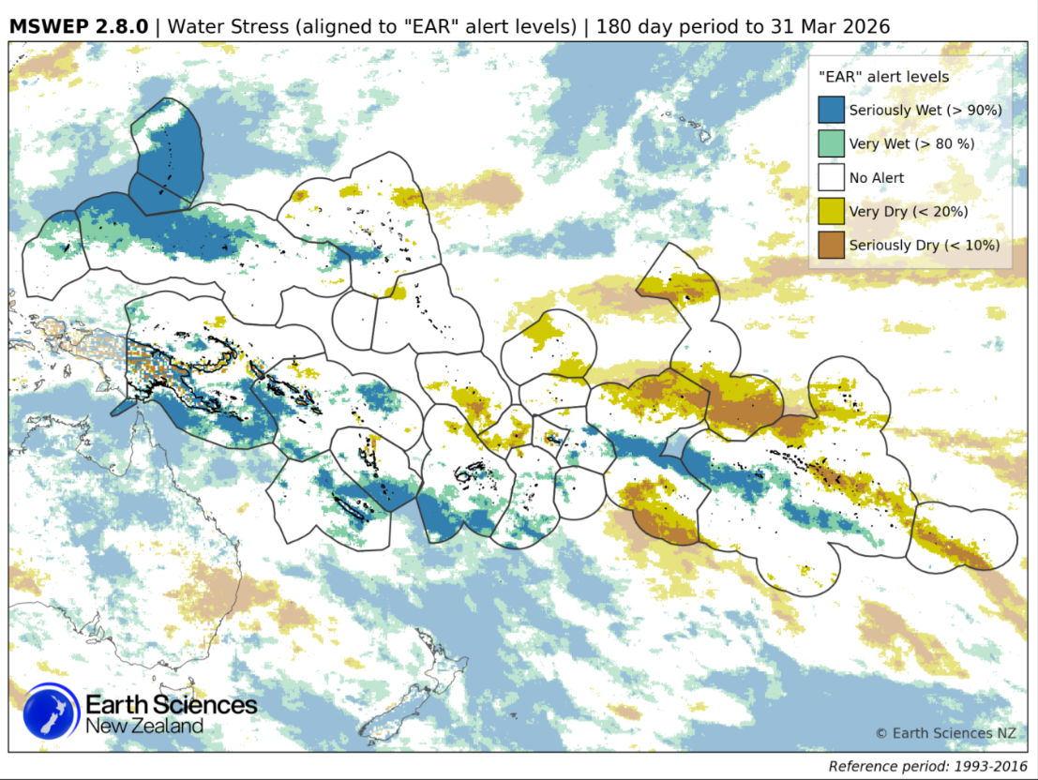
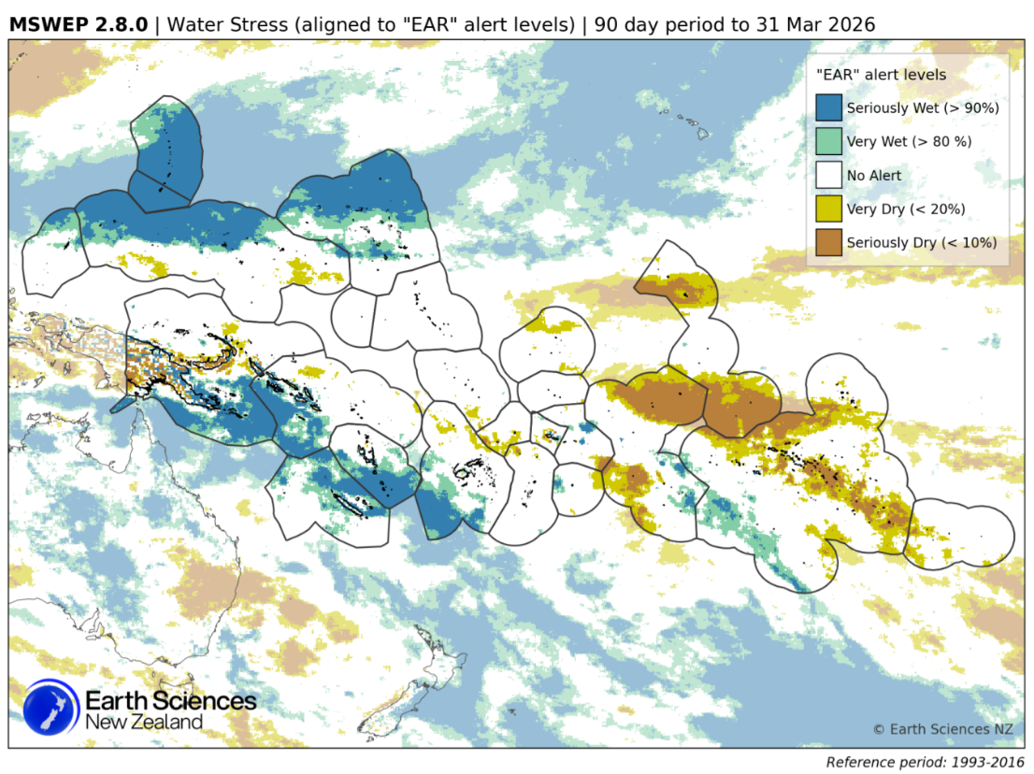
Rainfall
Past 6 months
Past 3 months

Slide 10
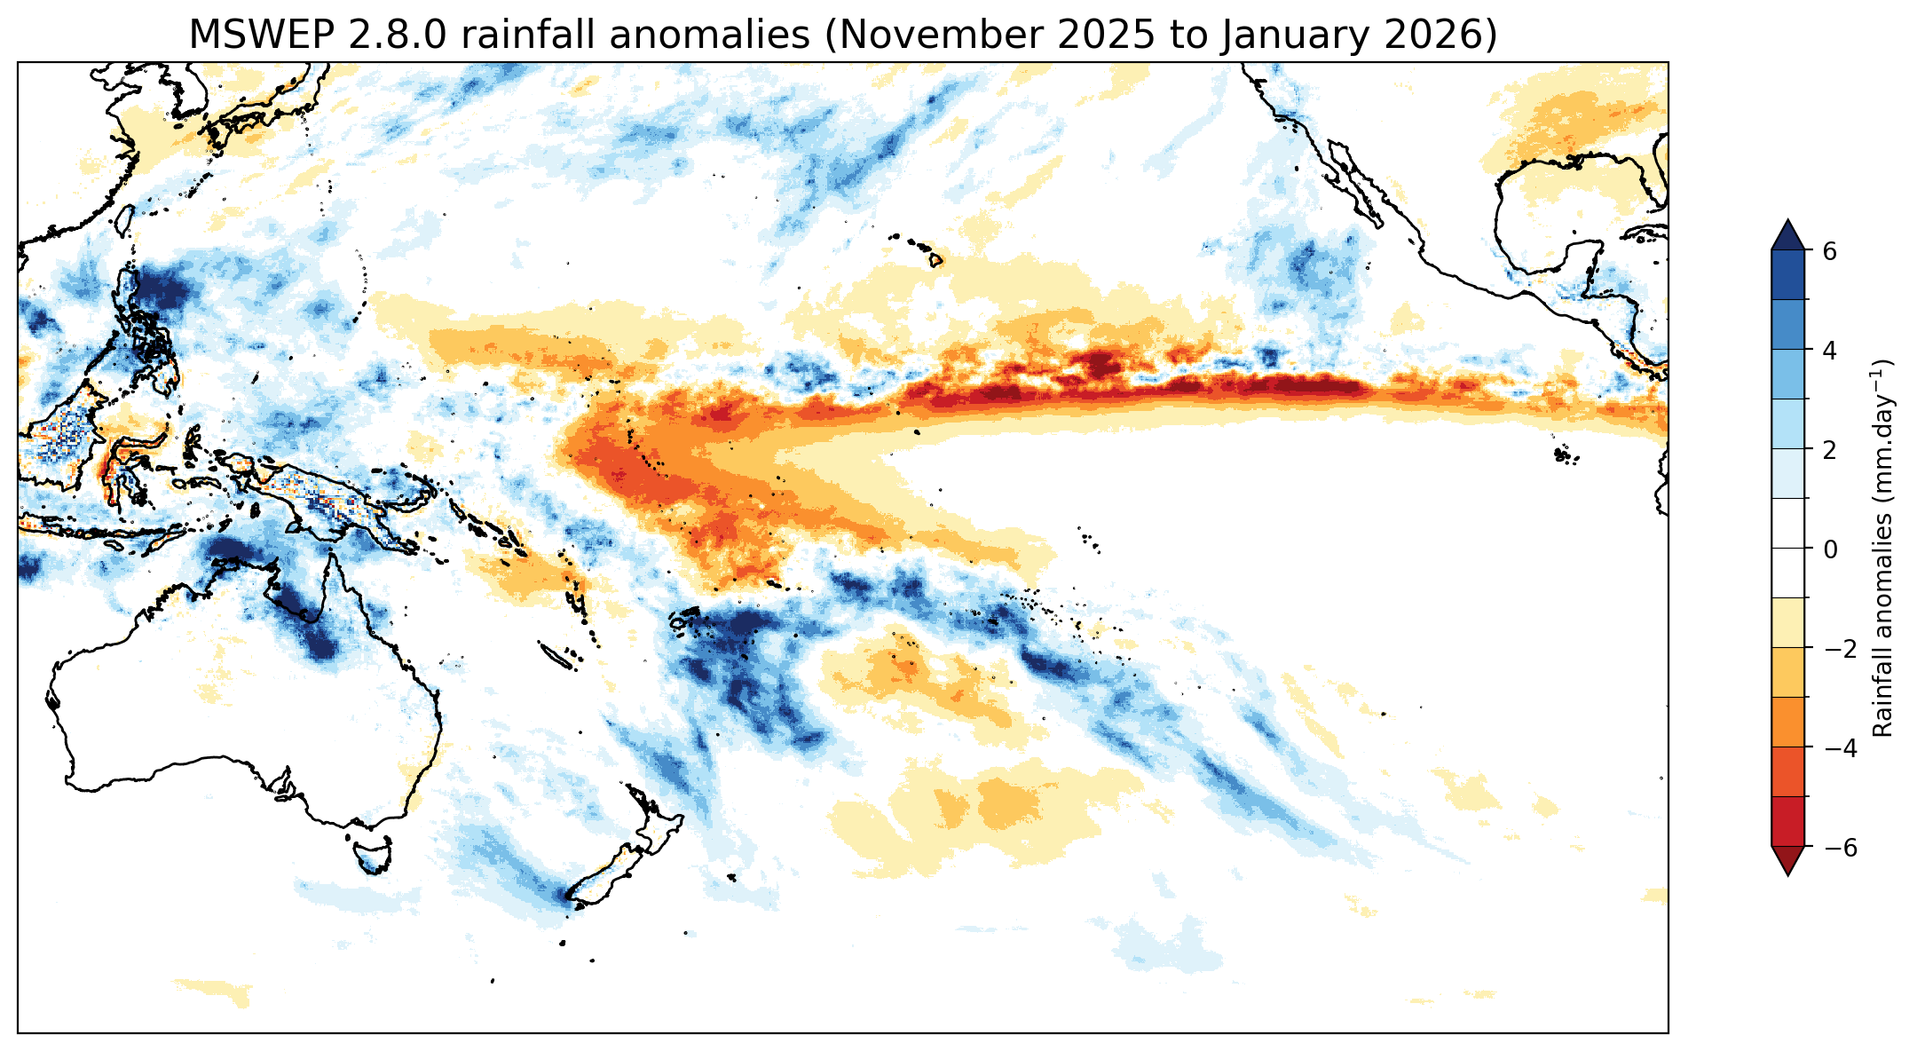
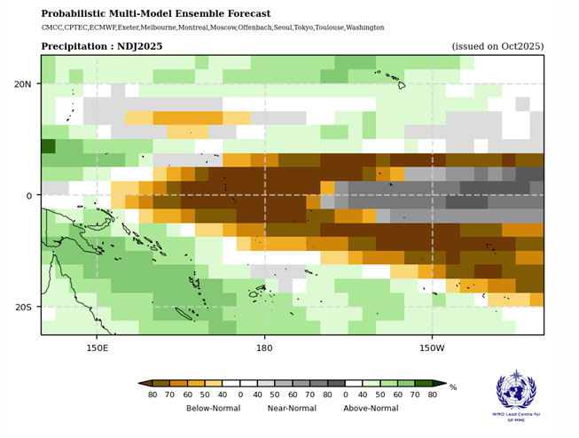
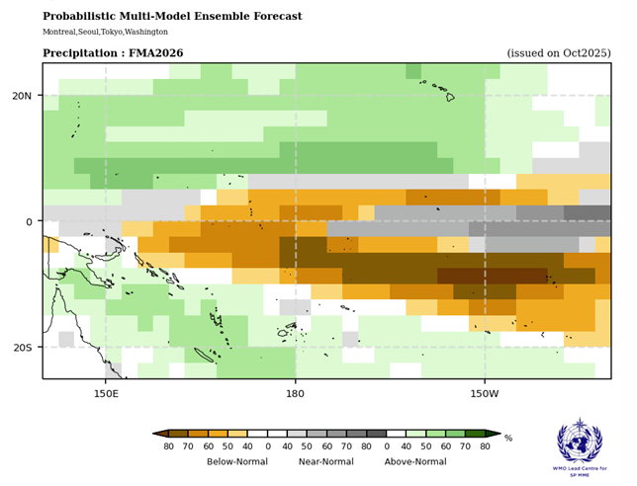
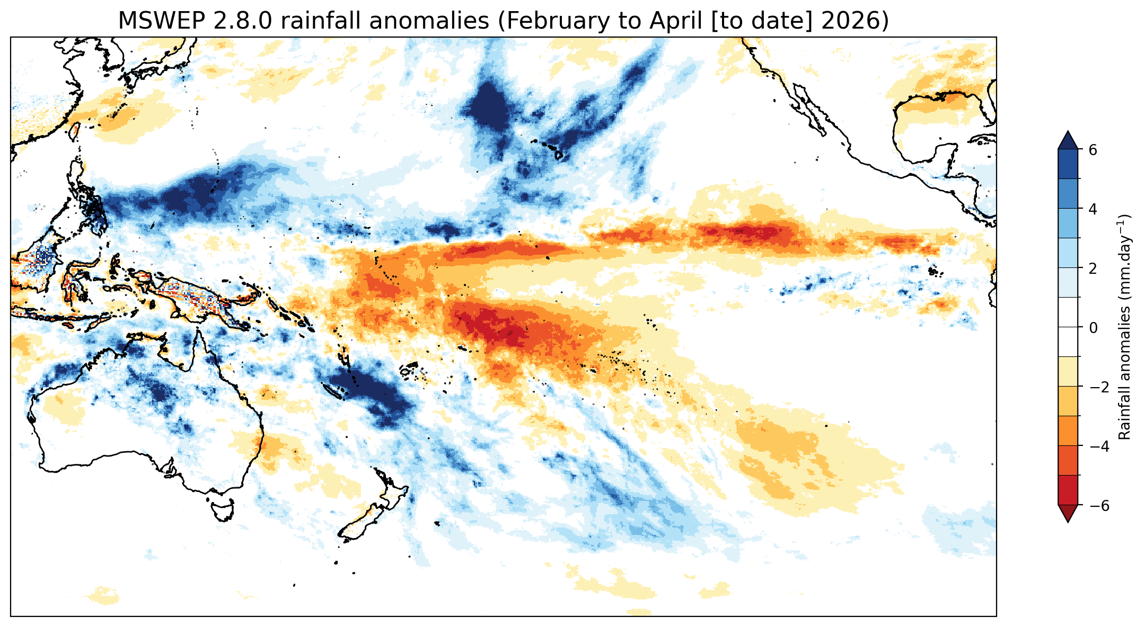
Rainfall outlooks vs observations

Slide 11
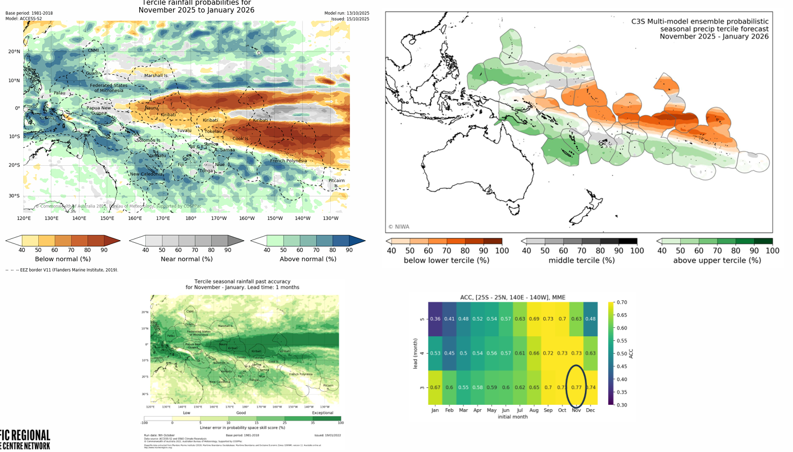
Node lead precipitation forecasts: November 2025 – January 2026

Slide 12
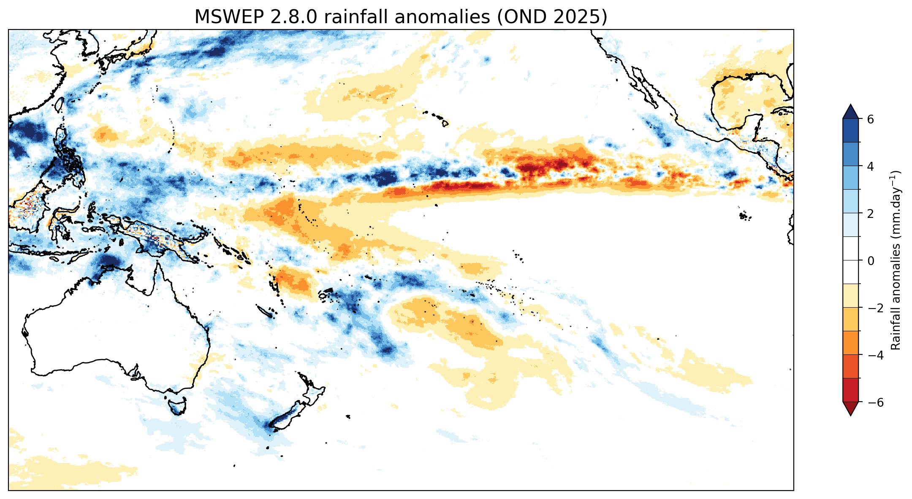
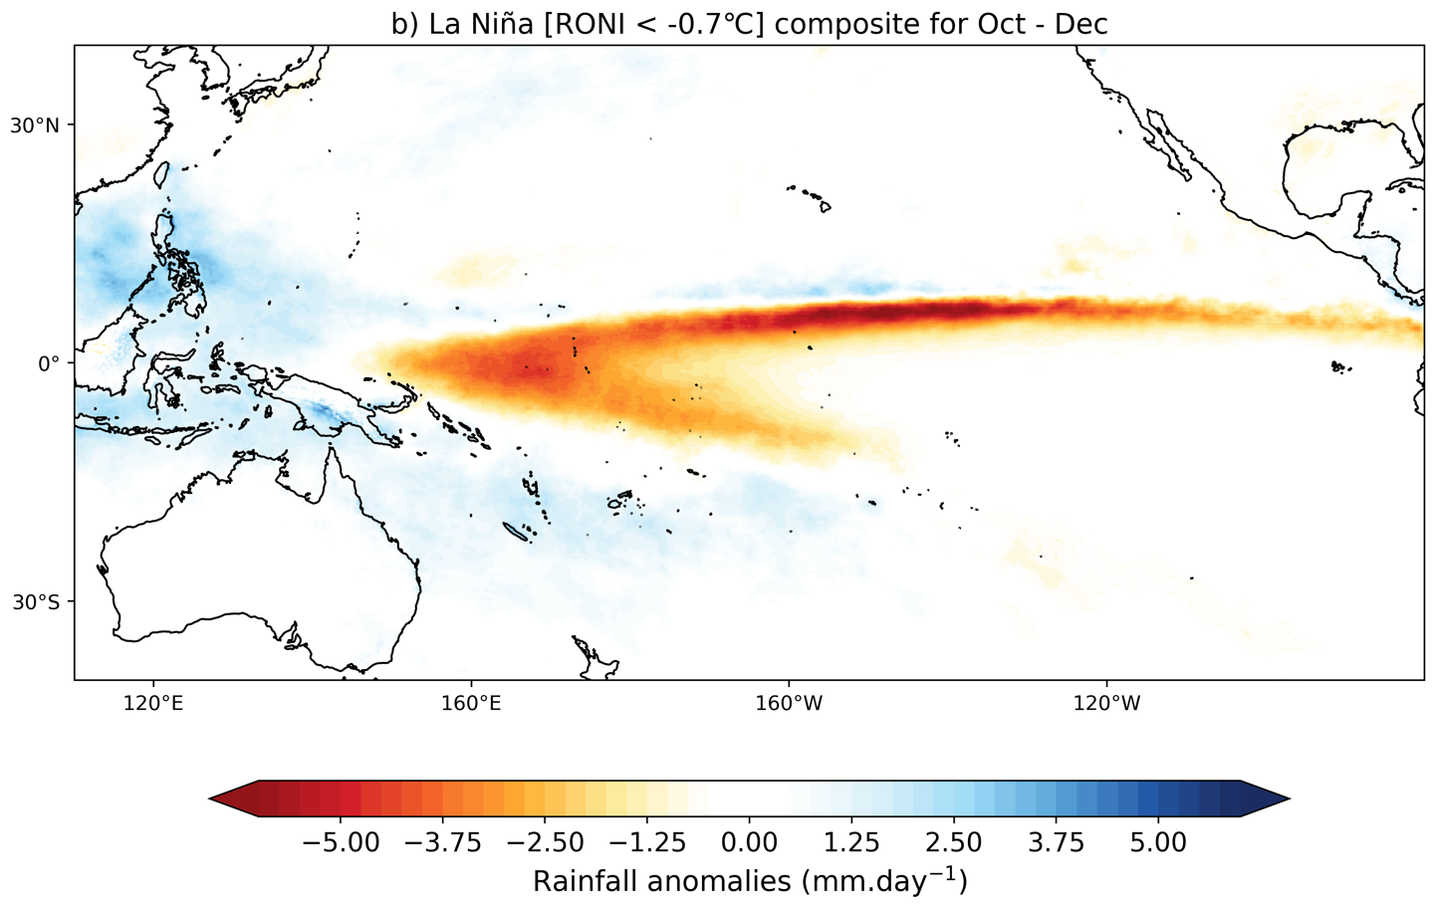
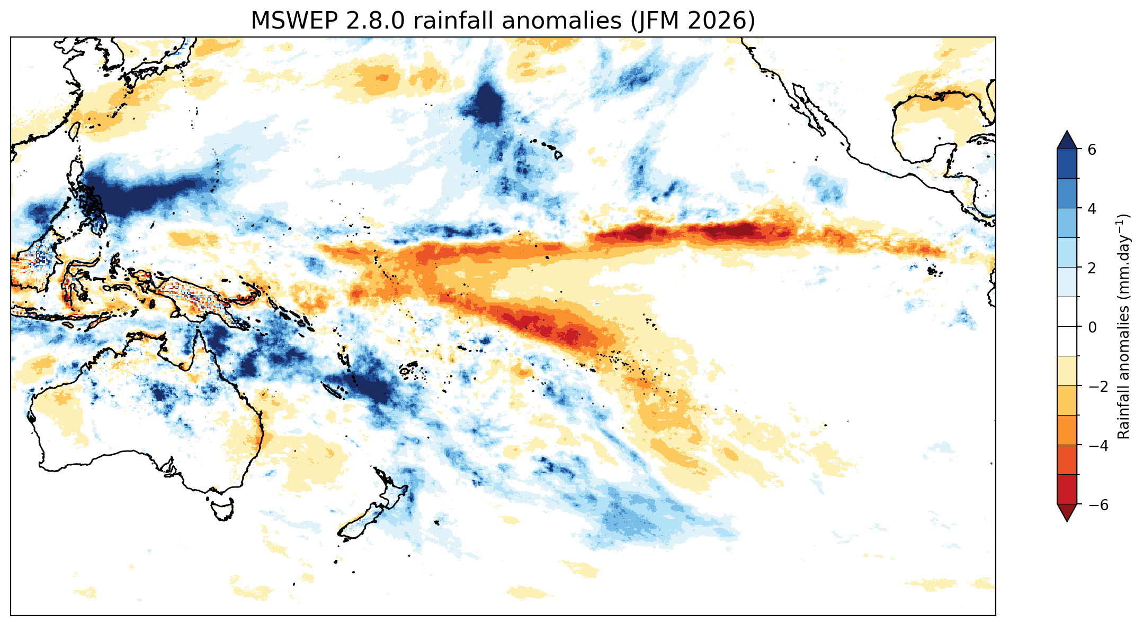
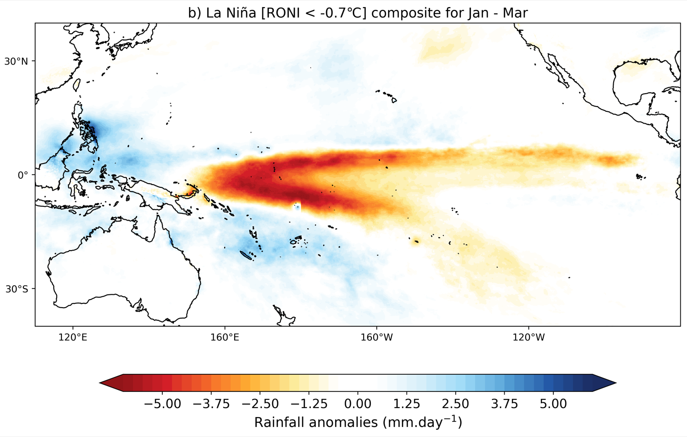
Rainfall observations vs La Nina composite

Slide 13
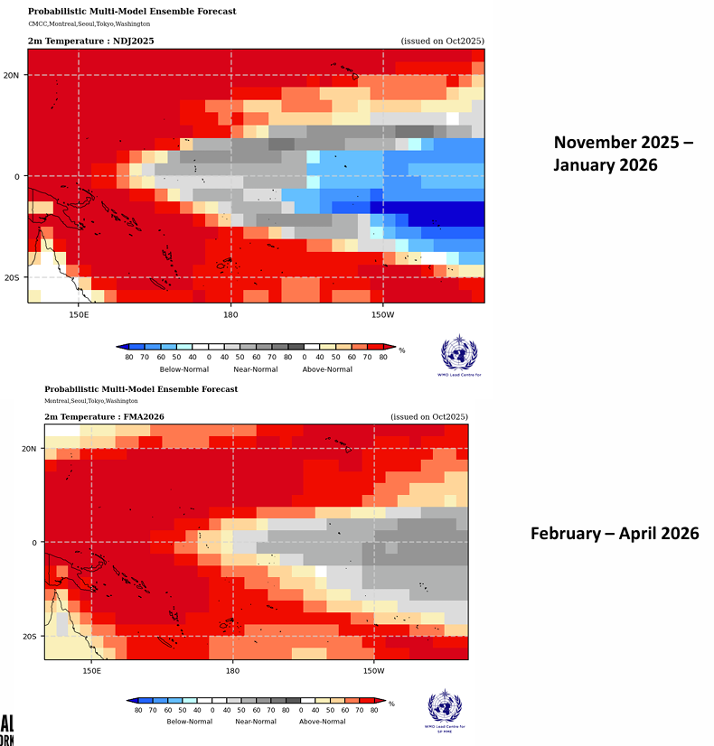
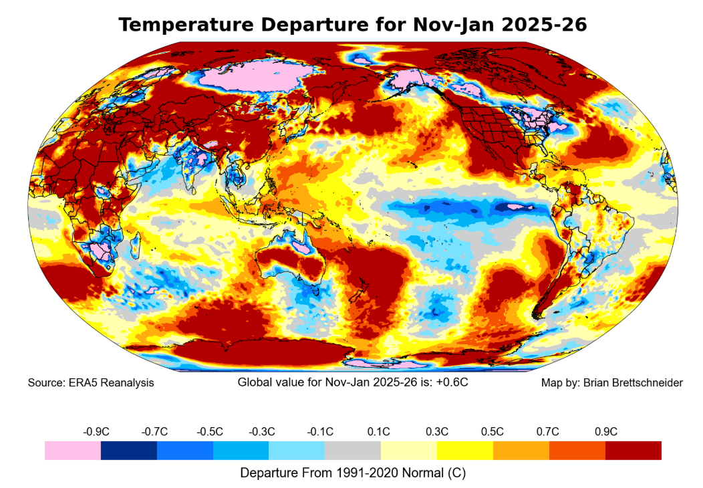
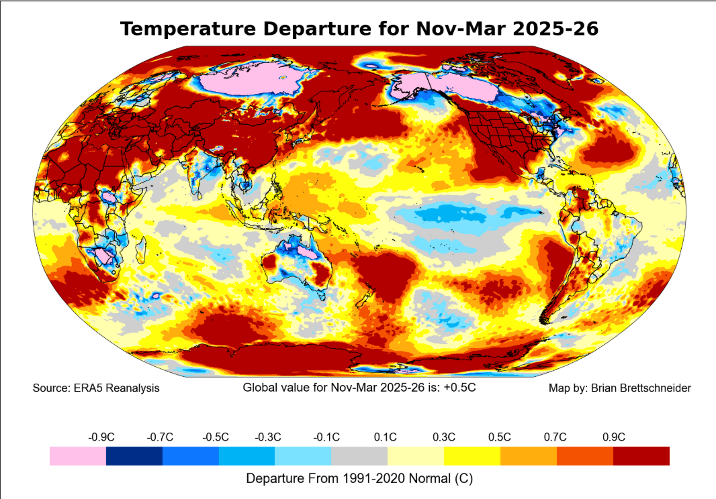
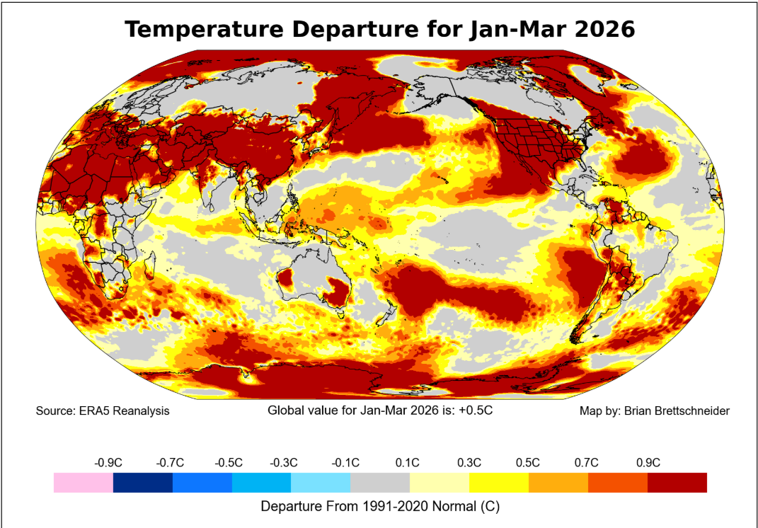
Temperature outlooks vs observations

Slide 14
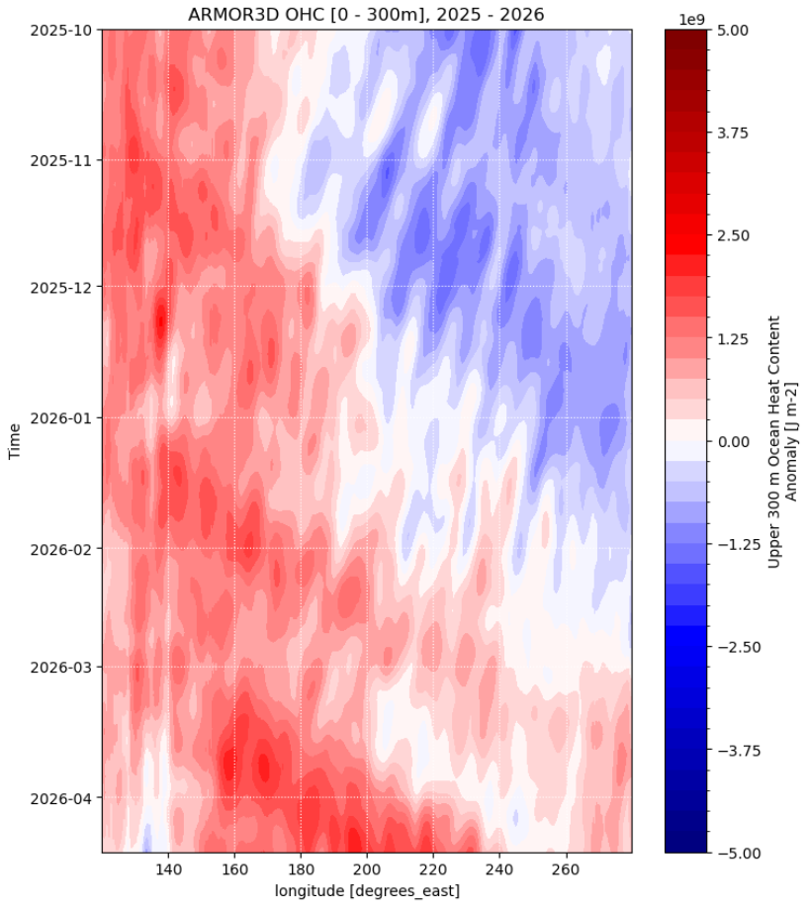
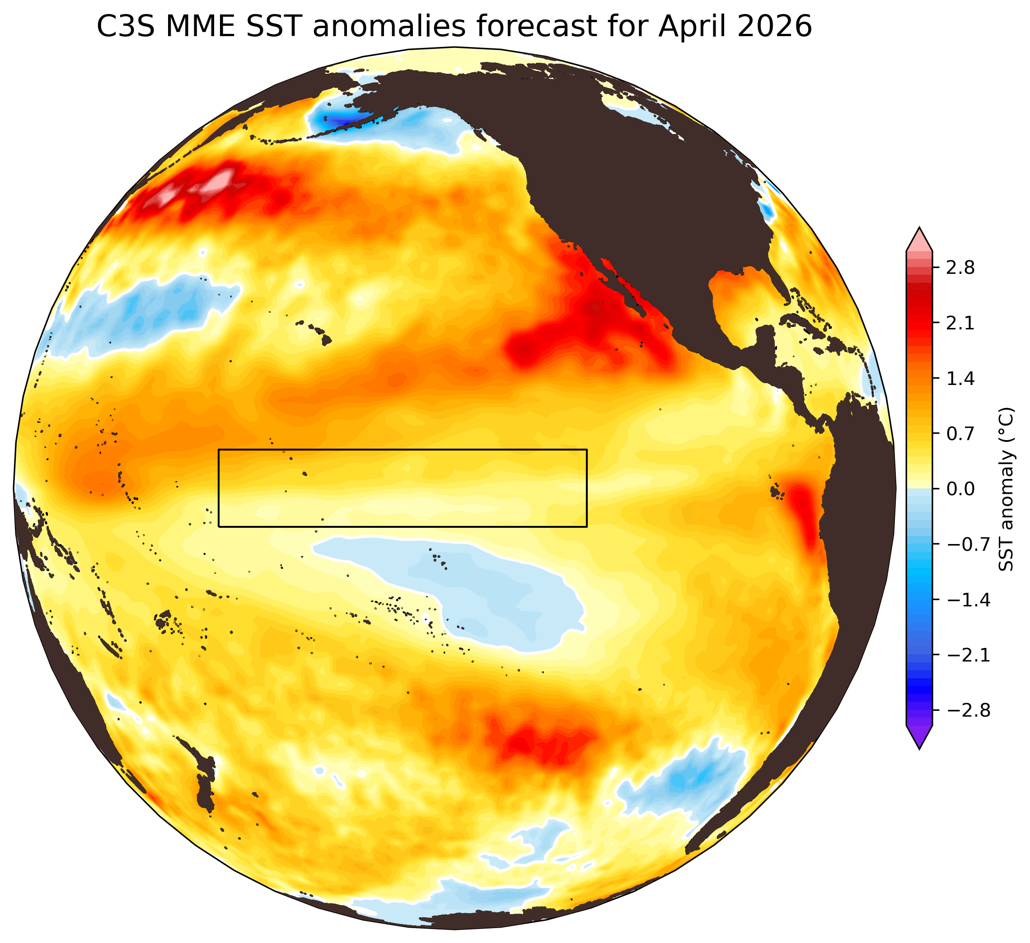
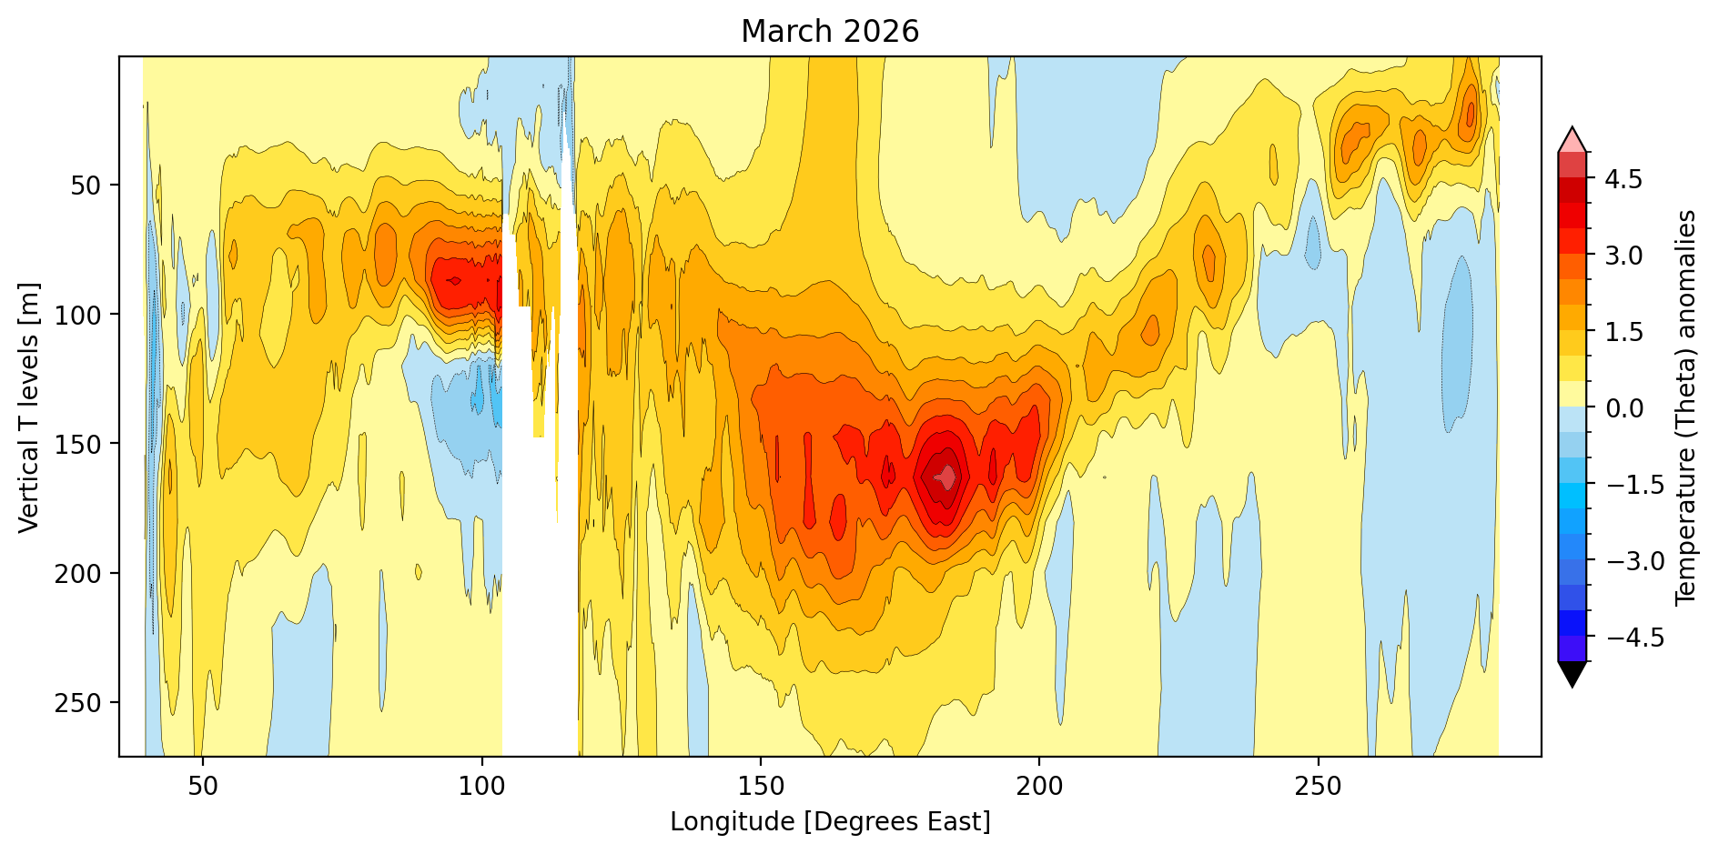
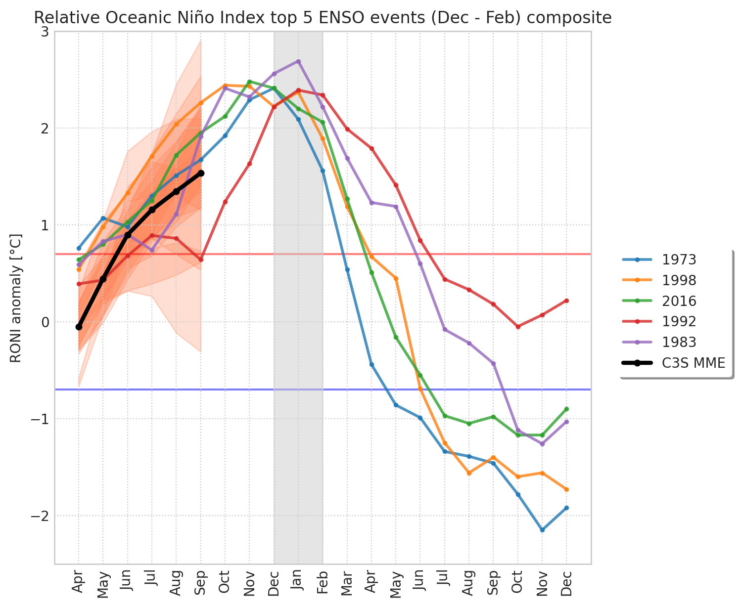
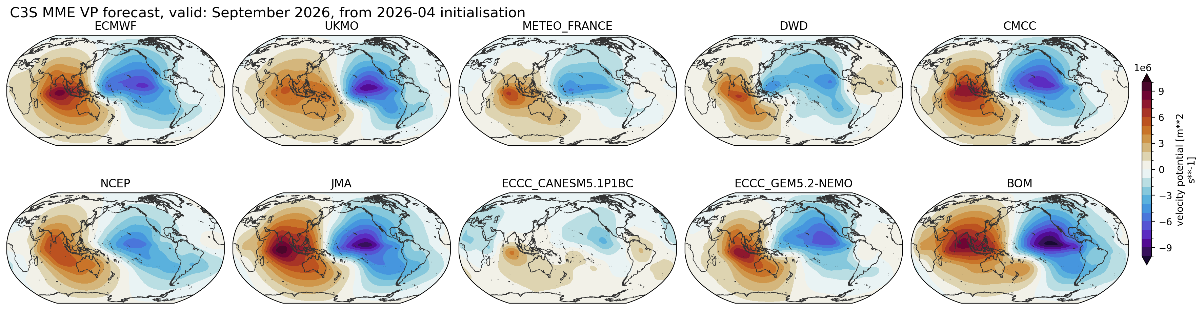
Extra slide: current status and El Nino forecast

Slide 15
Summary
ENSO Outlooks (‘relatively weak and short-lived La Nina conditions’) were correct
Rainfall outlooks were broadly consistent with observations:
  Drier than normal conditions affected island groups along the Equator (from about Nauru to western Kiribati) as well as south of the Equator from about Tuvalu to French Polynesia
  Wetter than normal conditions affected the northwestern Pacific (e.g. Palau, FSM, Mariana Islands) and the southwestern Pacific (e.g. parts of PNG, Solomon, Vanuatu, New Caledonia, Fiji)
Rainfall patterns were consistent with ‘typical’ La Nina patterns (‘horseshoe pattern’)
Temperature outlooks were also broadly consistent with observations, and the transition from early season to late season patterns was correctly anticipated

Slide 16
Thank You
Nicolas.Fauchereau@earthsciences.nz
Hannah.Marley@earthsciences.nz

